Slide 1
Telemetry Smorgasbord
A Little Taste of Everything
Terry Hill, Quasonix
Spring 2020

Slide 2
Course Outline – Day 3
Impairment Mitigation Techniques
  Adaptive Equalization
  Best Source Selection
  Best Channel Selection
  Space-Time Coding (STC)
  Low Density Parity Check (LDPC) Coding
  Auto-Tracking Antennas
Using All the Tools Together
Performance Comparison & Summary
Link Budgets

Slide 3
Best Source Selection

Slide 4
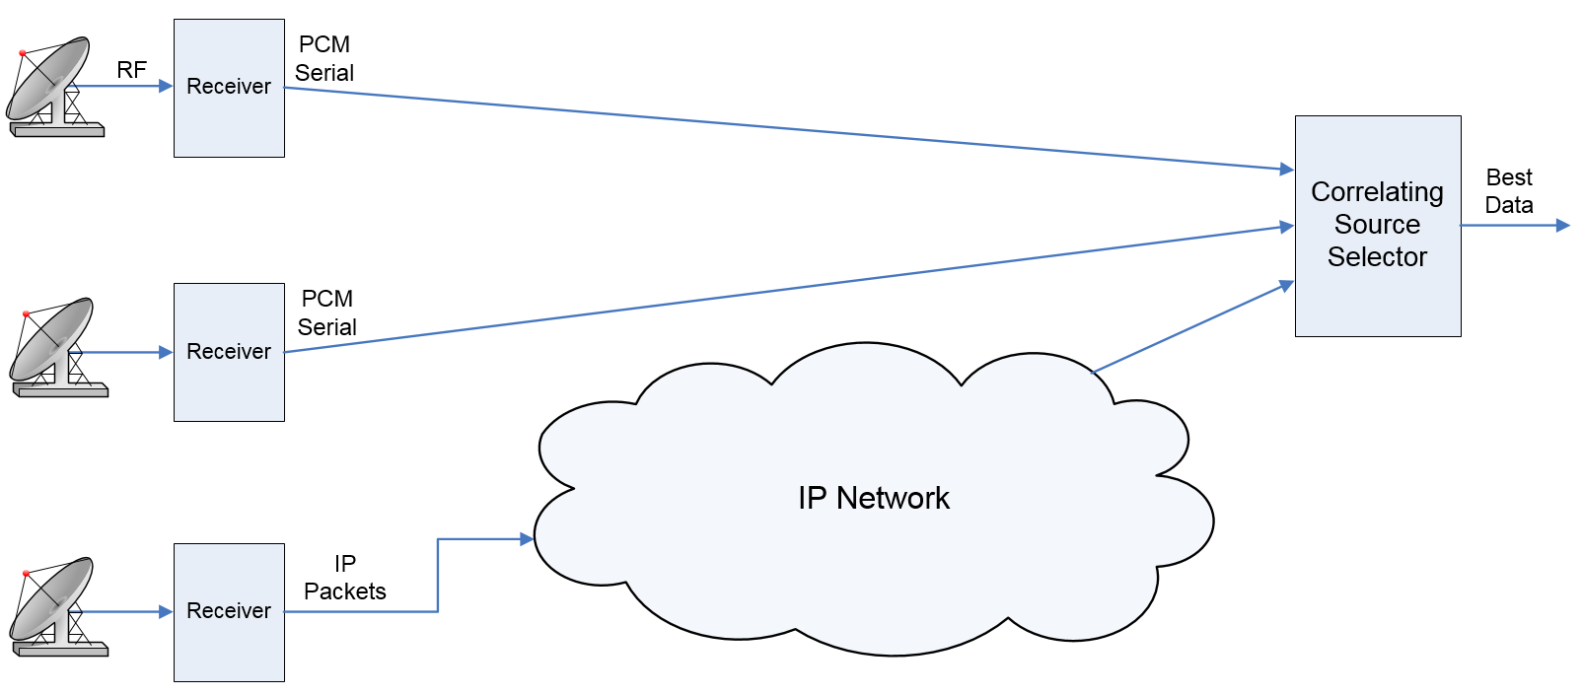
Combining Multiple Sources
Receive and demodulate the same signal at multiple receive sites
Funnel all the demodulated data to one central location
Time align the multiple data streams
Build a better output stream from the multiple input streams

Slide 5
Selection Algorithms
Majority vote
  Reasonably effective with three or more sources
  Reduces to guesswork with only two sources
  Sub-optimal for any number of sources
PCM frame header accuracy
  Uses only a small fraction of the bits to make an estimate
  Poor resolution (BER is typically measured as Num_errors ÷ 32)
  Useless with encrypted data
Log-likelihood ratio
  Uses all the bits
  Works with encrypted data
  Max-likelihood (optimal) combining scheme
    Rice, Michael and Perrins, Erik. "Maximum Likelihood Detection From Multiple Bit Sources", Proceedings of the International Telemetering Conference, Las Vegas, NV, USA, 2015.

Slide 6
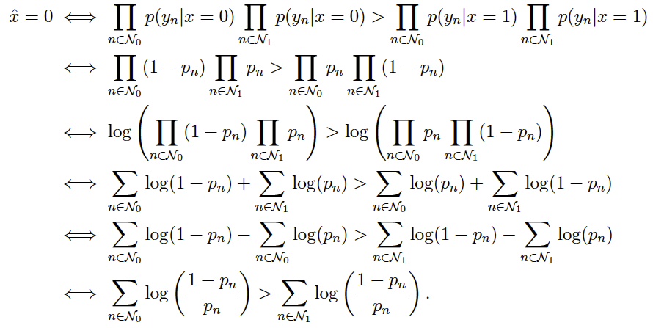
Why Measure Data Quality?
Telemetry links suffer from a wide range of impairments
  Noise
  Interference
  Multipath
  Shadowing
  Loss of antenna track
We need a way to asses the impact of all these impairments
We need to compute p_{n}
  Quickly
  Accurately
Rice, Michael and Perrins, Erik. "Maximum Likelihood Detection From Multiple Bit Sources", Proceedings of the International Telemetering Conference, Las Vegas, NV, USA, 2015.

Slide 7
Data Quality Encapsulation
Payload data is bundled with its DQM, to give Best Source Selectors a valid basis for “best”
Interoperability among vendors requires standards
  DQM calibration against multiple signal impairments
  DQE packet structure
Quasonix has developed and shared an open DQM/DQE format
  Published at ITC 2015
  License-free, royalty-free
  RCC standard as of IRIG 106-17, Chapter 2, appendix G
Includes test procedures to evaluate DQM accuracy

Slide 8
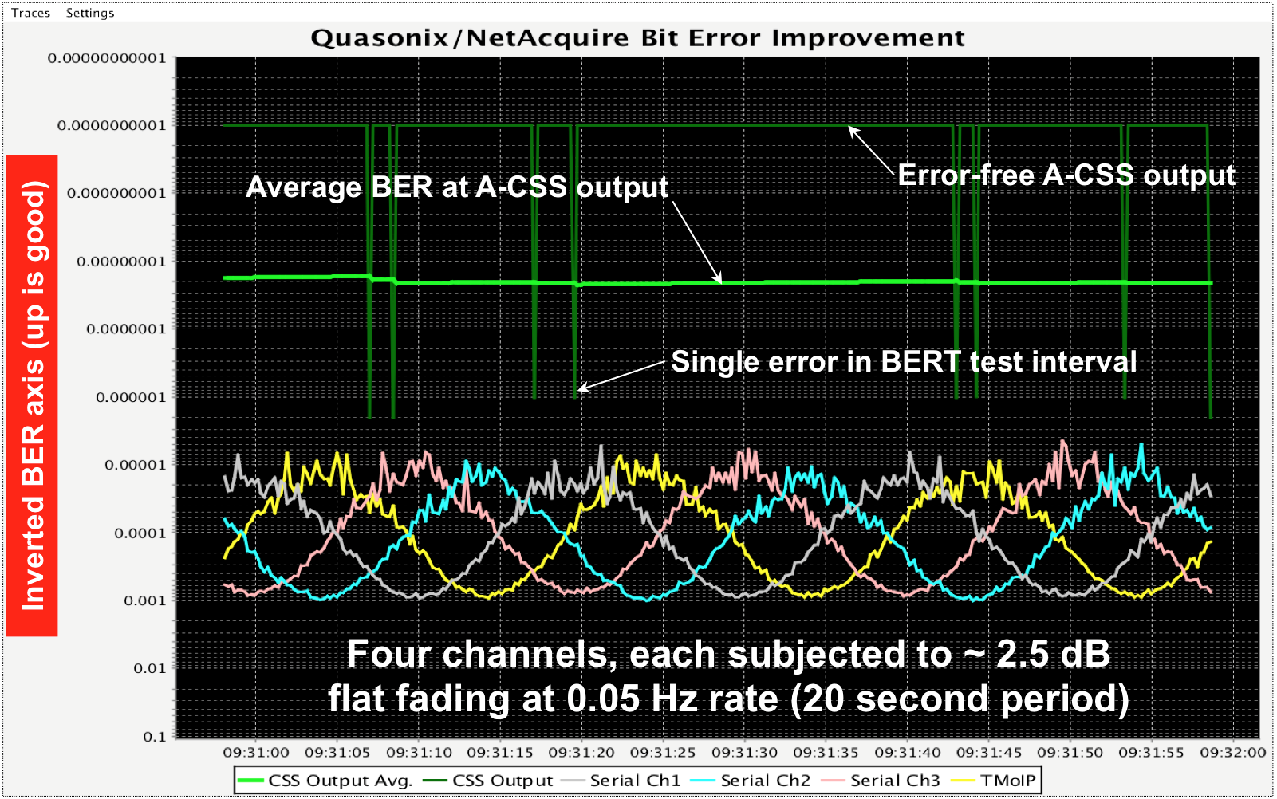
Does it work?
Four “poor” channels for input to BSS
One nearly error-free output from BSS
10⁻¹¹
10⁻¹⁰
10⁻⁹
10⁻⁸
10⁻⁷
Inverted BER axis (up is good)
10⁻⁶
10⁻⁵
10⁻⁴
10⁻³
10⁻²
10⁻¹

Slide 9
BSS Summary
Correlating (time-aligning) source selectors deliver output data that is better than any single input stream
Combats all forms of signal impairment
  Noise
  Multipath
  Interference
  Shadowing
  Loss of antenna track
Diversity can be in any form
  Polarization
  Frequency
  Spatial
DQE / DQM equip the BSS to make optimal decisions

Slide 10
Best Channel Selector (BCS)
Handling the “Un-Combinable” Signals

Slide 11
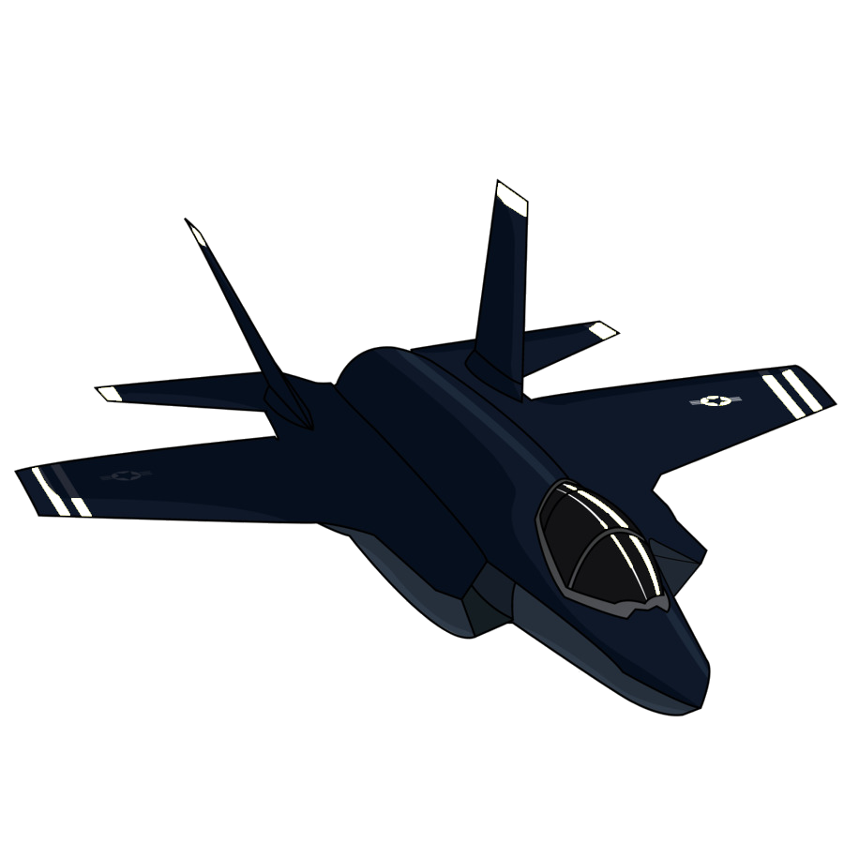
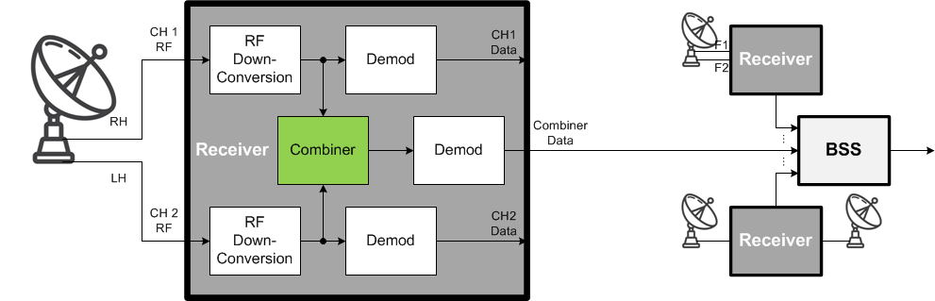
Receive Diversity – Combiner
Polarization, frequency, or short-range spatial diversity
Maximal Ratio Combiner sums input channels proportional to their SNR
  Optimal in additive white Gaussian noise (AWGN) – up to 3 dB gain
  Use as only receiver output?
Notes:
Receive diversity uses multiple different copies of received data to minimize the chance of data dropouts or bit errors
This diagram shows two common forms of receive diversity:
Three receivers feeding a Best Source Selector, and two received signals feeding each receiver
These signals may have different polarization, different frequencies, or come from different antennas
…

Slide 12
Combiner Structure
Maximal ratio combining
sum
(more of the better,
less of the worse)
how good?
make sure we can
sum coherently
Notes:
To answer that question, let’s look at how a combiner works
…
So, what could possibly go wrong?

Slide 13
Combiner Performance
Maximal ratio combining issues
  Inaccurate SNR estimation: multiple signal copies, little or no noise
  Degraded time and phase alignment
  Downstream demodulator must deal with all received reflections
n₁ reflections
n₁+n₂ reflections
n₂ reflections
Notes:
…

Slide 14
Combiner Performance
Maximal ratio combining issues
  Inaccurate SNR estimation: overwhelm estimator with strong undesired signal
Notes:
…

Slide 15
Combiner Performance
Maximal ratio combining issues
  Propagation effects may result in non-combinable signals
Notes:
…
More details on this in the paper

Slide 16
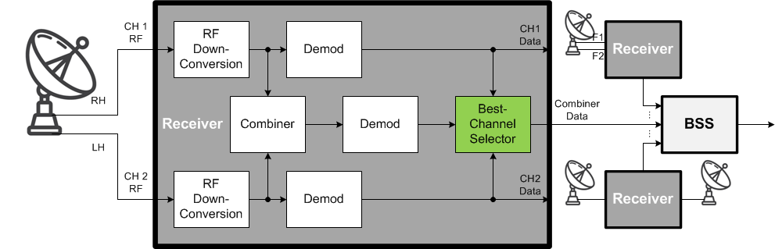
Receive Diversity – BCS
Like a mini-BSS inside the receiver
Selects and outputs best data from just three sources (Channel 1, Channel 2, and Combiner)
Optimized for this narrowly scoped role
Notes:
To address those shortcomings, we introduce the concept of a Best Channel Selector
…

Slide 17
BCS Structure
3-channel correlating selection
“hit-less” – no dropped or duplicated bits
select best bit based on
best DQM
line up bits from all channels
Notes:
Like a BSS…
…

Slide 18
BCS Test – Multipath
Apply severe multipath, engage adaptive equalization
BCS outperforms all channels
Notes:
BCS has been subjected to numerous tests in the lab as well as months of use in the field
Here’s just one example
…

Slide 19
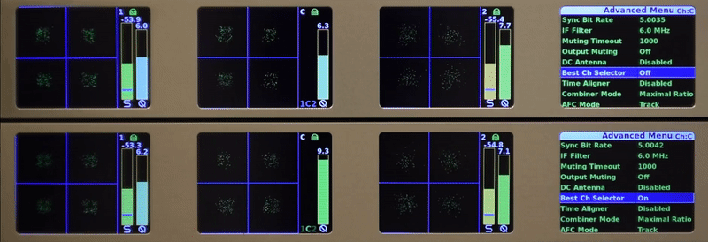

BCS Test – Multipath
DQM reduction of 1 = BER increase of 10x (!)
BCS selection > 1000x faster than display
Combiner DQM
BCS DQM
Notes:
…

Slide 20
BCS Test – Summary
Uniformly equals or exceeds best channel’s performance
BCS
AWGN
Break Frequency
STC polarization
Flight Recording
Multipath
Notes:
…

Slide 21
Conclusions
Combiner best most of the time, but not always
BCS mitigates cases where Combiner falls short
  Uses DQM to form reliable selection criterion
  Dynamically selects best data from Channel 1, Channel 2, or Combiner
    Preserves combiner gain in AWGN
    Supplements combiner in multipath, interference, etc.
  Generates output with accurate composite DQM
  Provides single output from dual-channel receiver that reliably supplies data superior to best channel, including Combiner
BCS does not replace BSS
  BCS has great performance local to one receiver
  BSS extends performance range-wide with multiple receive sites
Notes:
…

Slide 22
Space-Time Coding
Eradicates Porcupines!

Slide 23
Difficulties with TX Diversity
Spatially Separated Antennas Create
Interference Pattern
Antenna 1
Antenna 2

Slide 24
Alamouti Space-Time Coding (STC)
A B C D E F G H I J K L ...
Traditional
A B C D E F G H I J K L ...
A -B* C -D* E -F* G -H* I -J* K -L* ...
B A* D C* F E* H G* J I* L K* ...
STC
1st block
2nd block

Slide 25
Symbol Error Rate - QPSK
Traditional signaling
Addition of transfer
functions leads to
reduction in effective
SNR
For Alamouti signaling
Only magnitudes of
transfer functions
used in sum

Slide 26
Antenna Pattern Interpretation
Consider BPSK Signaling and Assume s₁ = s₂ = 1
Time Slot 1:
Gain Pattern:
Time Slot 2:
Gain Pattern:

Slide 27
SER Simulations
Circular Polarization Diversity Reception
Results Identical to Single Receive Antenna System

Slide 28
Flight Tests: Airborne Configuration
Channel Microwave
L320I
upper antenna
STC
Transmitter
10 W
L-band
isolator
L-band
isolator
3 dB
5 W
+
Pasternak
PE 7016-3
Channel Microwave
L320I
Channel Microwave
L320I
3 dB
Narda 4322-2
10 W
L-band
isolator
L-band
isolator
5 W
Pasternak
PE 7016-3
Quasonix
QSX-VLT-110-105-20-6A
Channel Microwave
L320I
Channel Microwave
L320I
lower antenna
SOQPSK
Transmitter
÷
5 W
+
10 W
L-band
isolator
5 W
Channel Microwave
L120I
Narda 4322-2
Narda 4322-2
Quasonix
SOQPSK
Transmitter
GPS/AHRS
house keeping link antenna
(separate lower antenna)

Slide 29
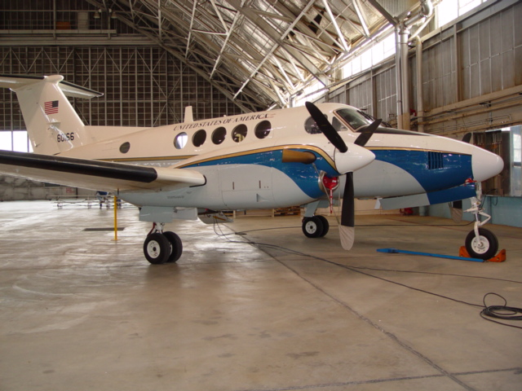
C-12 Beechcraft: Airborne Platform

Slide 30
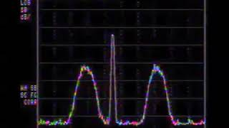
STC Video Clip
Jump to file: stc-video.mp4
  Or, click to view on our website: STC vs Two-Antenna Video

Slide 31
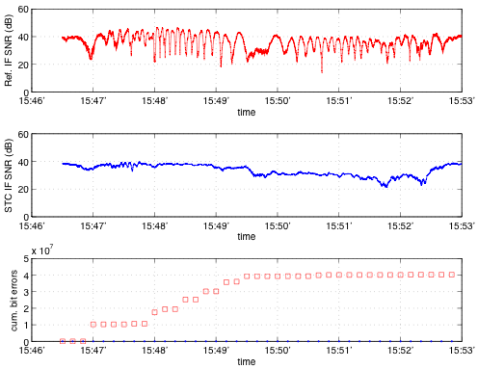
M1: Test Results

Slide 32
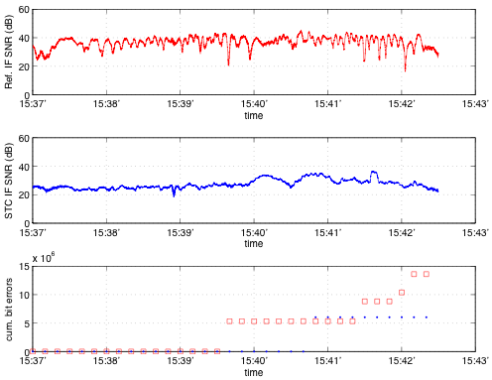
M2: Test Results

Slide 33
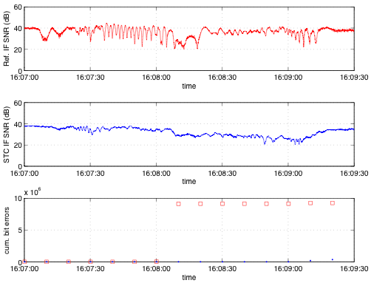
M3: Test Results

Slide 34
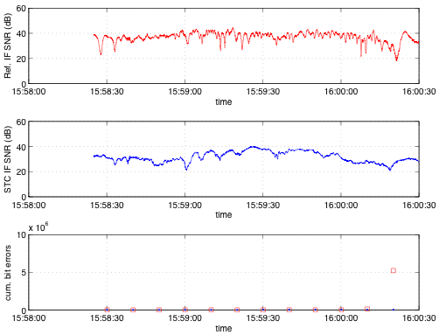
M4: Test Results

Slide 35
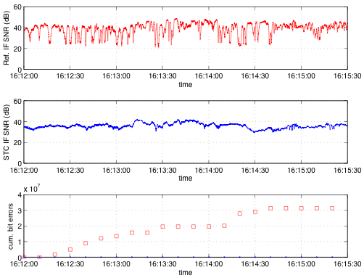
M3 to C2 Transition Test Results

Slide 36
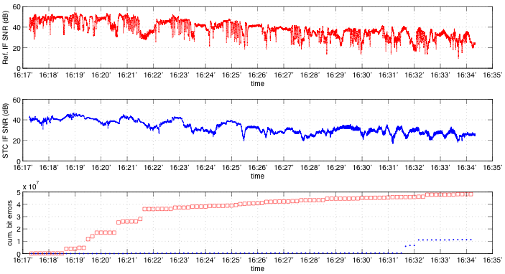
C2: Test Results

Slide 37
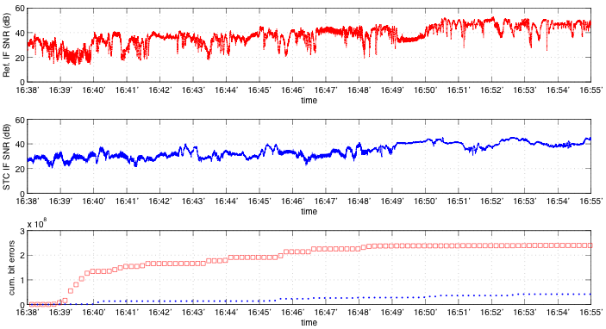
D2: Test Results

Slide 38
STC Summary
Dual-Antenna Diversity Scheme
Removes dropouts created by multiple transmit antennas
  SNR equivalent to single antenna transmission
  Multi-antenna scheme alleviates masking during maneuvering
  Can be used with diversity reception
Realtime hardware flight tested at Edwards AFB and showed substantial performance benefit

Slide 39
Forward Error Correction

Slide 40
Forward Error Correction
Basic premise
  Insert redundant bits into transmitted stream
  Use known relationships between bits to correct errors
Countless schemes have been developed
  Convolutional code / Viterbi decoder
  Block codes
    BCH
    Reed-Solomon
  Concatenated codes
    RS / Viterbi
    Turbo product codes (TPC)
  Low Density Parity Check (LDPC)

Slide 41
LDPC Codes - History
LDPC: Low Density Parity Check
Linear block codes
  Some are systematic
Developed by Robert G. Gallager at M.I.T. in 1960
  Published by the M.I.T Press as a monograph in 1963
No practical implementations at that time
Re-discovered by David J.C. MacKay in 1996
  Began displacing turbo codes in the late 1990s
Recent history
  2003: LDPC code selected for the new DVB-S2 standard for the satellite digital TV
  2006: LDPC code selected for 10GBase-T Ethernet (10 Gbps over twisted-pair cables)
  2007: LDPC codes published by CCSDS as an “Orange Book”
  2008: LDPC code selected for the ITU-T G.hn standard
  2009: LDPC codes adopted for Wi-Fi 802.11 High Throughput (HT) PHY specification
  2012: LDPC code selected for integrated Network Enhanced Telemetry (iNET)

Slide 42
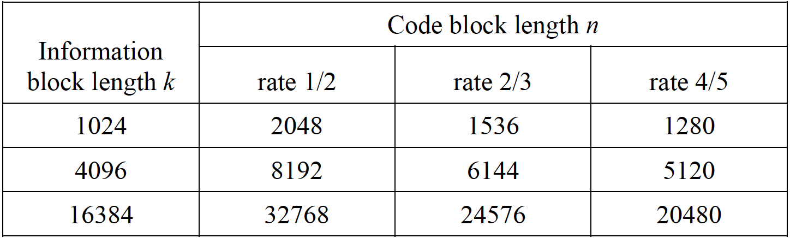
LDPC AR4JA Codes
AR4JA: Accumulate-Repeat-4-Jagged-Accumulate
Published by CCSDS as an “Orange Book”
  Low Density Parity Check Codes For Use in Near-Earth and Deep Space Applications
Defines a family of systematic LDPC codes
Defines attached sync markers (ASM)
  Specified in section 6 of CCSDS Recommended Standard CCSDS 131.0-B-1
Present work based on the (6144, 4096) code

Slide 43
Packet Assembly
Input 4096 data bits
  Randomize prior to encoding, if necessary
Compute and append 2048 parity bits
Prepend 256-bit attached sync marker (ASM)
  Yields a 6400-bit packet
  Each and every code word carries the ASM: A, A, Ā, A
    A = FCB88938D8D76A4F
    Ā = 034776C7272895B0
  Synchronization requires at most one code word
A
A
Ā
A
4096 Data Bits
2048 Parity bits

Slide 44
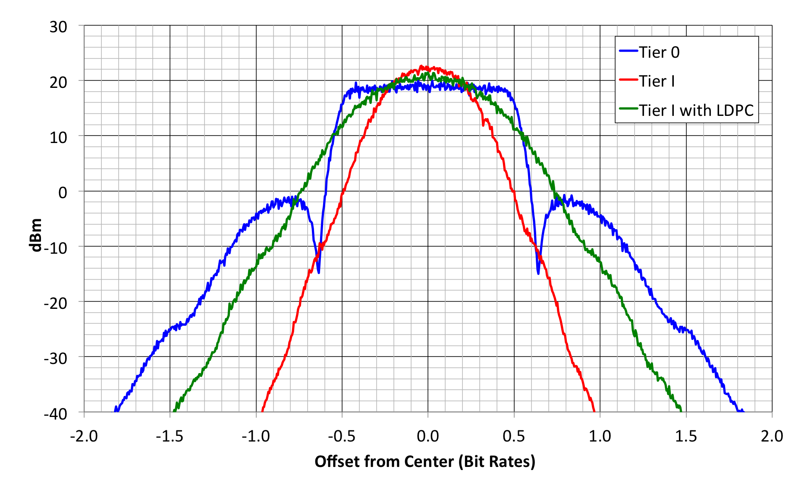
Spectral Characterization

Slide 45
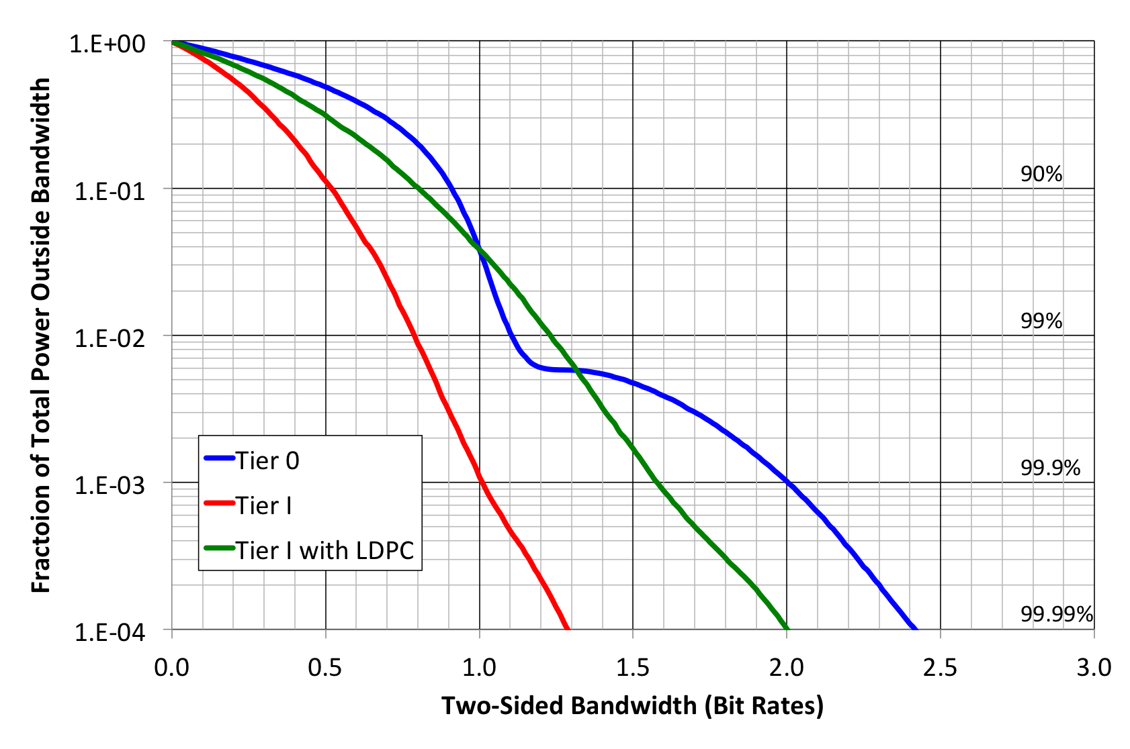
Fractional Out-of-Band Power

Slide 46
Decoder
Demodulate SOQPSK with soft decisions
  Implemented 8-bit decisions
    Iterative decoders work best with high resolution soft decisions
  Estimate E_{b}/N₀ for soft decision scaling
Correlate for ASM with hard decisions
  Resolves the 4-ary phase ambiguity in SOQPSK
  Virtually certain sync at E_{b}/N₀ = 0 dB
Initialize decoder
Execute decode iterations until next code word
  Coding gain varies with bit rate

Slide 47
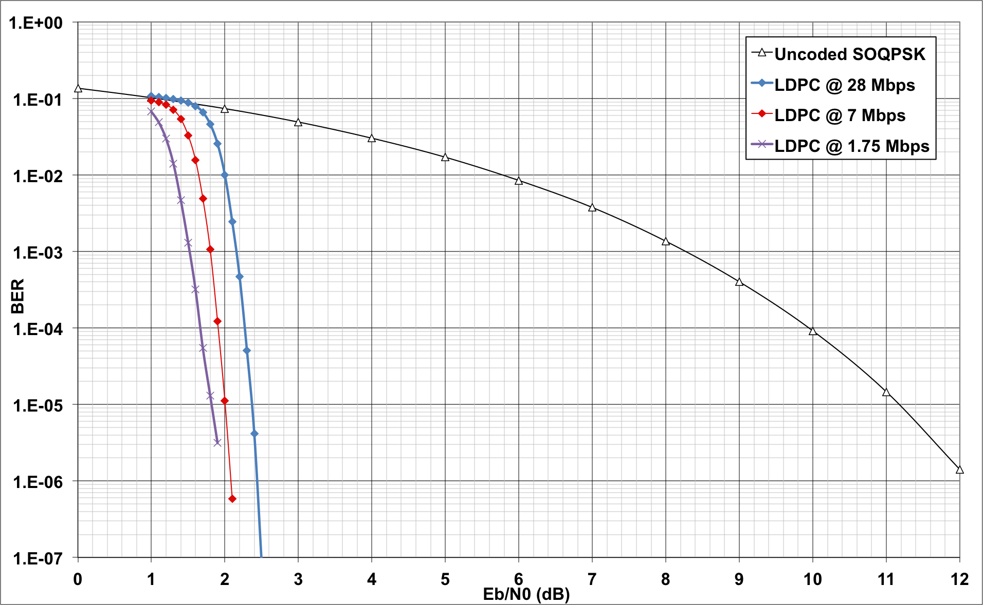
Measured BER Results

Slide 48
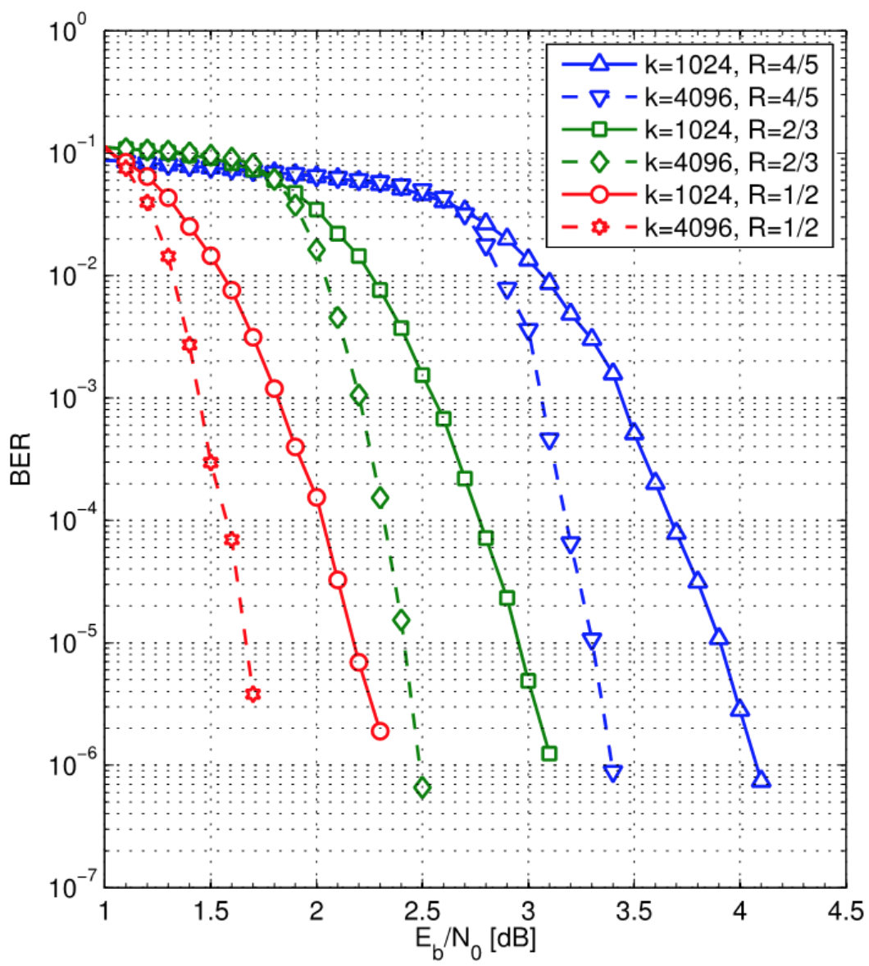
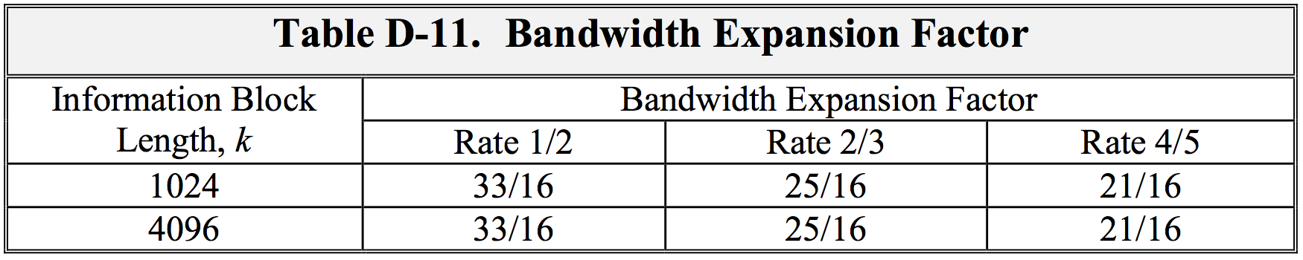
LDPC from Appendix 2-D

Slide 49
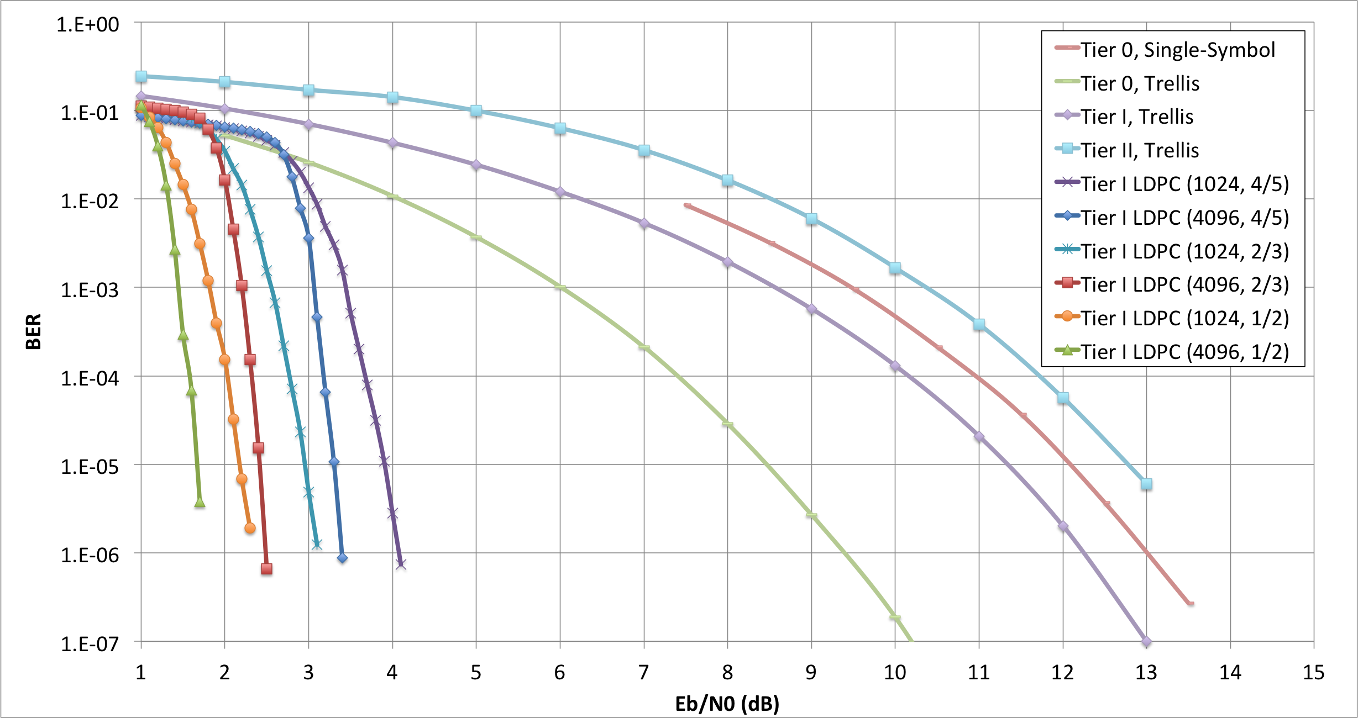
BER – All Modes

Slide 50
Conclusions
Rate 2/3 LDPC code yields ≈9 dB coding gain relative to uncoded SOQPSK
  ±0.5 dB, depending on data rate
256-bit ASM provides reliable, fast synchronization at Eb/N0 < 0 dB
  Synchronization is consistently achieved in < 4096 data bits
Bandwidth expansion of 25/16
  Still 22% less bandwidth than legacy PCM/FM
SOQPSK with LDPC offers a reasonable trade of spectral efficiency for a significant gain in detection efficiency
5 other LDPC codes offer similar trade of bandwidth for BER performance

Slide 51
Auto-Tracking Antennas

Slide 52
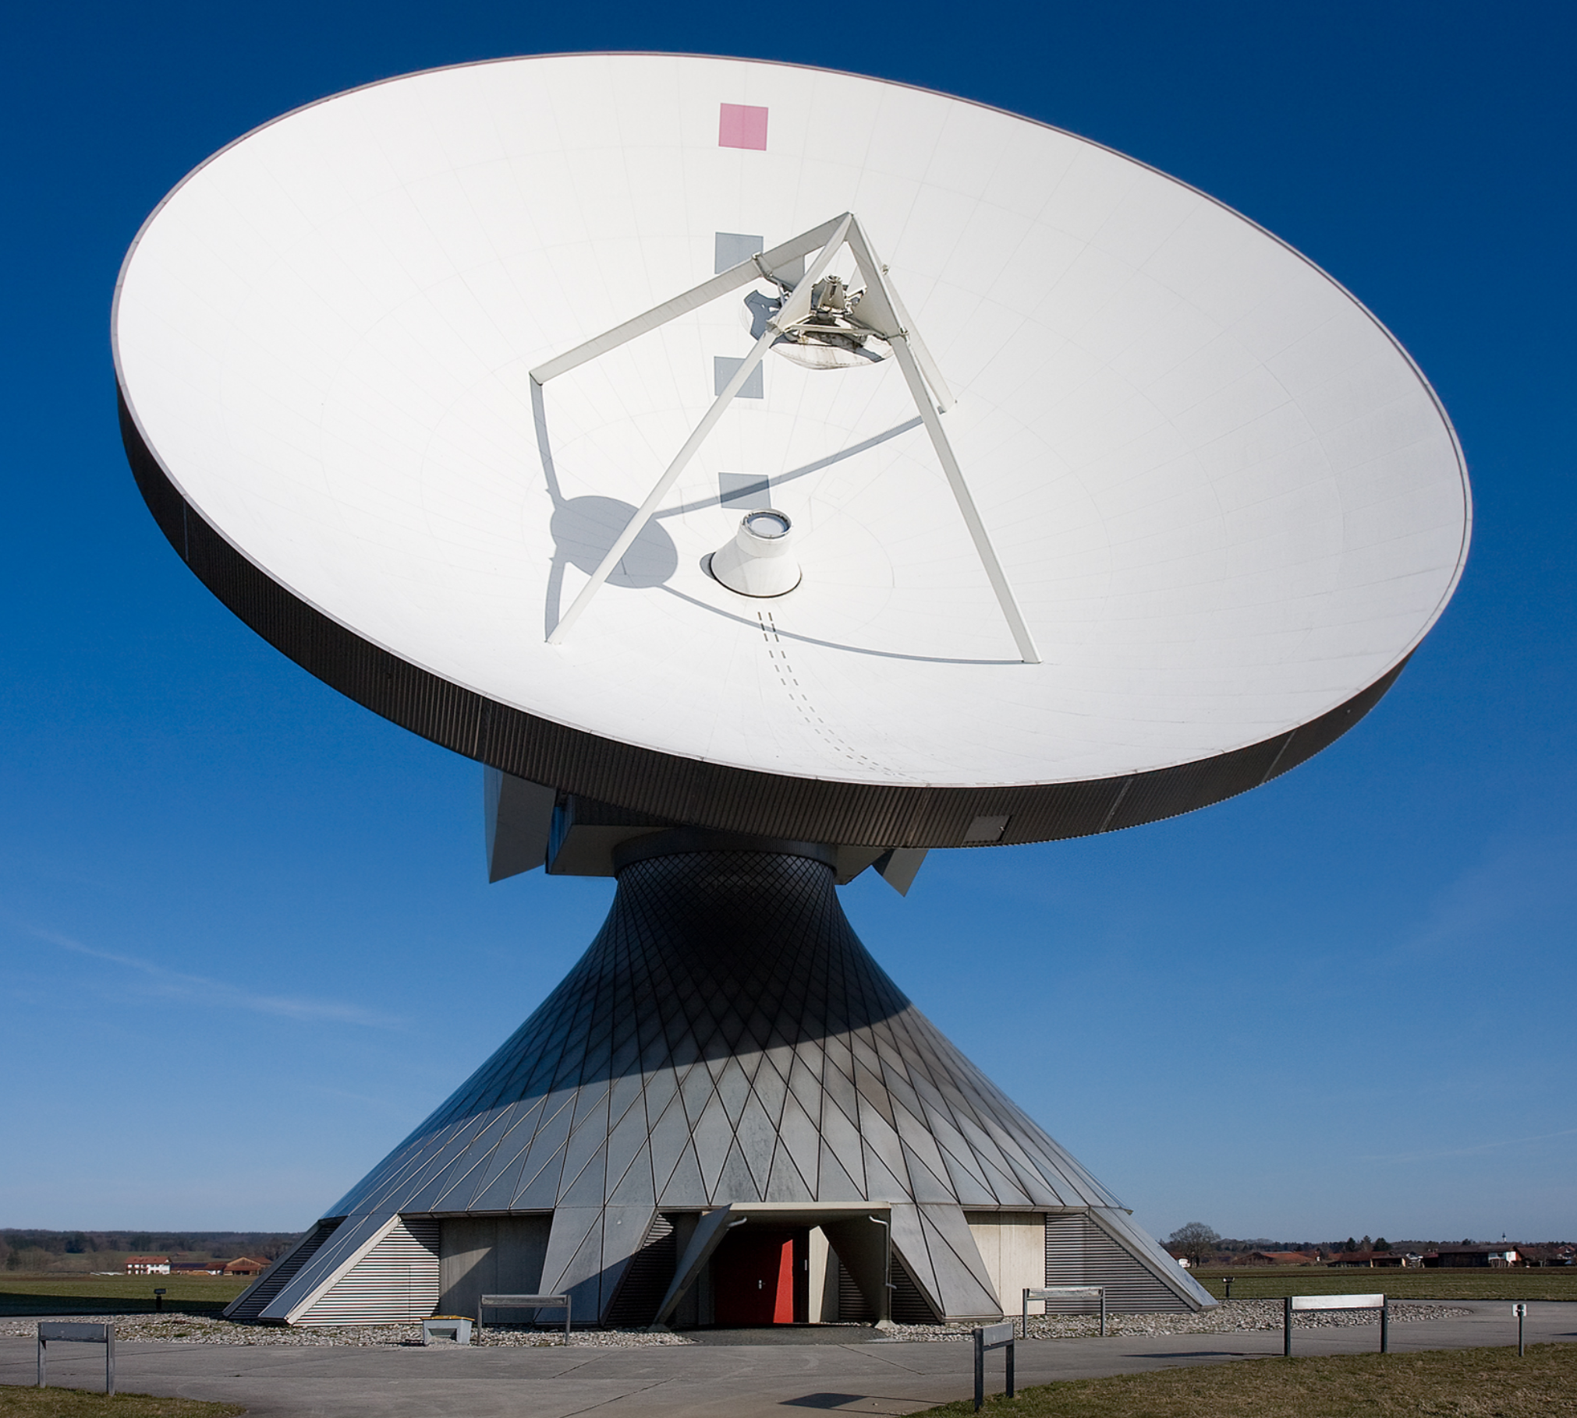
Can You Hear Me NOW?
Reflectors focus energy on the feed
Bigger reflectors capture more energy
Bigger reflectors see a smaller spot in the sky
Notes:
52

Slide 53
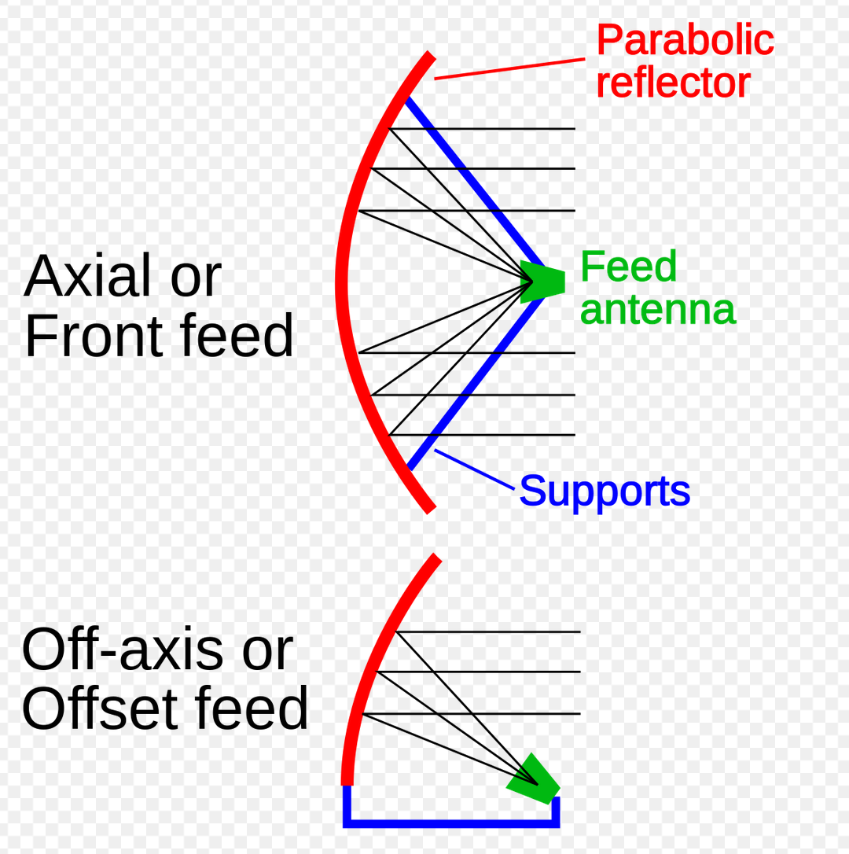
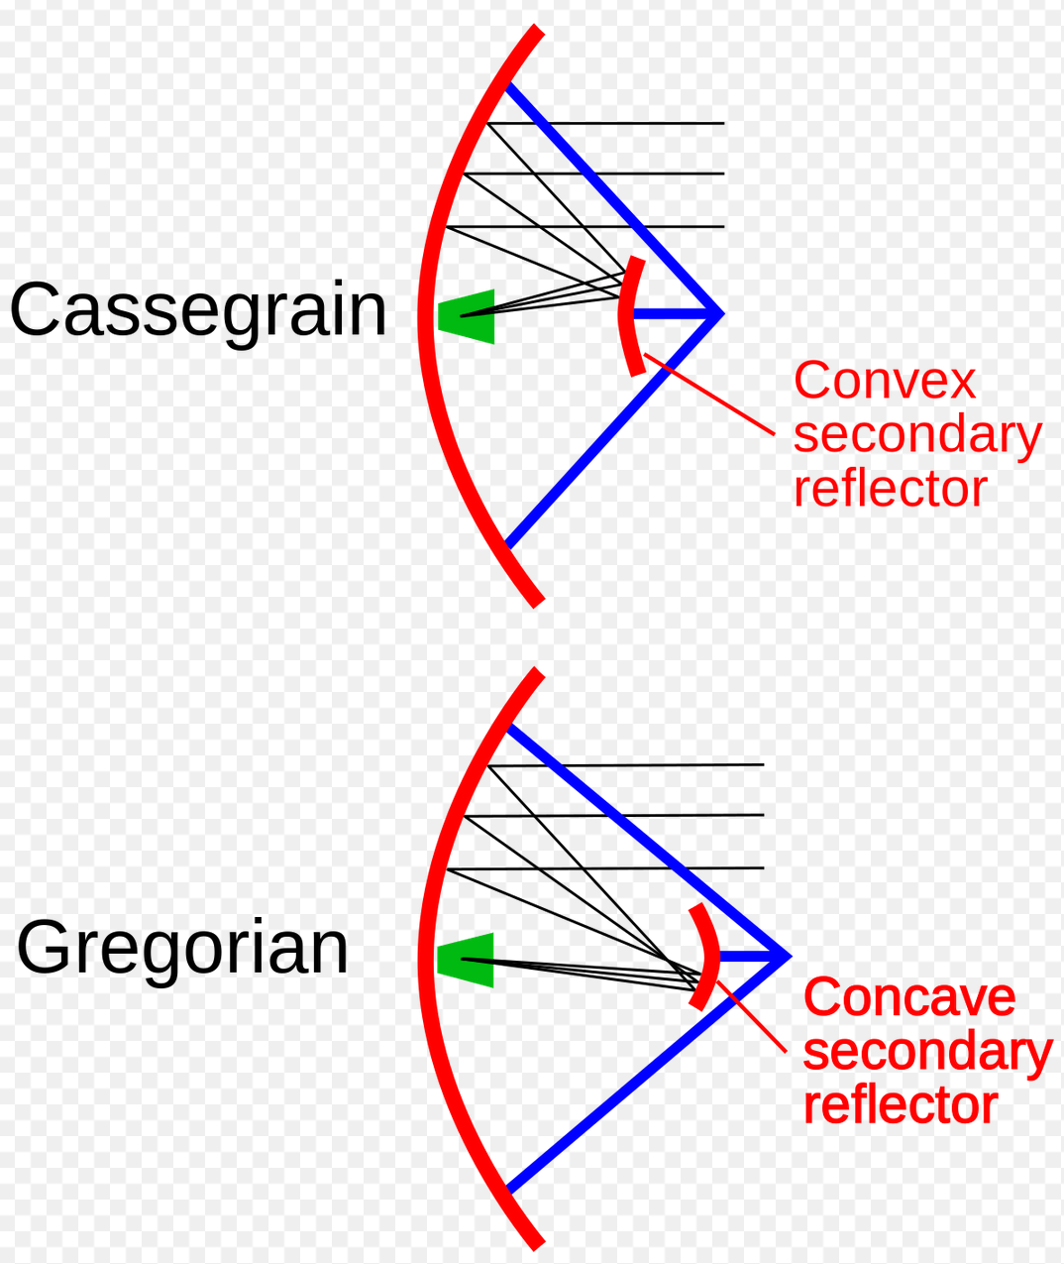
House of Mirrors
Notes:
53

Slide 54
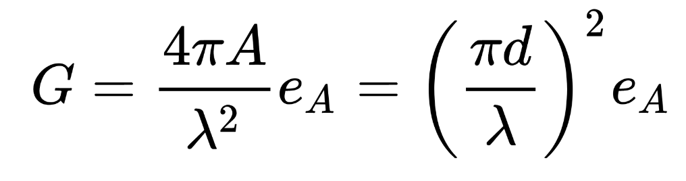
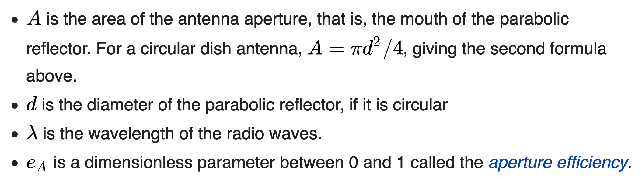
Antenna Gain
Notes:
54

Slide 55
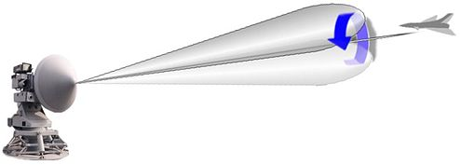
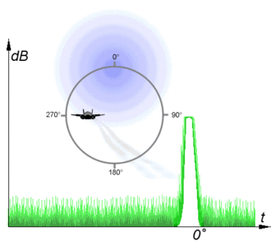
Autotracking Antennas
Tracking antennas steer the receiving beam through space, producing amplitude modulation (AM) on the RF signal.
For a Con-Scan system this is done by mechanically nutating a waveguide, resulting in a continuous AM error signal.
For a Monopulse system this is done by electronically switching the RF difference signal and coupling it into the RF sum channel, resulting in a stepped AM signal.
AM allows the receiving antenna to follow the target with minimal or no operator interaction.
Notes:
55

Slide 56
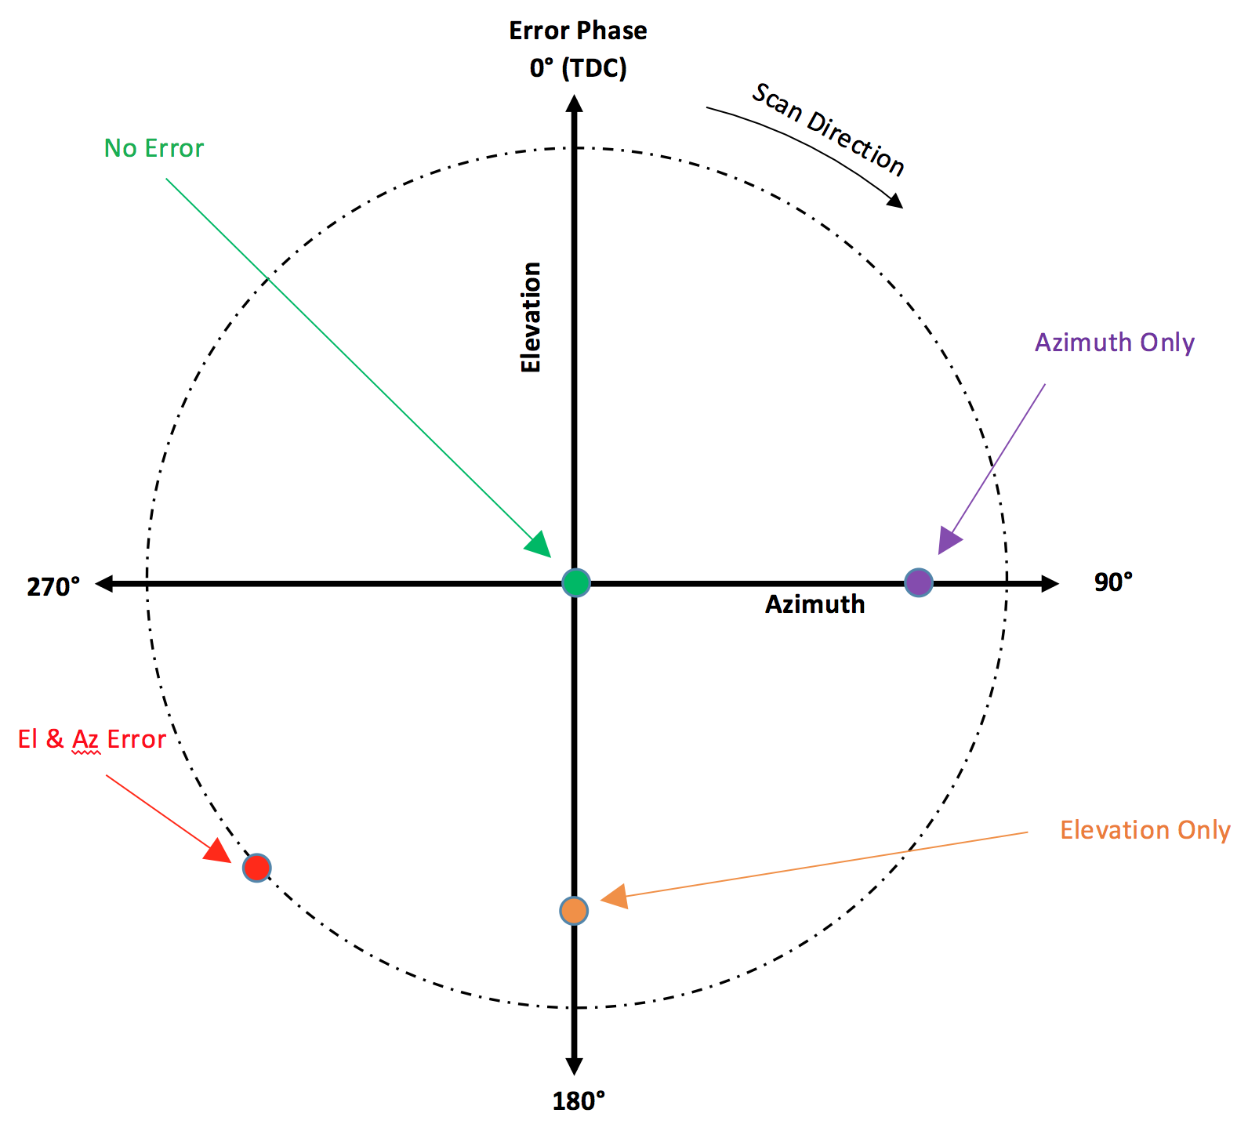
Pointing Error Calculation
Phase of the AM with respect to top dead center timing mark determines target location…

Slide 57
How Well Does It All Work Together?
Yuma Proving Grounds, AZ
Feb 8-11, 2016

Slide 58
Recipe for Delivering Every Bit
Space Time Coding (STC)
  Eliminates aircraft pattern nulls
Low Density Parity Check (LDPC) coding
  Improves margin, stops “dribbling errors”
Adaptive Equalization (for non-STC signals)
  Mitigates multipath
Spatial diversity with correlating source selection
  Eliminate coverage-based dropouts
  Requires DQE/DQM for optimal operation
  TMoIP makes delivery easy

Slide 59
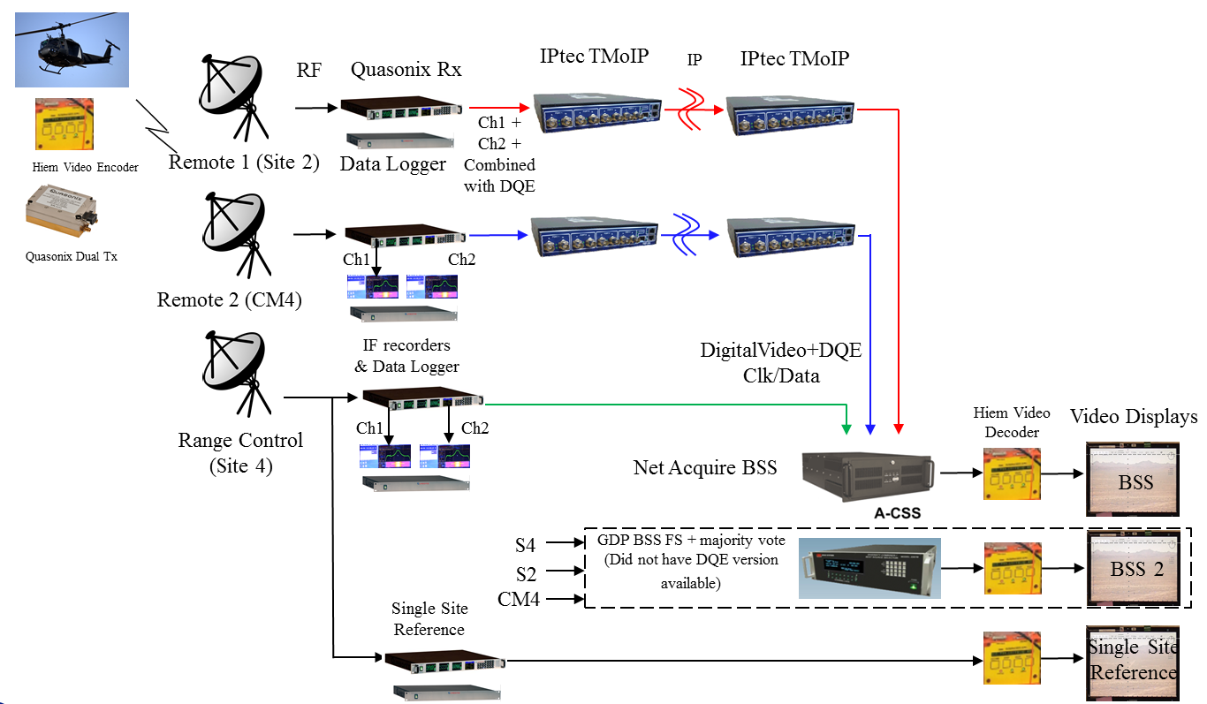
Multiple Receiving Sites
Best Source Selector used 6 inputs: Ch1, Ch2 from each source, but not the combiner outputs (not enough channels).

Slide 60
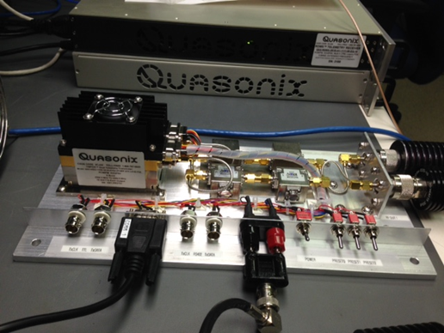
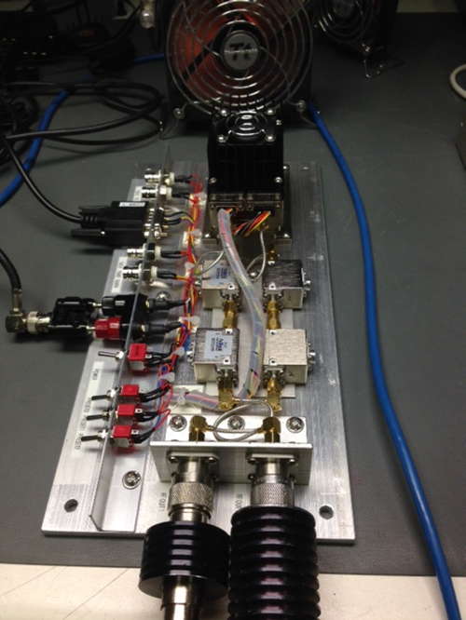
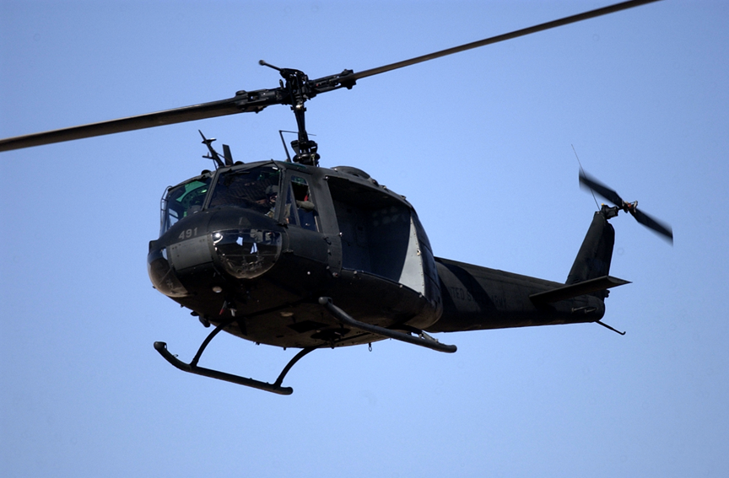
Dual Transmitter – S band – 10 W each output
Installed in UH-1 (Huey) helicopter with top and bottom blade antennas

Slide 61
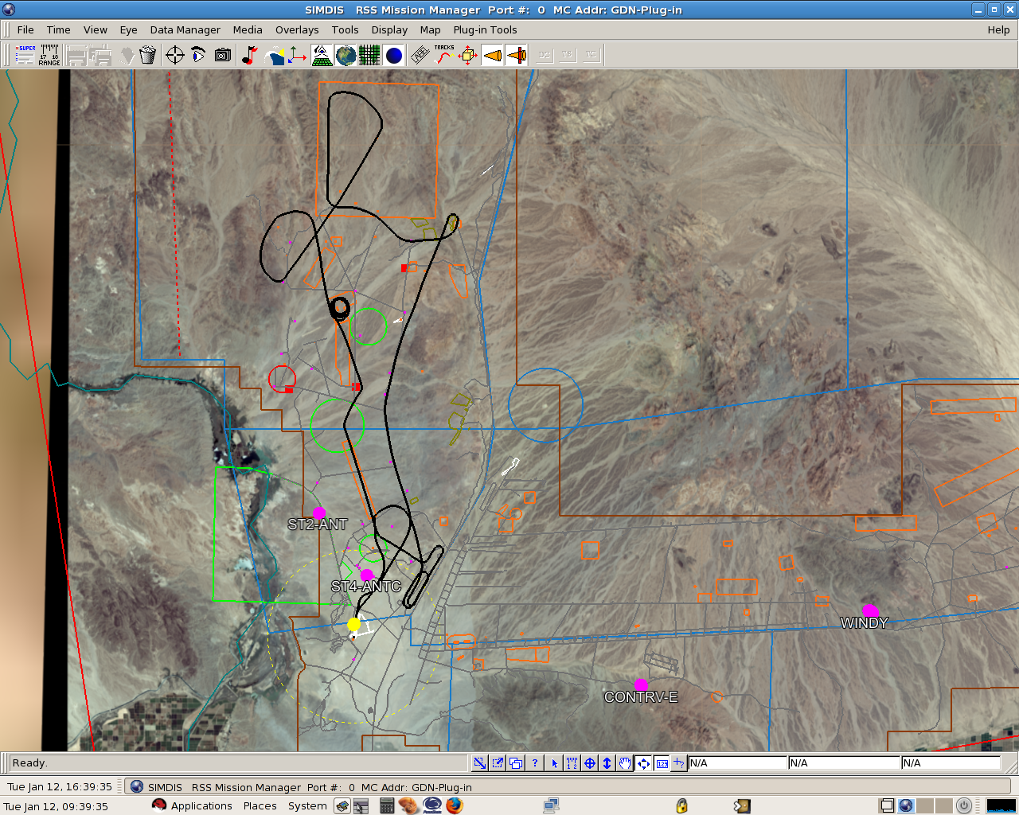
YPG Test Sites
Site CM4
Site 4 to Site CM4 = 14.25 mi
Site 2
Site 4
Laguna Airfield

Slide 62
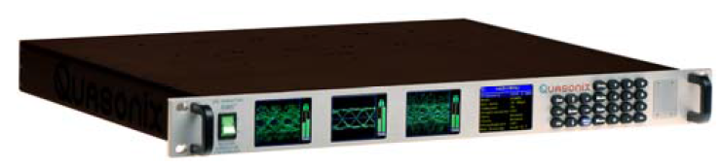
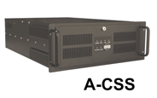
Analysis using Data Logs
F1
Top
Antenna
F2
Bottom
Antenna
Transmit F1-Top, F2-Bottom
3 Receive Sites
6 Clock & Data streams provided to A-CSS with Data Quality Encapsulation (DQE)
DQE = Receiver inserts periodic estimate of instantaneous BEP
Items of interest
  Top vs Bottom Antenna
  Individual Site Performance
  Source Selector Performance
Site 4
Site 2
CM4
F1
F2
F1
F2
F1
F2
Ch1
Ch2
Ch1
Ch2
Ch1
Ch2
Data Log on
Each Receiver
(BEP, BER, RSSI,...)
Ch1, Ch2
DQE
Ch1, Ch2
DQE
Ch1, Ch2
DQE
A-CSS Log
(BEP of each time-aligned source)
‘Best’
Receiver Analyzer
BERT Log
Receiver Analyzer Log
(BER of A-CSS output)

Slide 63
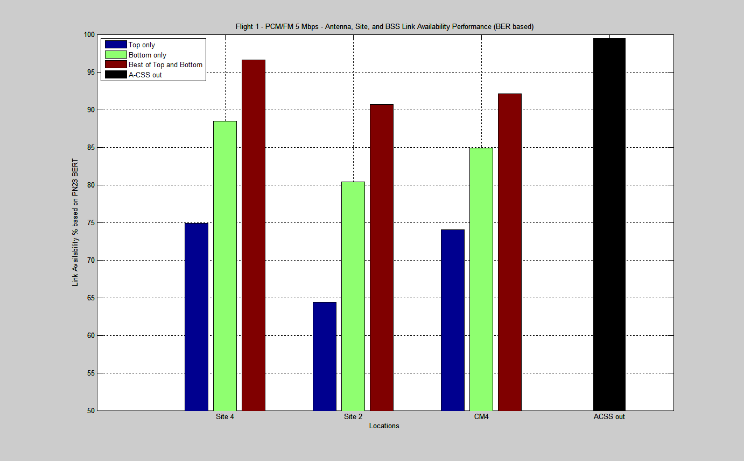
Flight 1 – PCM/FM 5 Mbps
Link Availability Summary (PN23 BER)

Slide 64
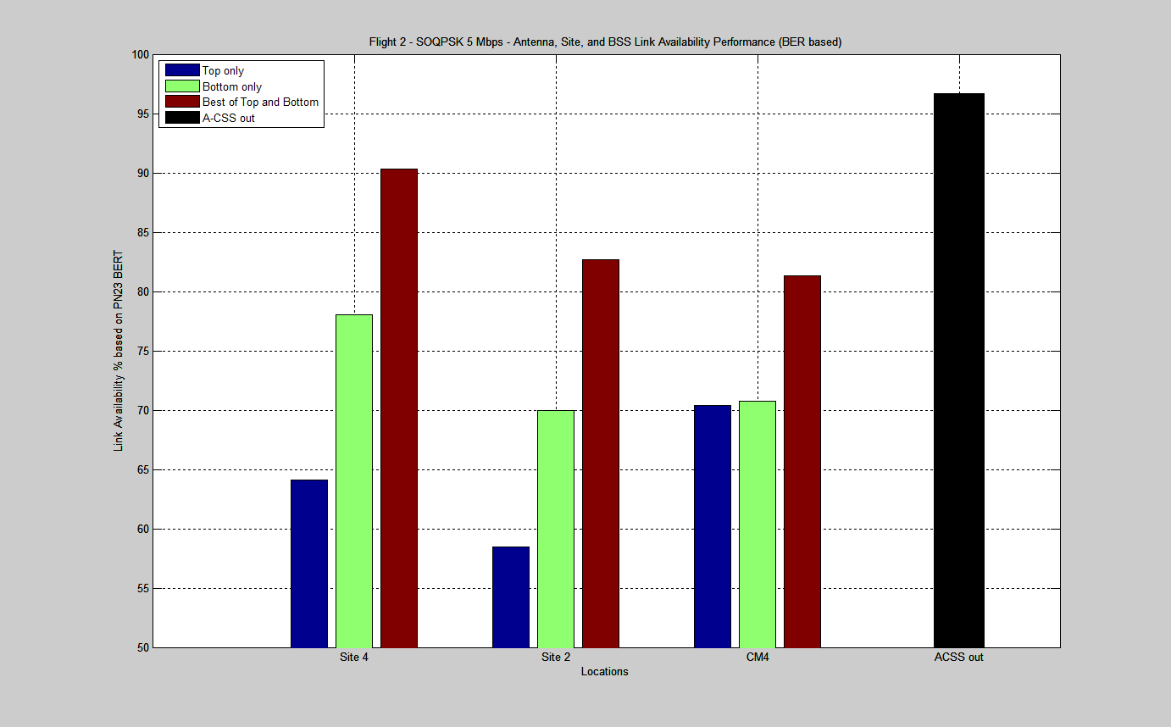
Flight 2 – SOQPSK 5 Mbps
Link Availability Summary (PN23 BER)

Slide 65
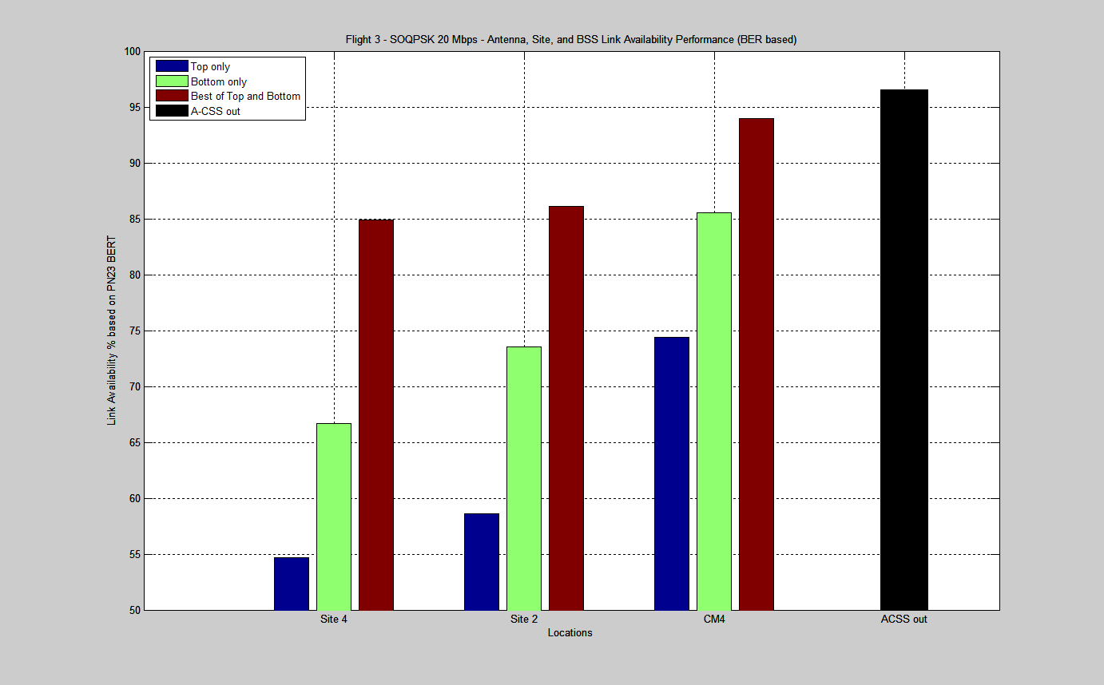
Flight 3 – SOQPSK 20 Mbps
Link Availability Summary (PN23 BER)

Slide 66
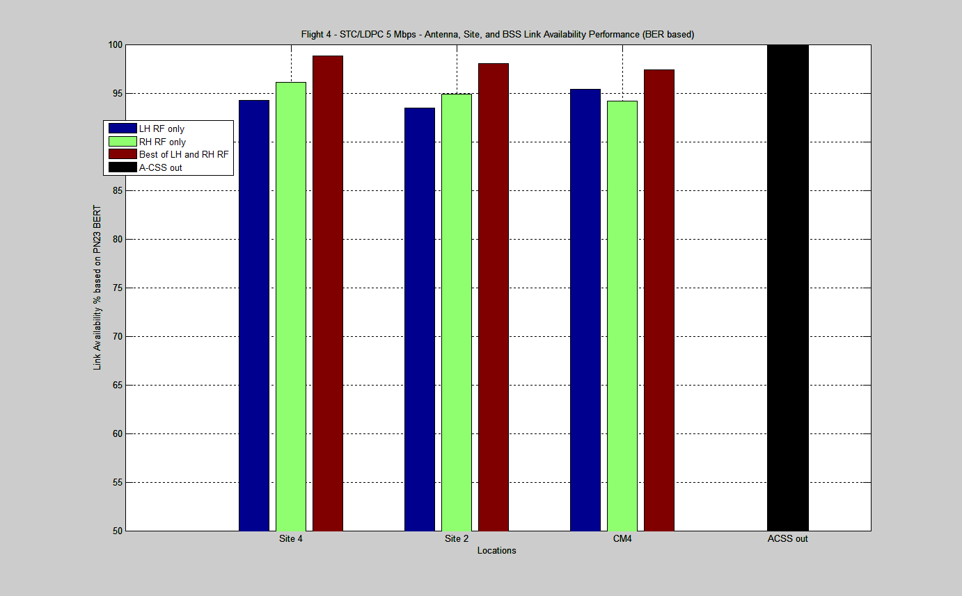
Flight 4 – STC/LDPC 5 Mbps
Link Availability Summary (PN23 BER)

Slide 67
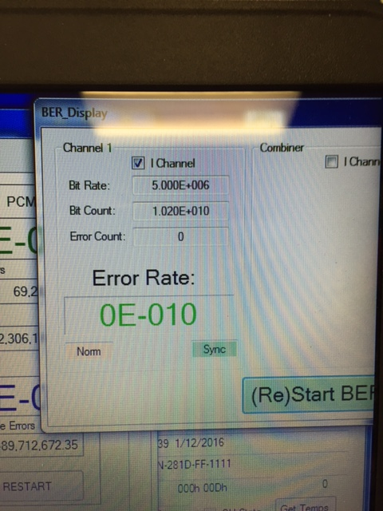
The elusive zero-error link…..
STC/LDPC from 3 sites at 5 MBPS
1st pass PN23 -- 34 minutes of helicopter flight across YPG…
Error-free!
2nd pass video with no freeze ups or blackouts!

Slide 68
Performance Comparison and Summary

Slide 69
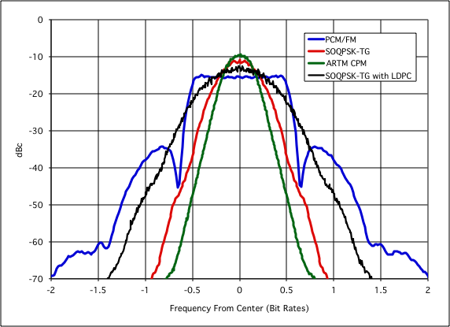
Power Spectral Densities

Slide 70
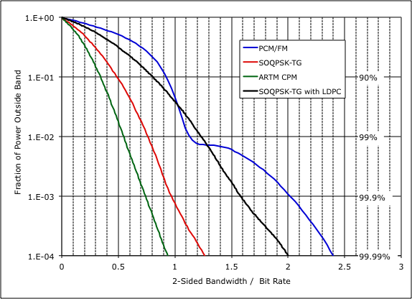
Out-of-Band Power

Slide 71
BER Performance Comparison

Slide 72
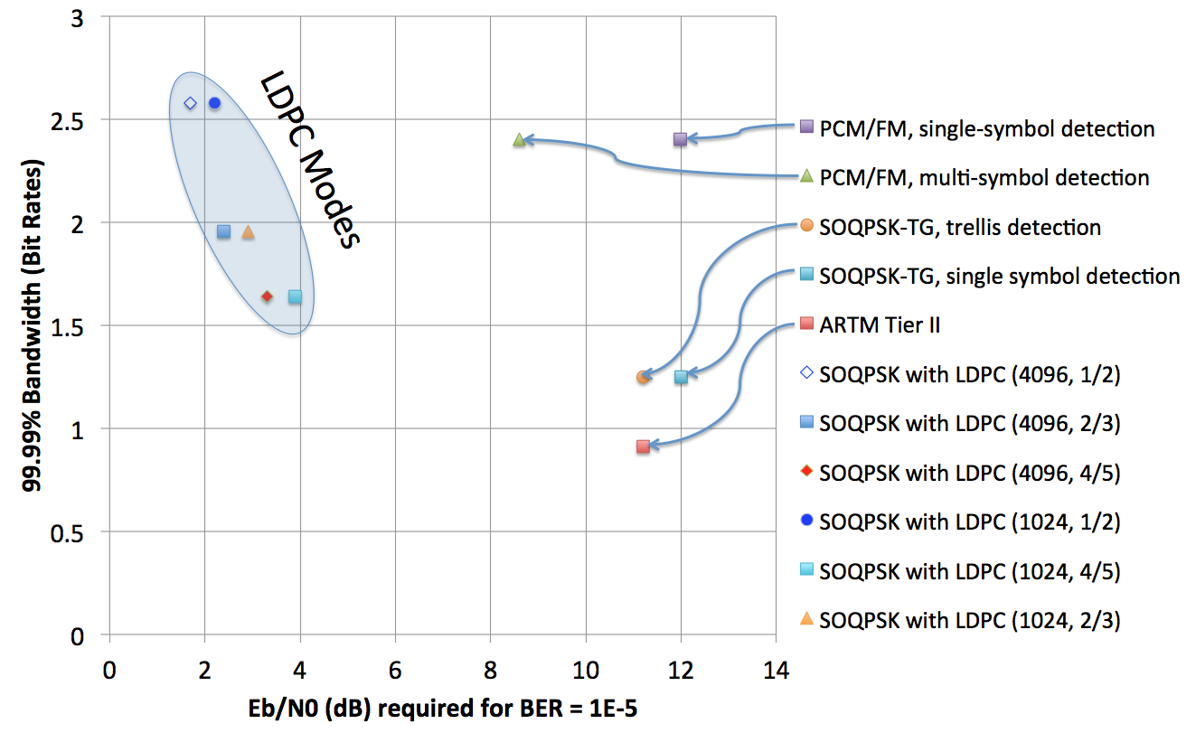
Bandwidth-Power Plane

Slide 73
Stitching it all Together

Slide 74
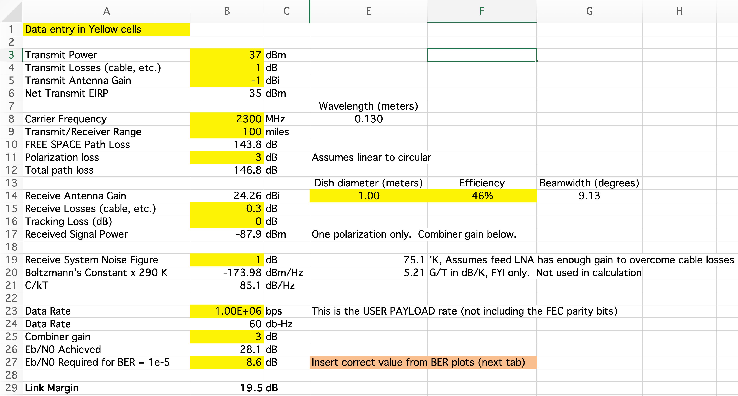
Link Budget

Slide 75
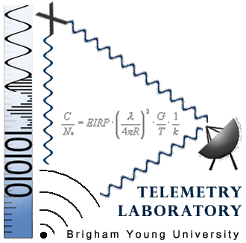


Acknowledgements
Mark Geoghegan, Quasonix
Dr. Michael Rice, Brigham Young University
Bob Jefferis, Tybrin, Edwards AFB
Kip Temple, ARTM, Edwards AFB
Gene Law, NAWCWD, Pt. Mugu
Vickie Reynolds, White Sands Missile Range

Slide 76
Questions/Comments

