Slide 1
Telemetry Smorgasbord
A Little Taste of Everything
Terry Hill, Quasonix
Spring 2020

Slide 2
Course Outline – Day 2
Demodulation
  Trellis vs. Single-Symbol
  Data Quality Metric
  Diversity Combining
  Synchronization
Channel Impairments
  Adjacent Channel Interference
  Multipath Propagation
Impairment Mitigation Techniques
  Adaptive Equalization
  Best Source Selection

Slide 3
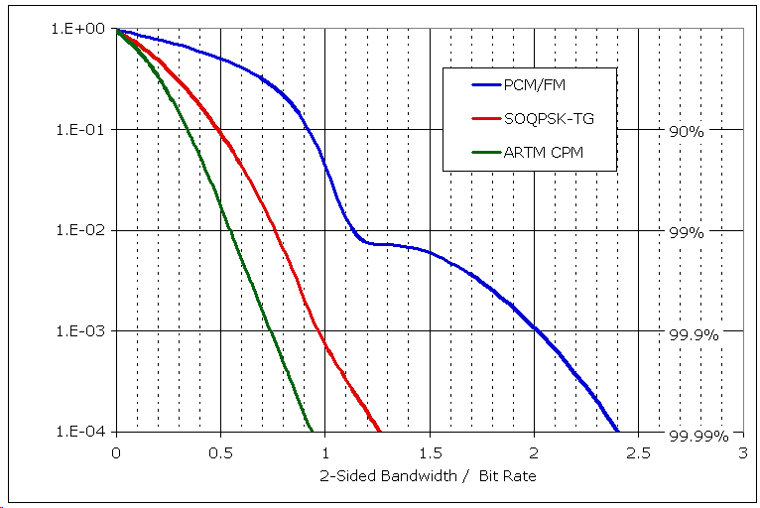
Side by Side Summary
Tier | M | α_{i} | h | g(t) | 99.9% BW
0 | 2 | {-1, +1} | 0.7 | Normalized impulse response of a high order Bessel filter with 3 dB bandwidth = 0.7 * bit rate | 2.03
I | 3 | {-1, 0, +1} | 0.5 | Normalized windowed impulse response of a spectral raised cosine, 8 bits long | 0.98
II | 4 | {-3, -1, +1, +3} | {4/16, 5/16} | Normalized raised cosine, 3 symbols (6 bits) long | 0.75

Slide 4
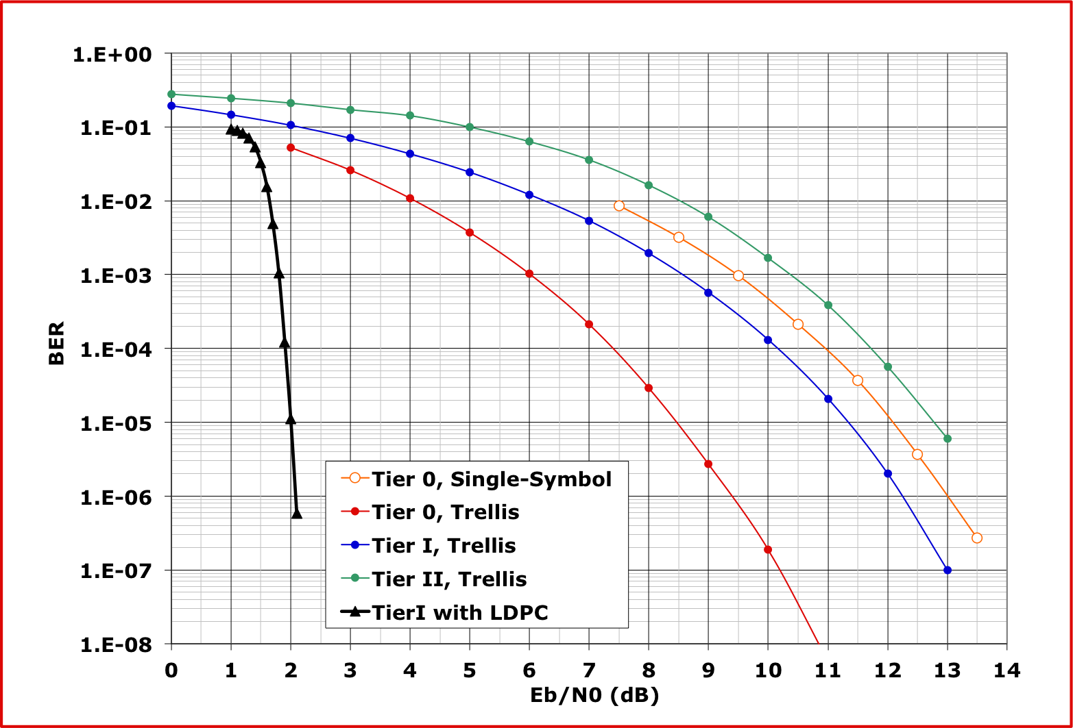
BER Performance Comparison

Slide 5
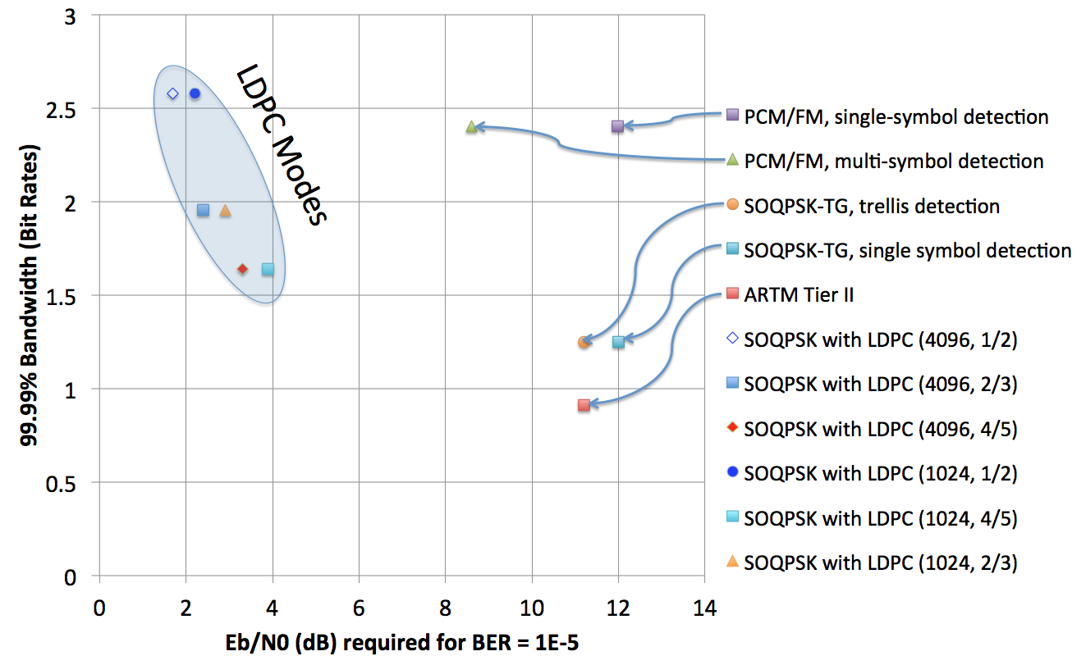
Today’s Modulation Tour

Slide 6
Data Quality Metric (DQM)

Slide 7
How to Assess Data Quality
Measured BER is not practical
  Requires known data in the stream – not possible with encryption
  Takes a long time to measure low BERs
Bit error probability (BEP), however…
  Does not require any known data
  Can be determined quickly and accurately from demodulator statistics
  Is an unbiased quality metric, regardless of channel impairments
  When calibrated per a standardized procedure, DQM based on BEP allows DQE from multiple vendors to interoperate
Each vendor can use their own algorithm for developing BEP
DQM is calculated directly from BEP
  Use of Likelihood Ratio leads to maximum likelihood BSS algorithms
  Converted to 16-bit integer on log scale

Slide 8
Definition of DQM
Start with BEP, derived within demod
Likelihood Ratio (LR) = (1 - BEP) / BEP
DQM = min (round (log10 (LR) / 12 * (2^16)), 2^16 -1)
  16-bit unsigned integer, ranges from 0 to 65,535
Easily reversed:
  LR = 10^(-12 * DQM / 2^16)
  BEP = 1 / (1 + LR)
Define “Q” as the “User’s DQM”
  Q = 12 * DQM / 65535
  Represents the exponent of 10 in the BEP
  Examples:
    Q = 3 ➔ BEP = 1e-3
    Q = 7 ➔ BEP = 1e-7
  Arbitrarily cap Q at “a perfect 10”.
BEP | LR | DQM | Q
0.5 | 1.00 | 0 | 0.00
1E-01 | 1.11111E-01 | 5211 | 0.95
1E-02 | 1.01010E-02 | 10899 | 2.00
1E-03 | 1.00100E-03 | 16382 | 3.00
1E-04 | 1.00010E-04 | 21845 | 4.00
1E-05 | 1.00001E-05 | 27307 | 5.00
1E-06 | 1.00000E-06 | 32768 | 6.00
1E-07 | 1.00000E-07 | 38229 | 7.00
1E-08 | 1.00000E-08 | 43691 | 8.00
1E-09 | 1.00000E-09 | 49152 | 9.00
1E-10 | 1.00000E-10 | 54613 | 10.00
1E-11 | 1.00000E-11 | 60075 | 10.00
1E-12 | 1.00000E-12 | 65535 | 10.00

Slide 9
DQE Format
Header
  16-bit sync pattern (0xFAC4)
    MSB first: 1111101011000100
  8-bit reserved word, potentially for packet header version number (currently 0)
  8-bit reserved word, potentially for source ID tag (currently 0)
  16-bit DQM
Payload data
  User selectable length, (128 ≤ N ≤ 16,536)
  Defaults to 4096
16-bit
Sync
Pattern
8-bit
Word
8-bit
Word
16-bit
DQM
N bits of payload data (128 ≤ N ≤ 16,536)

Slide 10
Calibration of DQM
Calibrate DQM under various channel impairments:
  AWGN – static level
  AWGN – dynamic level (step response)
  Dropouts
  In-band and adjacent channel interference
  Phase noise
  Timing jitter
  Static multipath
Test procedures are being developed to evaluate accuracy of DQM
  Targeted for inclusion in IRIG 118

Slide 11
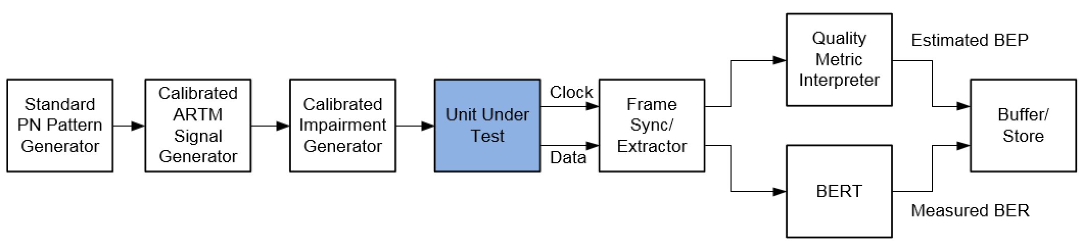
DQM Calibration Fixture
Synthesize “impaired” RF signal
Recover the “corrupted” data (with clock)
Extract the frame sync word, including DQM
Measure BER of payload data
Compare DQM (converted to BEP) to measured BER
  Recorded and stored on a packet-by-packet basis

Slide 12
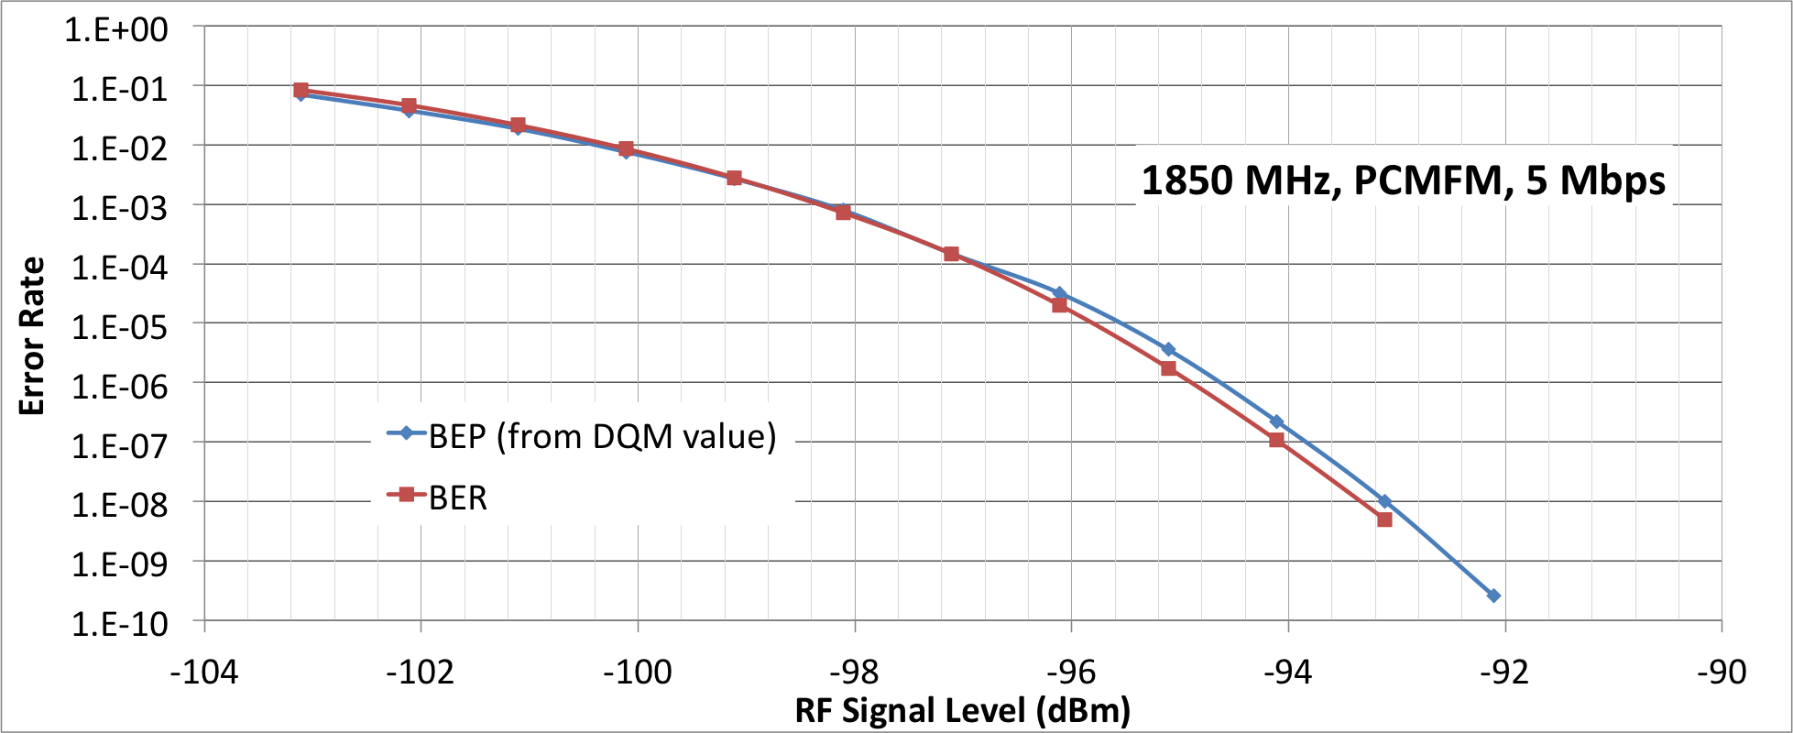
DQM Calibration in AWGN
Required as a baseline for all other tests

Slide 13
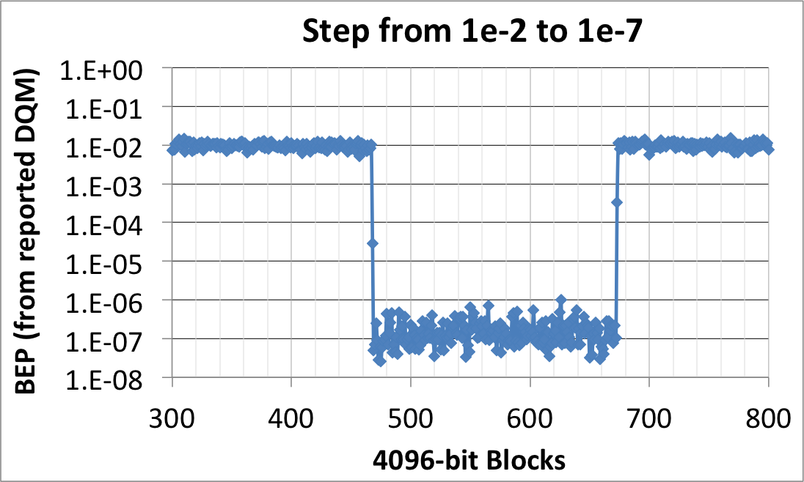
DQM Step Response
Assesses timeliness of DQM values
UUT stays synchronized during test
One block at each step is a blend of the two states

Slide 14
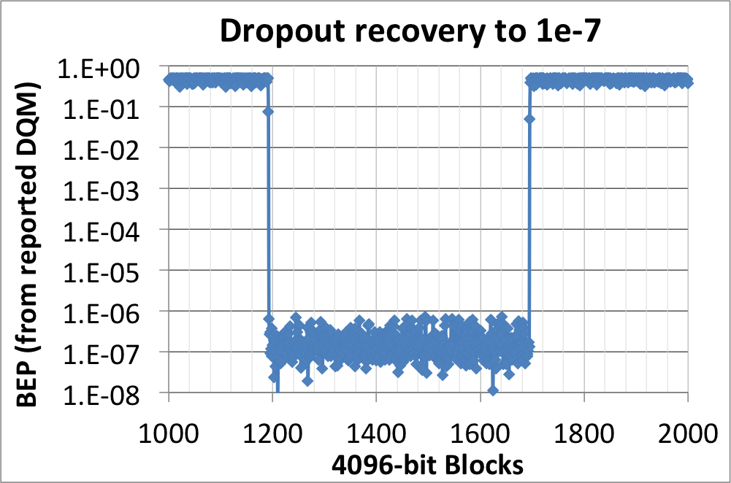
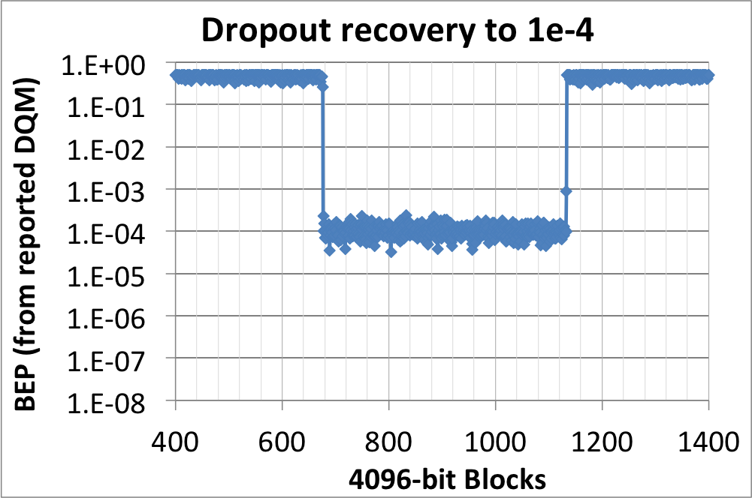
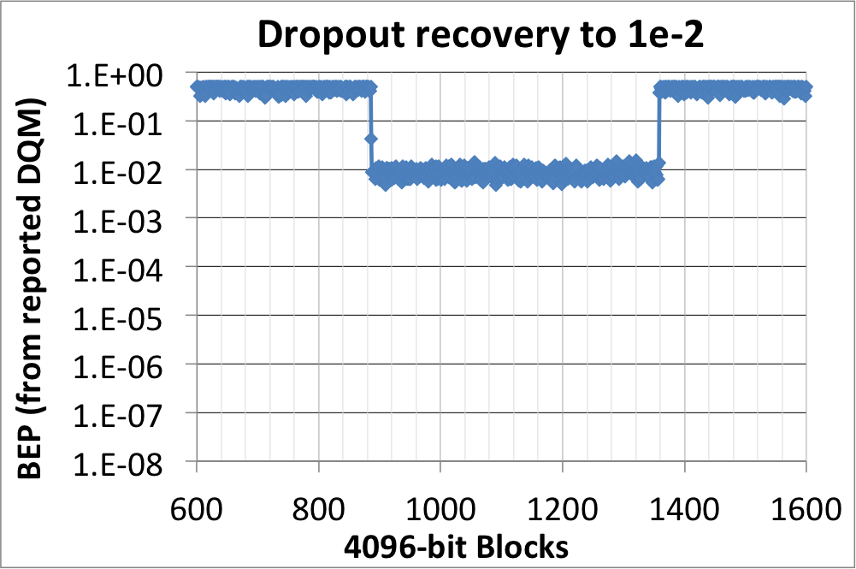
DQM Fade Recovery
Includes UUT synchronization time

Slide 15
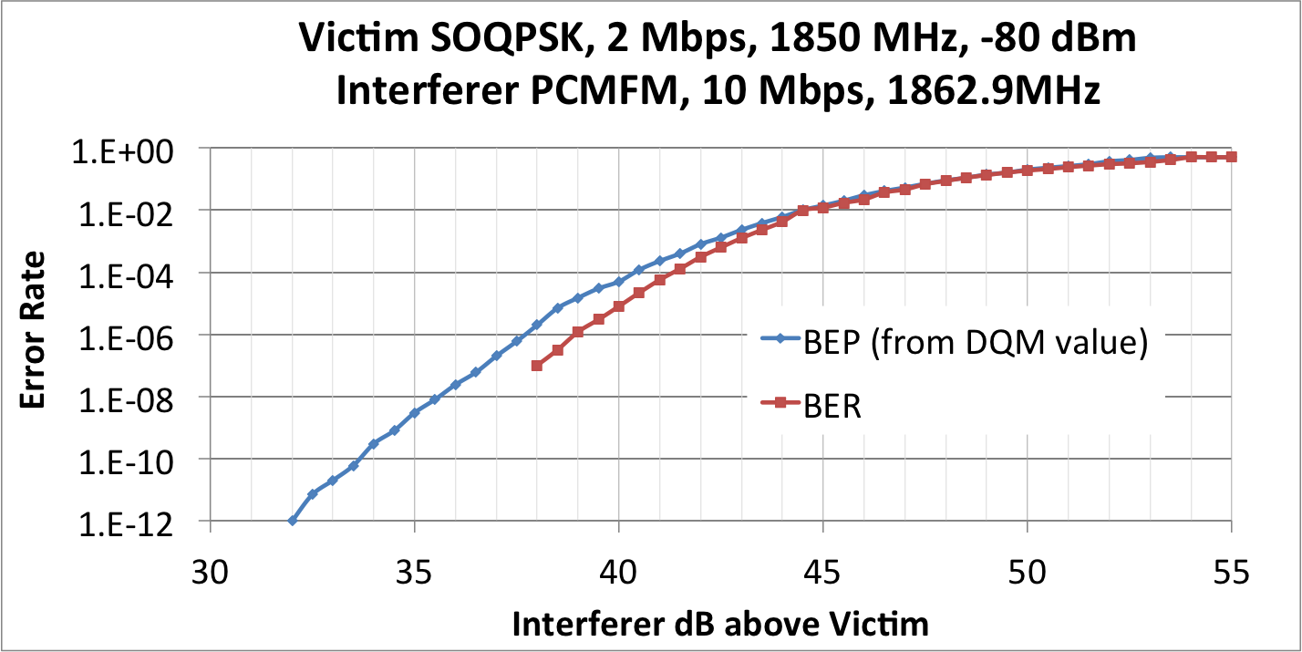
DQM Interference Test
Interference is not AWGN, but it causes bit errors

Slide 16
Diversity Combining

Slide 17
Maximal Ratio Combining
Many telemetry systems utilize diversity reception
  Frequency separation using two transmitter
  Orthogonal polarizations using cross-polarized antenna feeds
Combining two (or more) copies of the same signal
  Diversity combining
  Creates a third signal to be demodulated
  BER performance of third signal is better than either of the individual signals
Special case – the leading use of diversity
  Linearly polarized transmit antenna on test article – could be at any orientation
  Left-hand and right-hand circularly polarized receive antennas
  Each receive antenna loses half the transmit power
  Diversity combiner puts it all back together, eliminating the polarization loss
  Frequency diversity works the same way, but uses twice the bandwidth

Slide 18
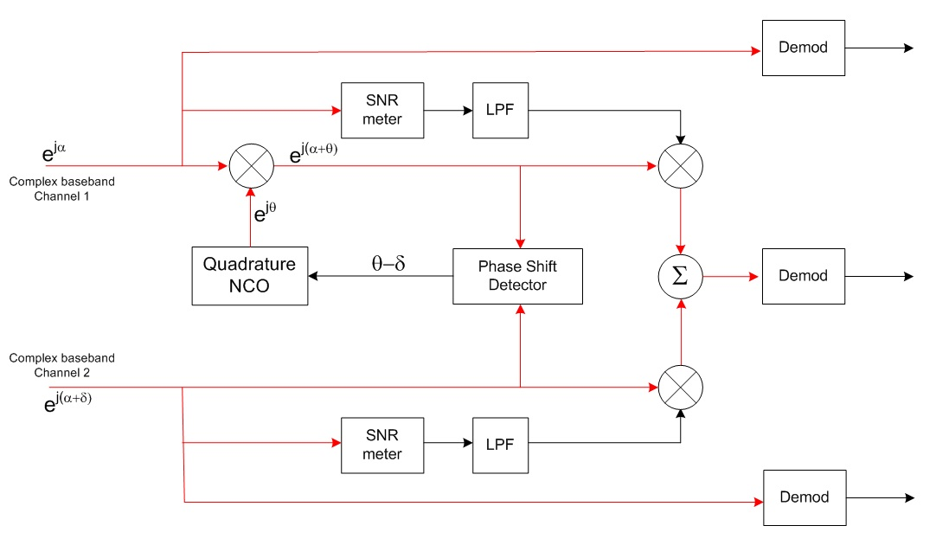
Maximal Ratio Combining
Weight each signal in proportion to its SNR and add
Yields optimum SNR on combined channel in AWGN
SNR_{combined} = SNR_{a} + SNR_{b}

Slide 19
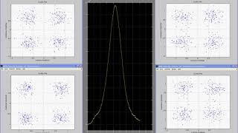
Maximal Ratio Combining
Jump to file: diversity-combiner-video.mp4
  Or, click to view on our website: Combining Video

Slide 20
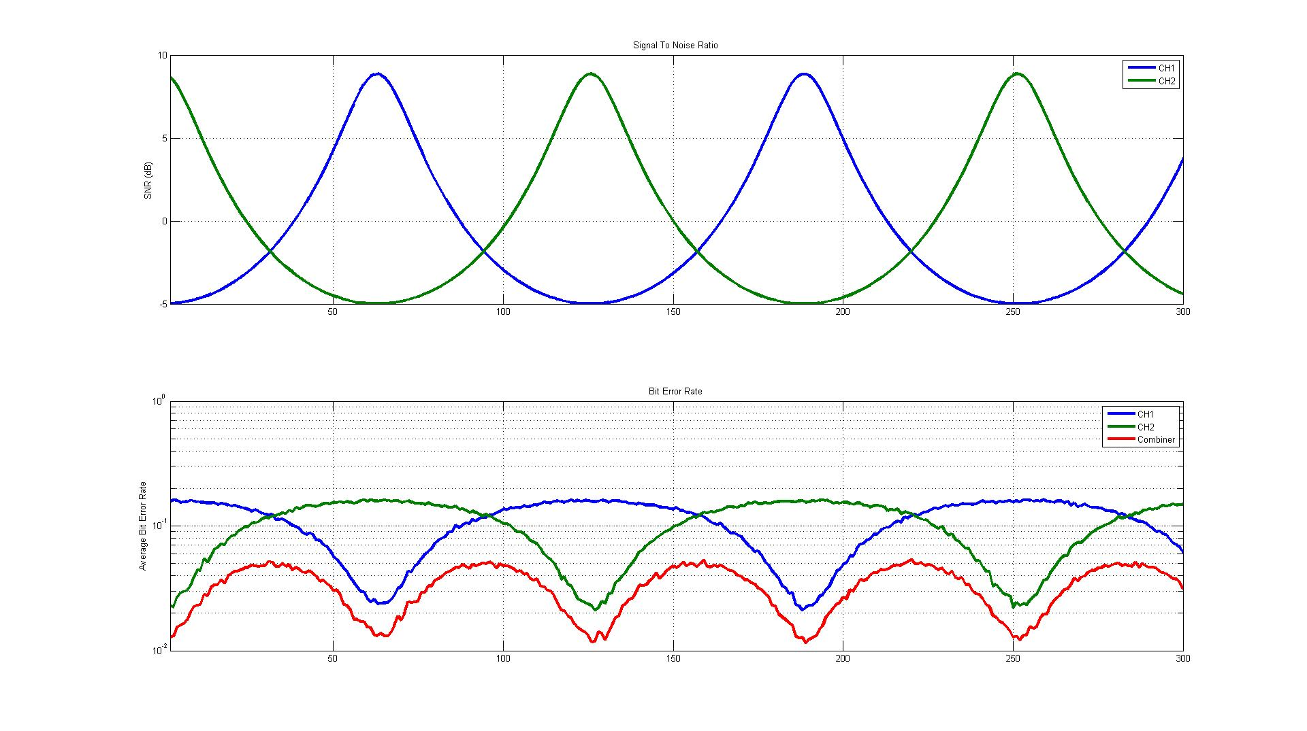
BER Results - Fading Signals

Slide 21
Measured Combiner BER - Tier 0

Slide 22
Measured Combiner BER - Tier I

Slide 23
Measured Combiner BER - Tier II

Slide 24
Combiner Summary
Receive-side processing
  No transmitter impact
Phase aligns the signals
Forms weighted sum of two inputs
SNR of the weighted sum is at least as high as the better signal
May be as much as 3 dB higher (equal input case)
Conventional combiner design assumes signals are time-aligned
  Performance falls off rapidly with increasing time skew
  Combiner will probably fail altogether at ± ½ bit time skew
Some combiners do both phase alignment and time alignment
  Supports operation with spatially separated antennas
If you have access to two copies of the signal, use them!

Slide 25
Synchronization

Slide 26
Telemetry Channels are Bursty
In a typical flight test, the vast majority of bit errors occur at dropouts
Synchronization is important!
Figure from Robert Jefferis, Tybrin, Edwards AFB. Reprinted by permission of the author.

Slide 27
Synchronization Test
IRIG 118-12, Procedure 7.4 (Flat Fade Recovery Test)
Transmit randomized ones pattern
Measure time at which output becomes “all (or mostly) ones”
All ones
Noise
IRIG
Randomizer
Modulator
Add Noise
Switch
Start
Timer
Controller
Demod
with
Derandomizer
Stop
Ones
Detector

Slide 28
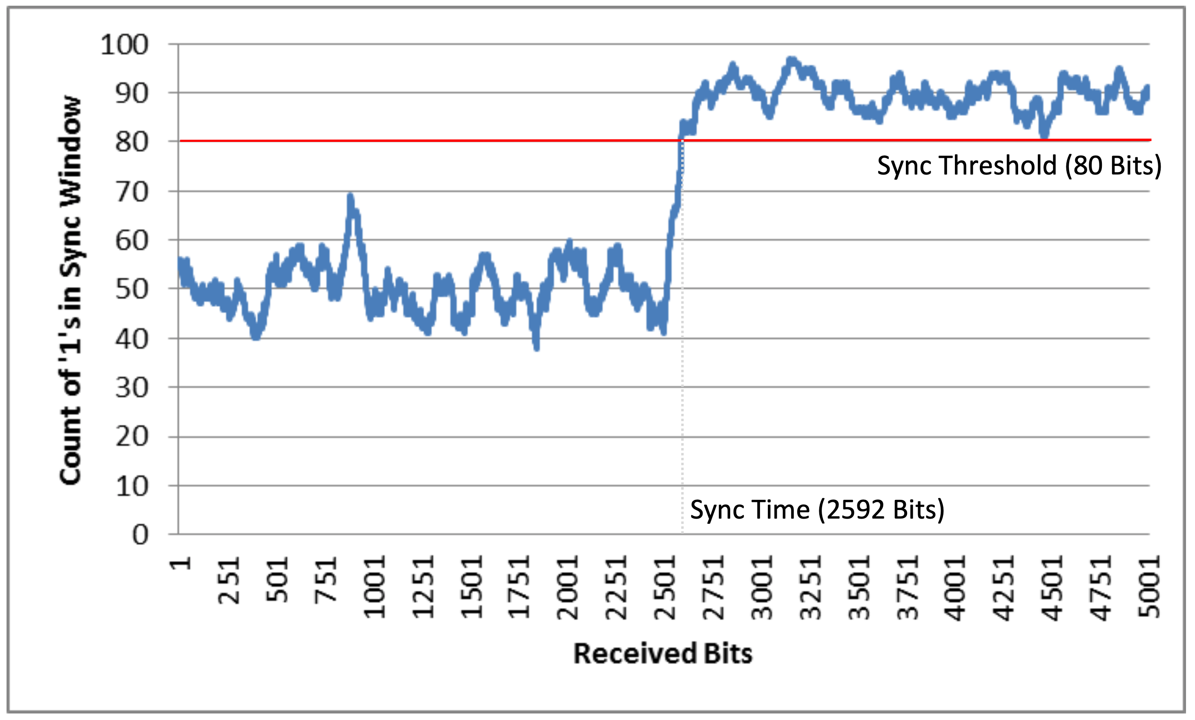
Typical Sync Test

Slide 29
Synchronization Parameters
Modulation technique
  Tier 0 uses more bandwidth – easier to synchronize to
  Tier I is spectrally compact, making it slippery – synchronization is more difficult
    Trellis demodulation helps achieve sync
  Tier II is even more compact – synchronization takes longer
Bit rate
  Fixed-duration tasks amount to more bits at high bit rates
Signal to noise ratio
  Sync times will be longer at low SNR
Synchronization threshold
  SNR at which the demodulator can acquire sync
Sync loss threshold
  SNR at which a synchronized demodulator will drop sync

Slide 30
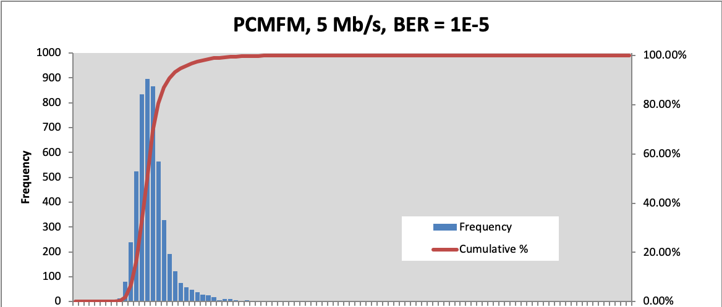
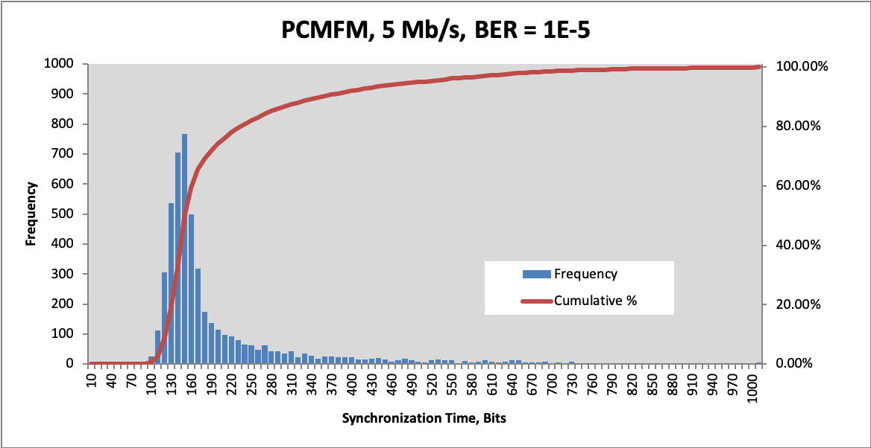
Tier 0 Synchronization
Channel 1, 2
Combiner

Slide 31
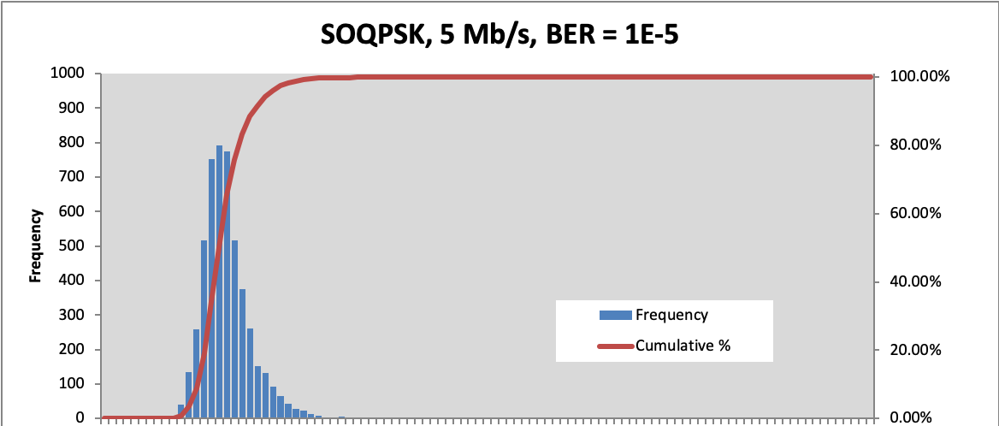
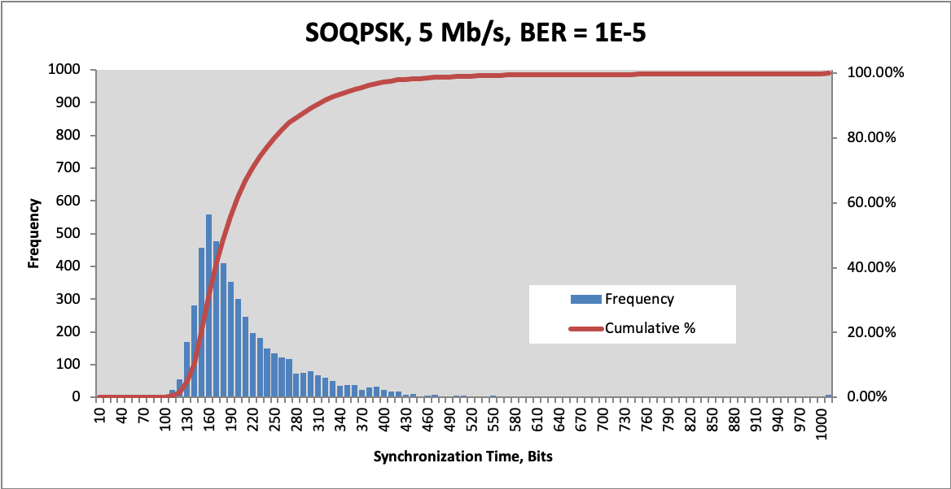
Tier I Synchronization
Channel 1, 2
Combiner

Slide 32
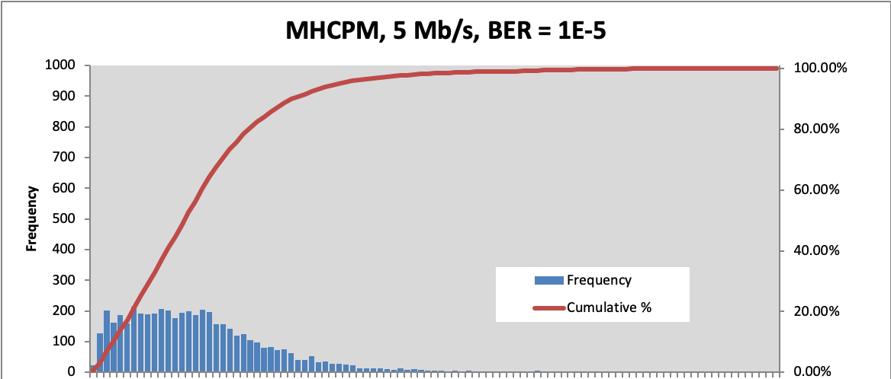
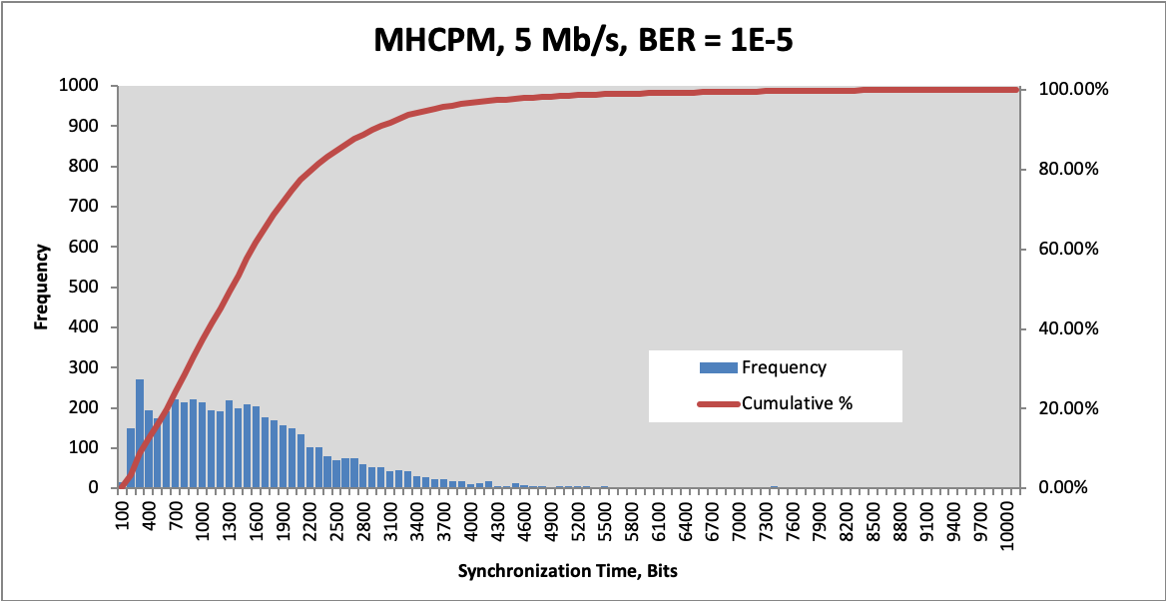
Tier 0 Synchronization
Channel 1, 2
Combiner

Slide 33
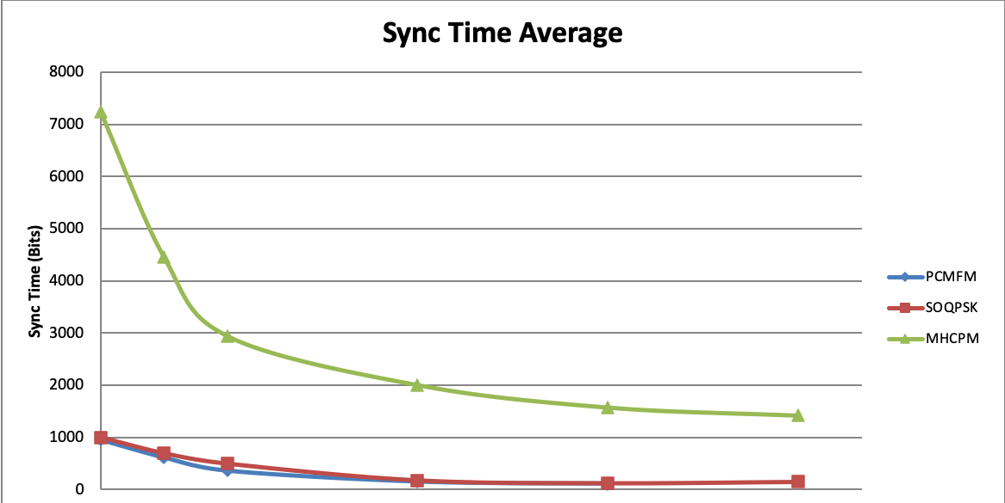
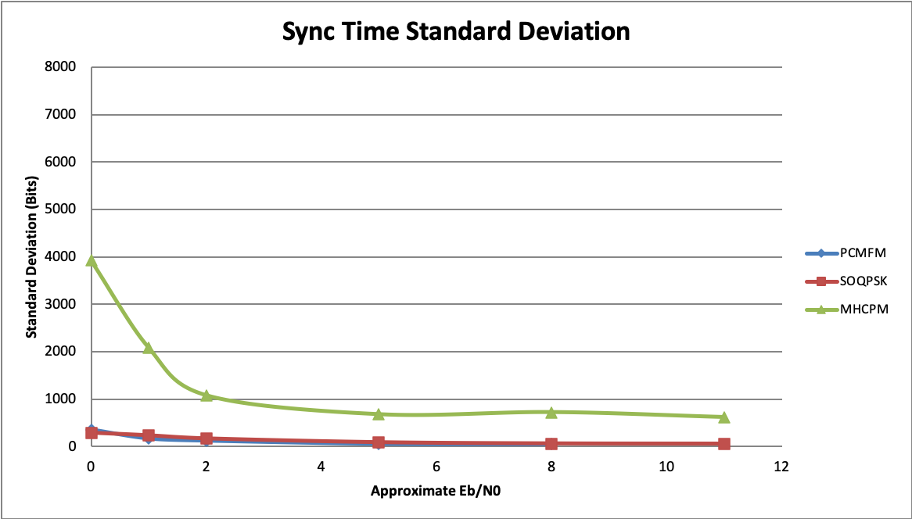
Low SNR Synchronization

Slide 34
Synchronization Summary
The aeronautical telemetry channel is plagued with dropouts
Rapid synchronization, and synchronization at low SNR, is the best means of minimizing the impact of these dropouts
IRIG 118 defines test procedures for measuring sync time and sync thresholds
Pay attention to synchronization performance!

Slide 35
Adjacent Channel Interference

Slide 36
PSD is Half the Story
Overall spectral efficiency is determined by spacing between channels
Receiver selectivity affects channel spacing
A valid comparison must account for both transmitted spectrum and “tolerable” receiver filtering
Not all modulations are equally “tolerant” of IF filtering and interference
Multi-channel testing accounts for these factors

Slide 37
Multi-channel ACI Test Set

Slide 38
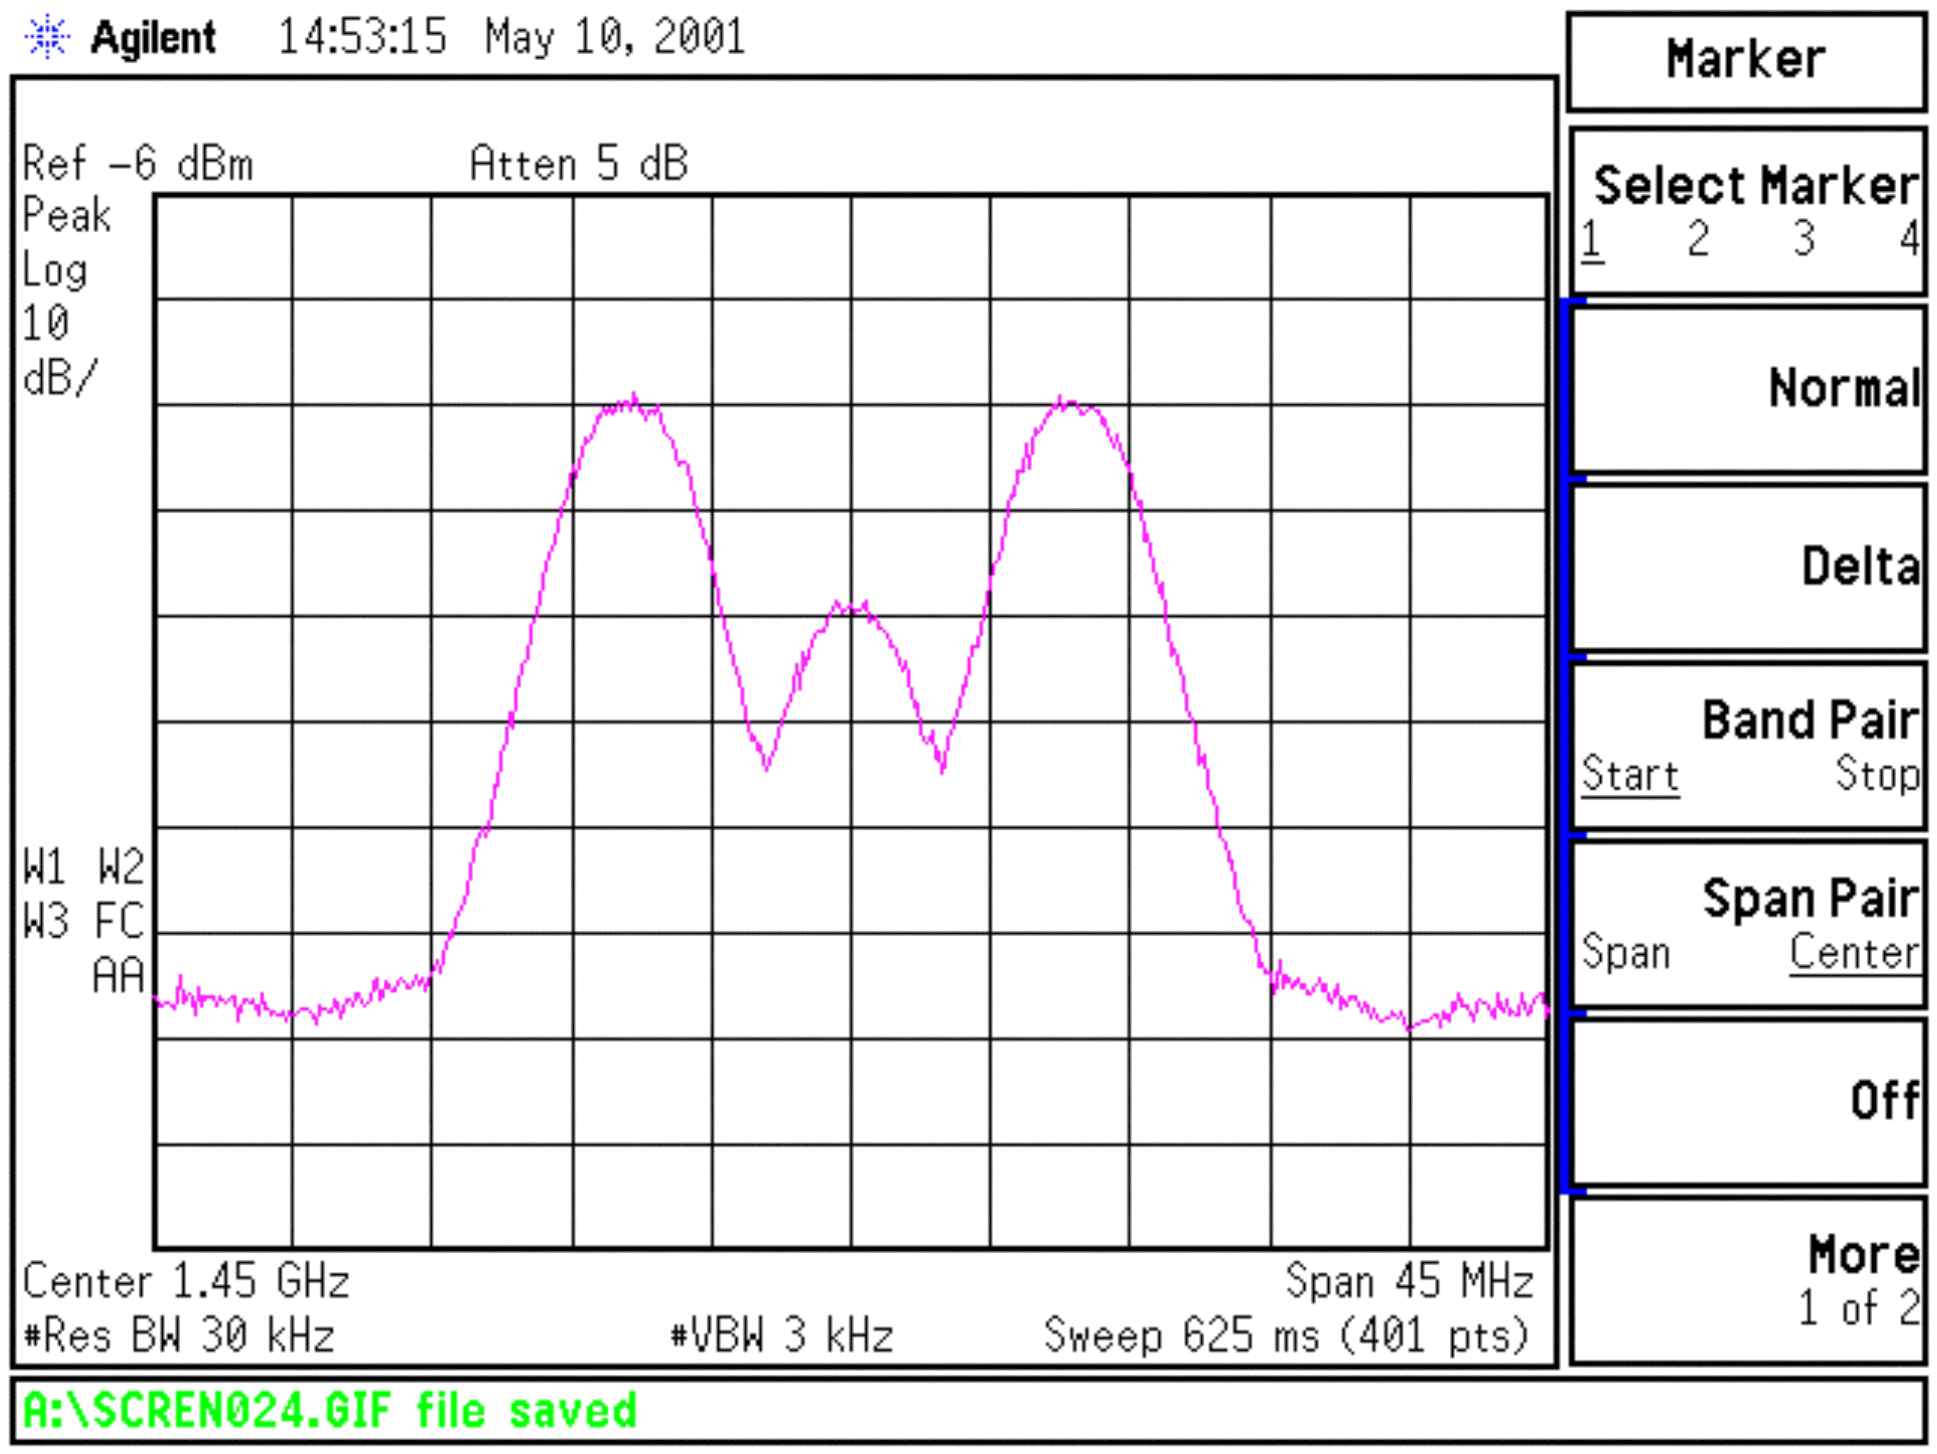
9 Mbps Multi-h CPM, Multichannel

Slide 39
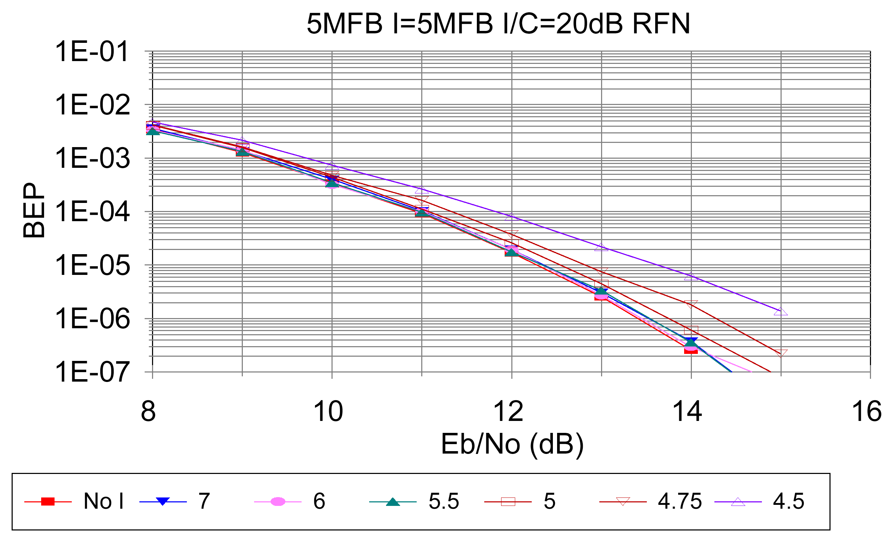
BER as a Function of ΔF
From Gene Law, “Recommended Minimum Telemetry Frequency Spacing With CPFSK, CPM, SOQPSK, and FQPSK Signals”, ITC 2003

Slide 40
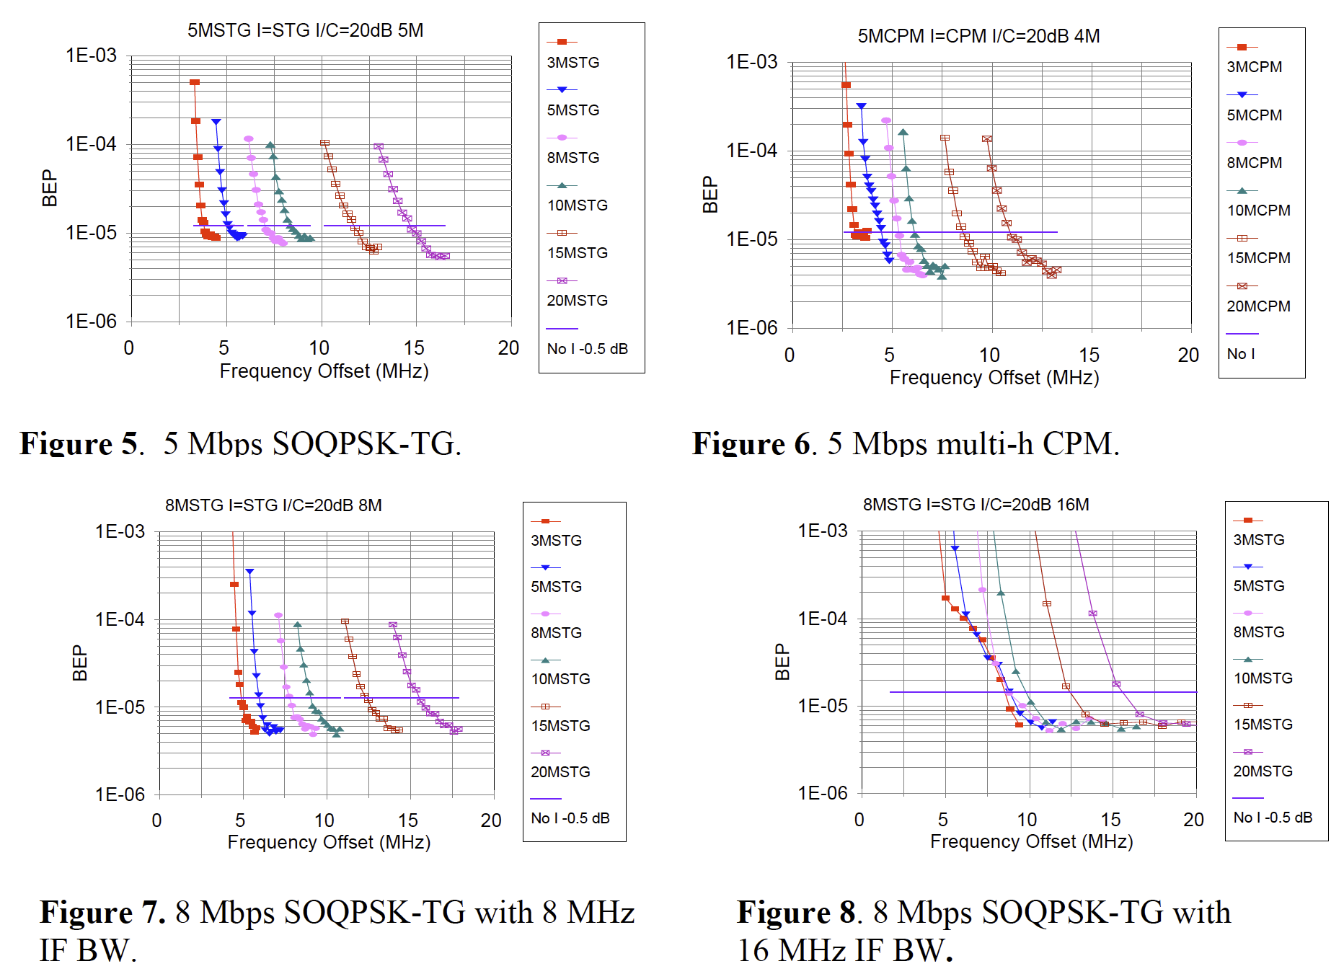
Degradation as a Function of ΔF
From Gene Law, “Recommended Minimum Telemetry Frequency Spacing With CPFSK, CPM, SOQPSK, and FQPSK Signals”, ITC 2003

Slide 41
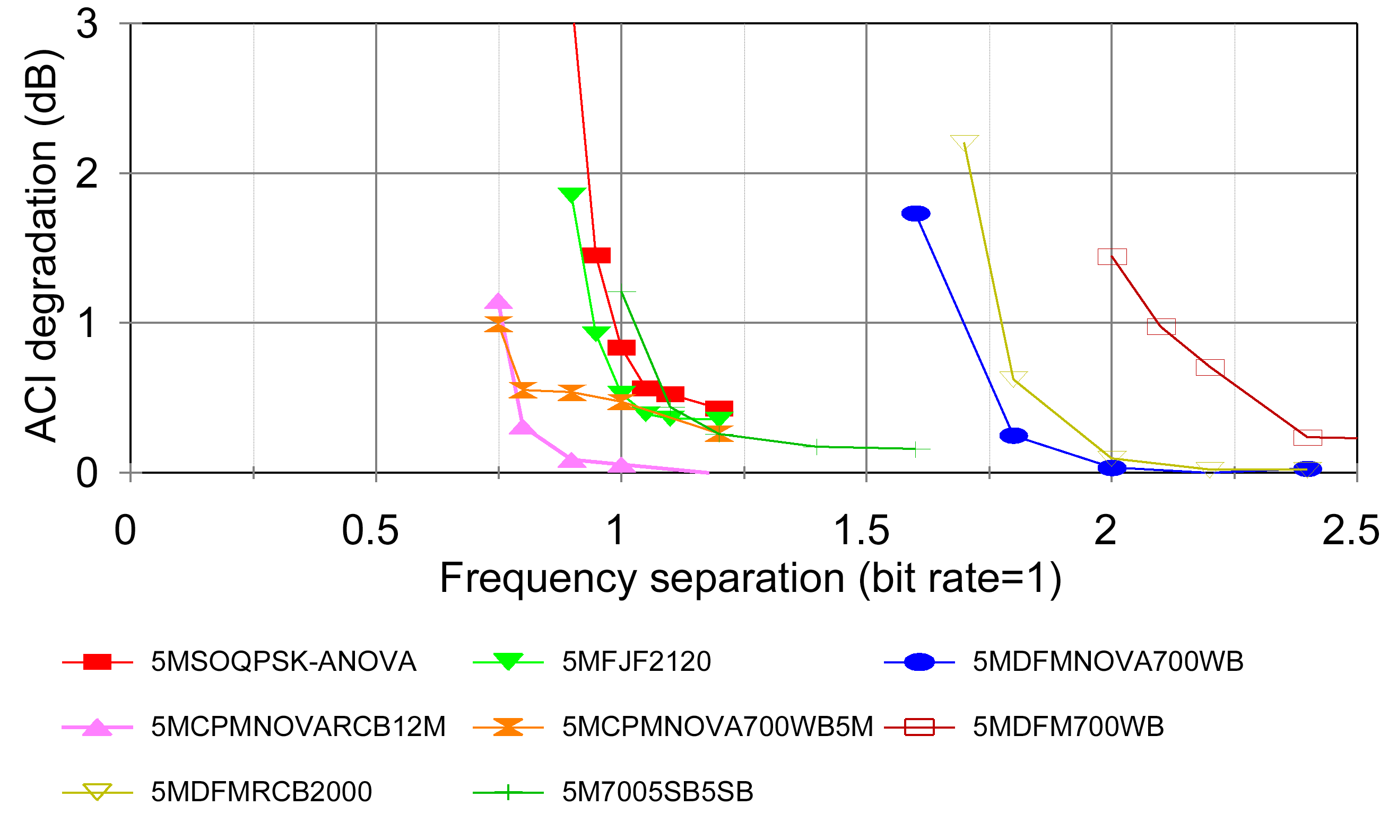
ACI Summary
I/C=20 dB
From Gene Law, “Recommended Minimum Telemetry Frequency Spacing With CPFSK, CPM, SOQPSK, and FQPSK Signals”, ITC 2003

Slide 42
Frequency Separation Rule
ΔF₀ = a_{s}*R_{s} + a_{i}*R_{i}
where:
  • ΔF₀ = the minimum center frequency separation in MHz
  • R_{s} = bit rate of desired signal in Mb/s
  • R_{i} = bit rate of interfering signal in Mb/s
The NRZ PCM/FM signals are assumed to be premodulation filtered with a multi-pole filter with 3 dB point of 0.7 times the bit rate and the peak deviation is assumed to be approximately 0.35 times the bit rate.
The receiver IF filter is assumed to be no wider than 1.5 times the bit rate and provides at least 6 dB of attenuation of the interfering signal.
The interfering signal is assumed to be no more than 20 dB stronger than the desired signal.
The receiver is assumed to be operating in linear mode; no significant intermodulation products or spurious responses are present.

Slide 43
Multipath Propagation
Brace yourself!
Greek symbols ahead!

Slide 44
Multipath Propagation
Airborne transmitter
Line-of-sight communications link
Narrow beam receive antenna
Low elevation angle
Irregular terrain
Dry lake bed = smooth reflecting surface
Figure from Dr.Michael Rice, BYU Telemetry Laboratory, Provo, Utah. Reprinted by permission of the author.

Slide 45
Assumptions
Channel can be modeled as a linear time-invariant (LTI) system over “short enough” time interval
Complex-valued path loss
Line-of-sight propagation path
L-1 multipath propagation paths
Figure from Dr.Michael Rice, BYU Telemetry Laboratory, Provo, Utah. Reprinted by permission of the author.

Slide 46
2-Ray Transfer Function
Magnitude of first multipath reflection: Γ₁
“sweep rate” of multipath null ~
(dB)
1 (0 dB)
Figure from Dr.Michael Rice, BYU Telemetry Laboratory, Provo, Utah. Reprinted by permission of the author.

Slide 47
3-Ray Transfer Function
M
1 (0 dB)
(dB)
(dB)
(2-Ray Model)
(3-Ray Model)
D
Figure from Dr.Michael Rice, BYU Telemetry Laboratory, Provo, Utah. Reprinted by permission of the author.

Slide 48
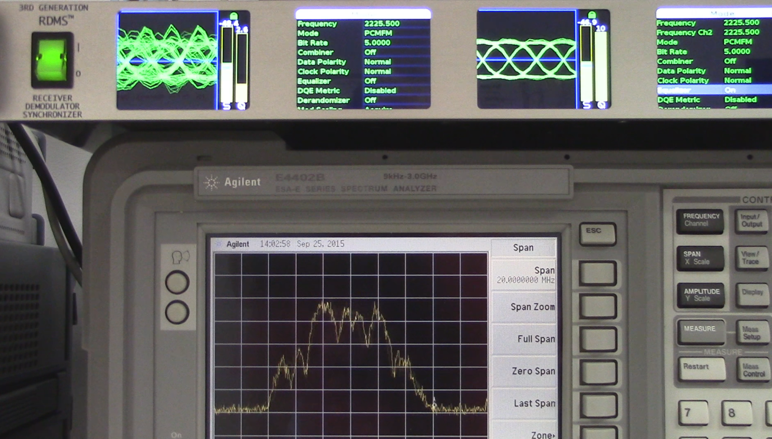
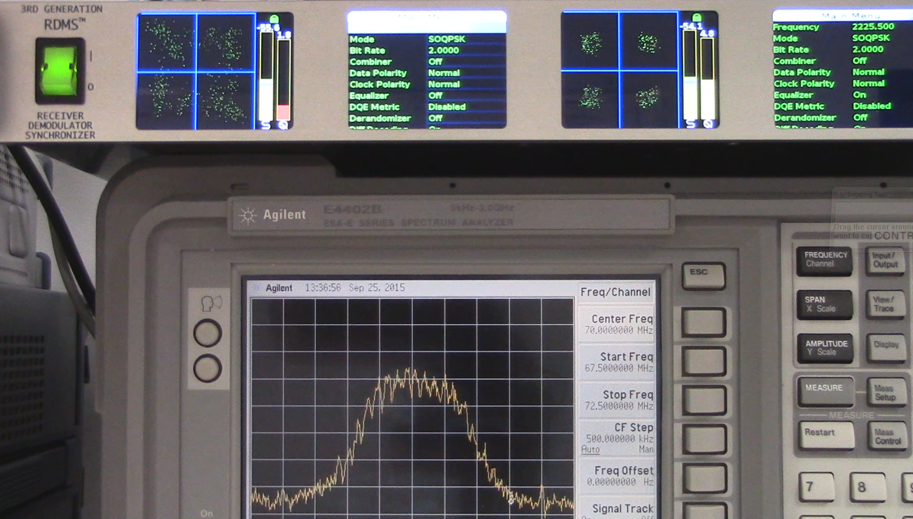
Multipath on the Tarmac
Nearly static, frequency selective, long delays

Slide 49
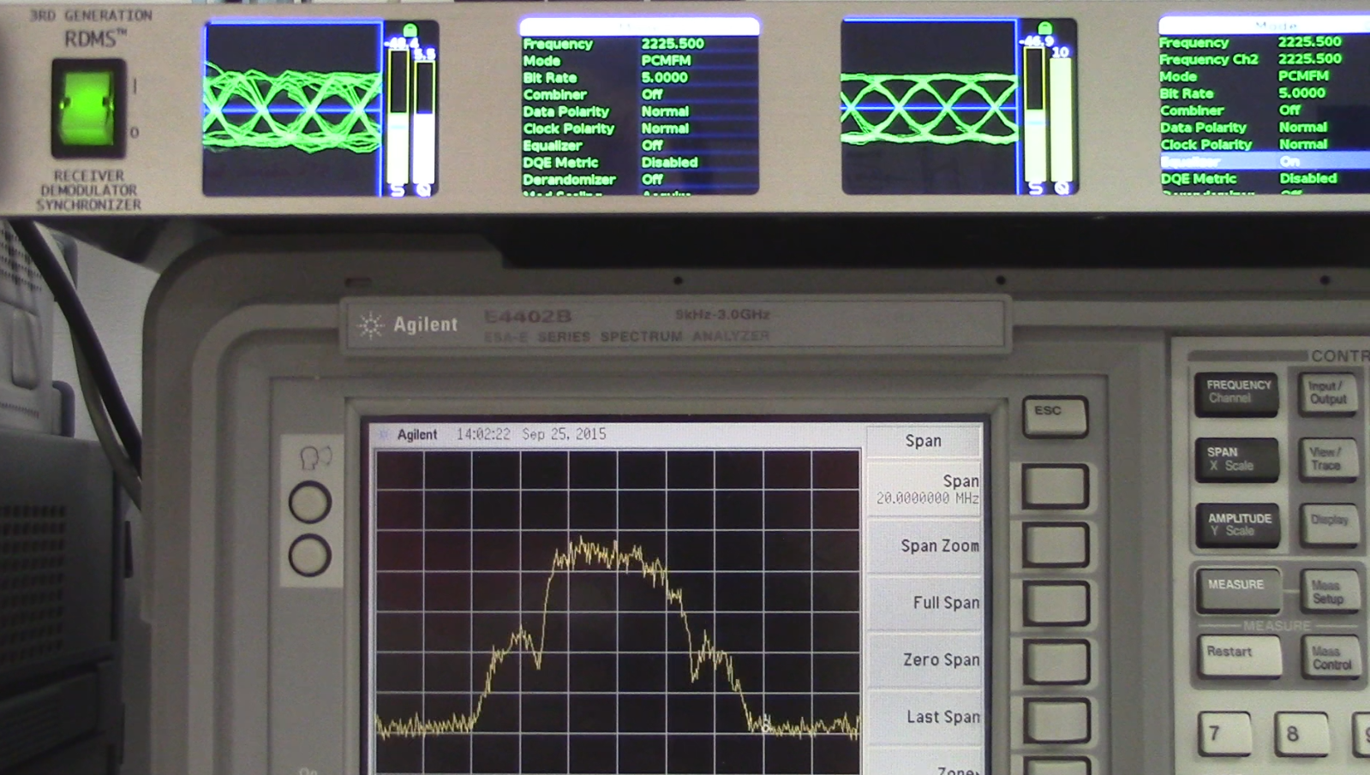
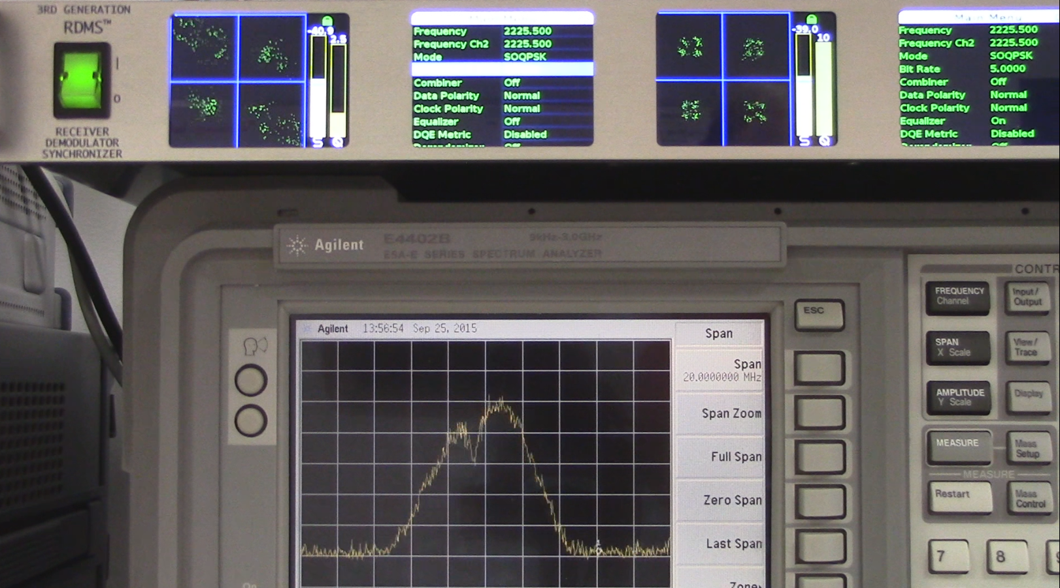

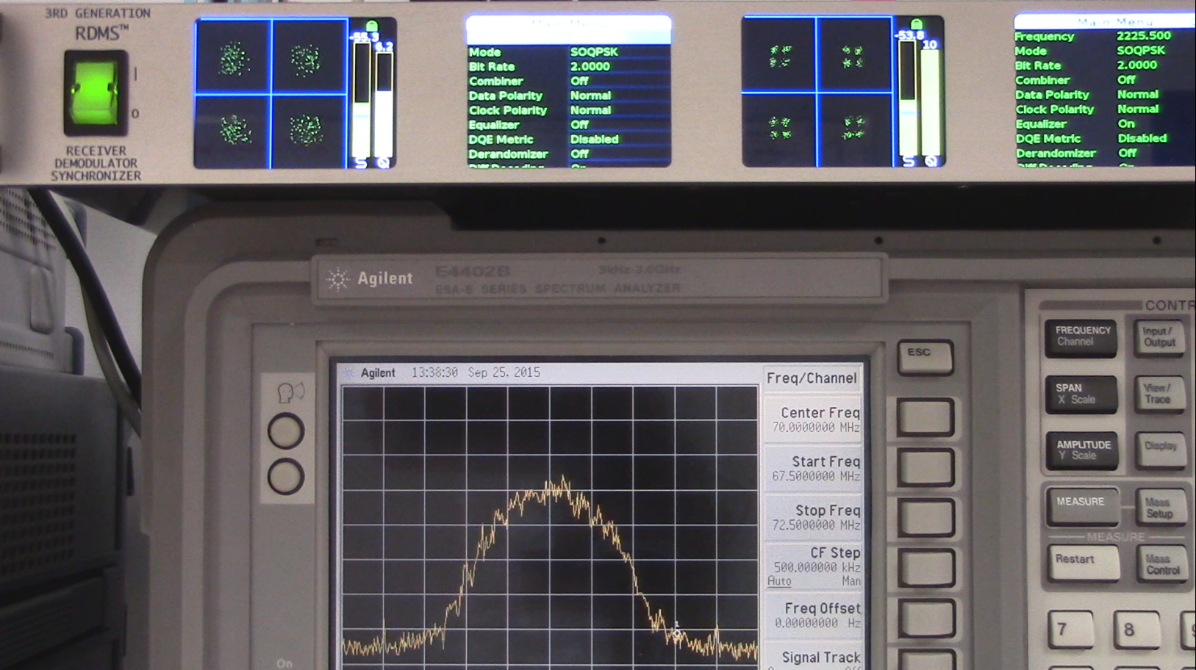
Multipath in Flight
Dynamic, frequency selective and flat fading, various delays

Slide 50
Multipath Summary
If your test article operates near the ground, you are quite likely experiencing multipath.
If so, there will be intervals during which no useful data is recovered.
Loss of bit count integrity is likely
  Encrypted links will lose crypto sync
What to do?
Stay tuned for the “Adaptive Equalizer” discussion

Slide 51
Adaptive Equalization

Slide 52
Multipath is Ugly
Equalization can turn
this into… this.
Actual multipath from aircraft on the tarmac at Edwards AFB

Slide 53
Adaptive Equalization
Consider the multipath channel to be a filter
  Varies over time
Consider building a filter which “undoes” the filtering imposed by the channel
  Let it keep track of the the channel and continuously adapt itself to the channel
Presto! You have an adaptive equalizer
  Can repair damage done by multipath
  Works with a single receiver
  Requires no bandwidth expansion
  Requires no changes to the transmitter

Slide 54
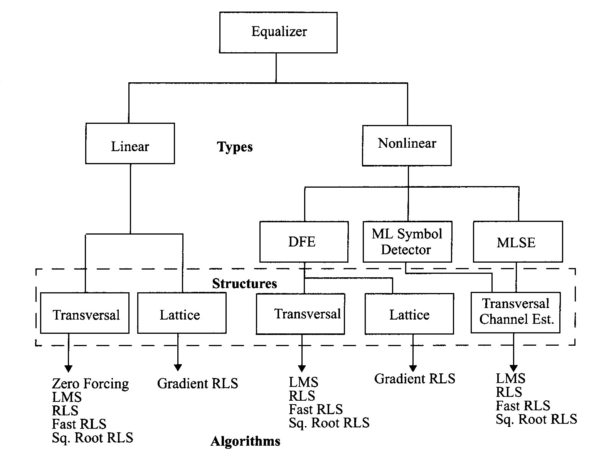
Equalizer Techniques
J.G. Proakis, Digital Communications. 1989 2nd Edition

Slide 55
Generic Adaptive Equalizer
Received Signal
Equalized
Signal
Transmitted Signal
RF
Channel
Equalizer
Decision
Device
Recovered
Data
Tap Weights
Equalizer
Adjustment
Error
Error
Calculation
Decision-Directed Mode
Training
Sequence
Symbol
Statistics
Training Mode
Blind Mode

Slide 56
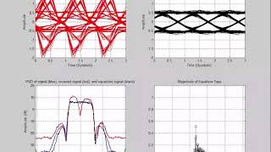
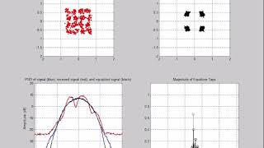
Adaptive EQ - Adapting
Jump to file: equalizer-out-pcmfm-3ray-dynamic-video.mp4
  Or, click to view on our website: PCMFM Adaptive Equalizer Video
Jump to file: equalizer-out-soqpsk-3ray-dynamic-video.mp4
  Or, click to view on our website: SOQPSK Adaptive Equalizer Video

Slide 57
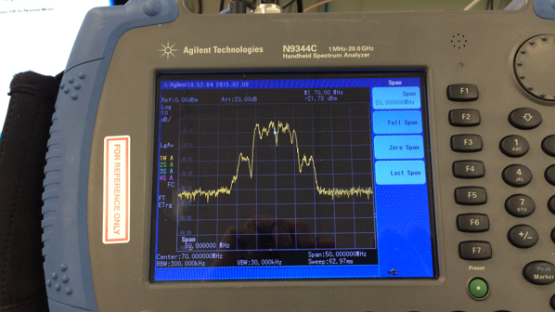
Adaptive Equalizer in Action
Jump to file: rdms-rackmount-receiver-adaptive-equalizer-demonstration-video.mp4
  Or, click to view on our website: Adaptive Equalizer Demonstration Video

Slide 58
Adaptive Equalizer Summary
Adaptive equalizer can “undo” multipath distortion
Requires no changes at the transmit end
  If available, a training sequence can be helpful
Effectiveness of equalizer depends on the severity of the multipath
Well-designed equalizers monitor their own performance and disengage when they are doing badly.
  This must be done without losing bit count integrity
If you have multipath, use an equalizer!

Slide 59
Performance Evaluation of Adaptive Equalizers

Slide 60
So Many Channels…
Each path is characterized by
  Delay
  Amplitude
  Phase shift (potentially time-varying)
2, 3, or more paths
Modulation matters
SNR matters
Need a 10-dimensional universe to plot the results
Way too many test points

Slide 61
Let’s Simplify
Stick to 2-ray model
  Easy to synthesize
  Still allows a range of channels from easy to impossible
  Maybe we add a third ray for a limited set of tests
Stick to one SNR
  High enough that the equalizer works on mitigating multipath, not rejecting noise
  Not so high that there are never any bit errors
  Should reflect actual use cases
  Propose 20 dB
Limited set of amplitudes and delays
Many phase angles

Slide 62
Proposed Signal Conditions
Pick a carrier frequency
  How many?
  Nulls “sweep faster” at higher frequencies (dynamic case only)
20 dB SNR (without multipath)
Tier 0, I, and II
  Tier 0: 1, 5, 10, 20 Mbps
  Tier I and Tier II: 2, 10, 20, and 40 Mbps
Areas for further research
  STC – different multipath on each signal, hmmm….
  LDPC – six codes?

Slide 63
Proposed Static Channels
Channel response depends on
  Carrier frequency,
  Delay,
  Reflection amplitude,
  Reflection phase,
Delays (in bits) of 0.5, 1, 2, 5, 10, 20, and 50
  Delays much shorter than 0.5 bit are essentially flat fades, where the signal power is simply gone. EQ cannot help.
Amplitudes of 0.5 to 0.9 in steps of 0.1
  For bonus points, include 0.95 and 0.98
Phases of 0° to 360° in 10° steps

Slide 64
What is the Measured Value?
Must be observable with EQ both on and off
Bit error rate is universally understood
DQM is readily computed from BER
  With calibration, DQM is much more quickly measured
Remind me again, what is DQM?

Slide 65
Definition of DQM (a.k.a. Q)
To a statistician, DQM is the “Log Likelihood Ratio”
Start with probability of error, P
  Be practical: 0.5 < P < 1e-12
  BEP, derived within demod
  BER, measured with a BERT
Likelihood Ratio (LR) = P / (1 – P)
Q = min (-log₁₀(LR), 12)
Easily reversed:
  P = 10^{-Q} / (1 + 10^{-Q})
Short version
  Q = 5 ➔ P = 1e-5
P | Q
0.5 | 0.000
1E-01 | 0.954
1E-02 | 1.996
1E-03 | 3.000
1E-04 | 4.000
1E-05 | 5.000
1E-06 | 6.000
1E-07 | 7.000
1E-08 | 8.000
1E-09 | 9.000
1E-10 | 10.000
1E-11 | 11.000
1E-12 | 12.000

Slide 66
DQM Calibration Fixture
Synthesize “impaired” RF signal
Recover the “corrupted” data (with clock)
Extract the frame sync word, including DQM
Measure BER of payload data
Compare DQM (converted to BEP) to measured BER
  Recorded and stored on a packet-by-packet basis

Slide 67
Test Procedure
Set frequency, modulation, and bit rate
Turn the equalizer off
Set E_{b}/N₀ to 20 dB
Set direct path to delay 0, amplitude 1, angle 0
Enable multipath
Set reflected path delay and amplitude
Loop through delayed path phase
  0 degrees to 360 degrees in 10 degree steps
  Record DQM at each step, or record BER and calculate DQM
  Plot DQM versus phase in polar form
Turn equalizer on and repeat
  If two test units are available, test EQ on and EQ off at the same time

Slide 68
Grading the Tests
Measure BER with EQ on and off, then compute DQM
  If your DQM is well calibrated, measure DQM directly
Plot DQM vs. delay path phase, in polar form
  Radius = DQM
  Angle = phase of delayed path
Result will be a distorted “hoop”
  Bigger radius is better
  Some angles will be worse than others
Compute the area of each “hoop” for EQ on and off
“Equalizer Benefit” = Area_{on} – Area_{off}
  Since the radius is (essentially) the logarithm of the BER, the difference is the number of orders of magnitude improvement in BER

Slide 69
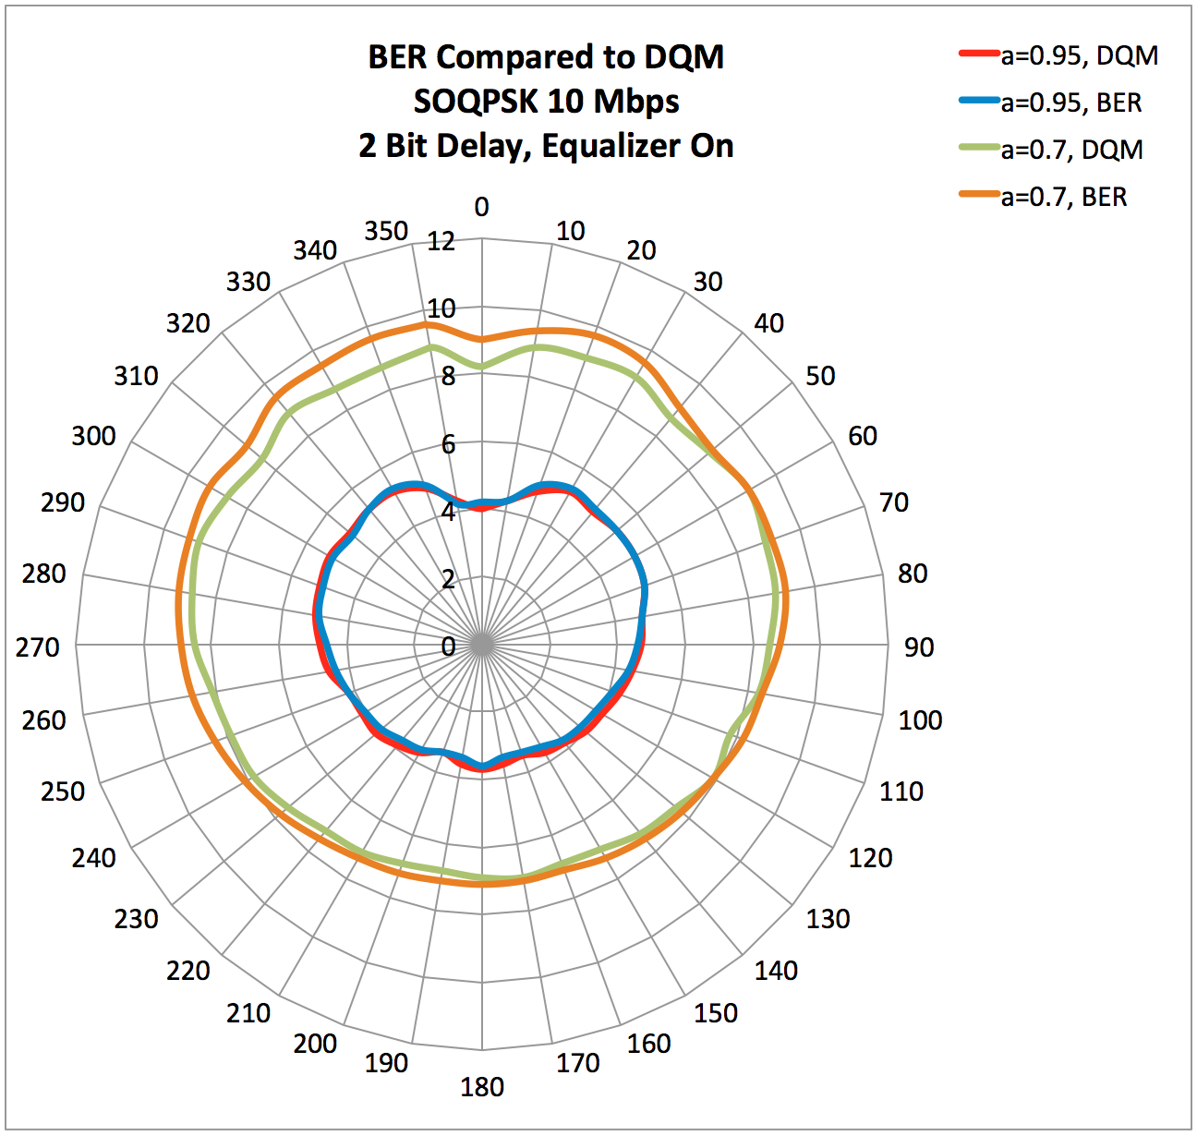
DQM Calibration

Slide 70
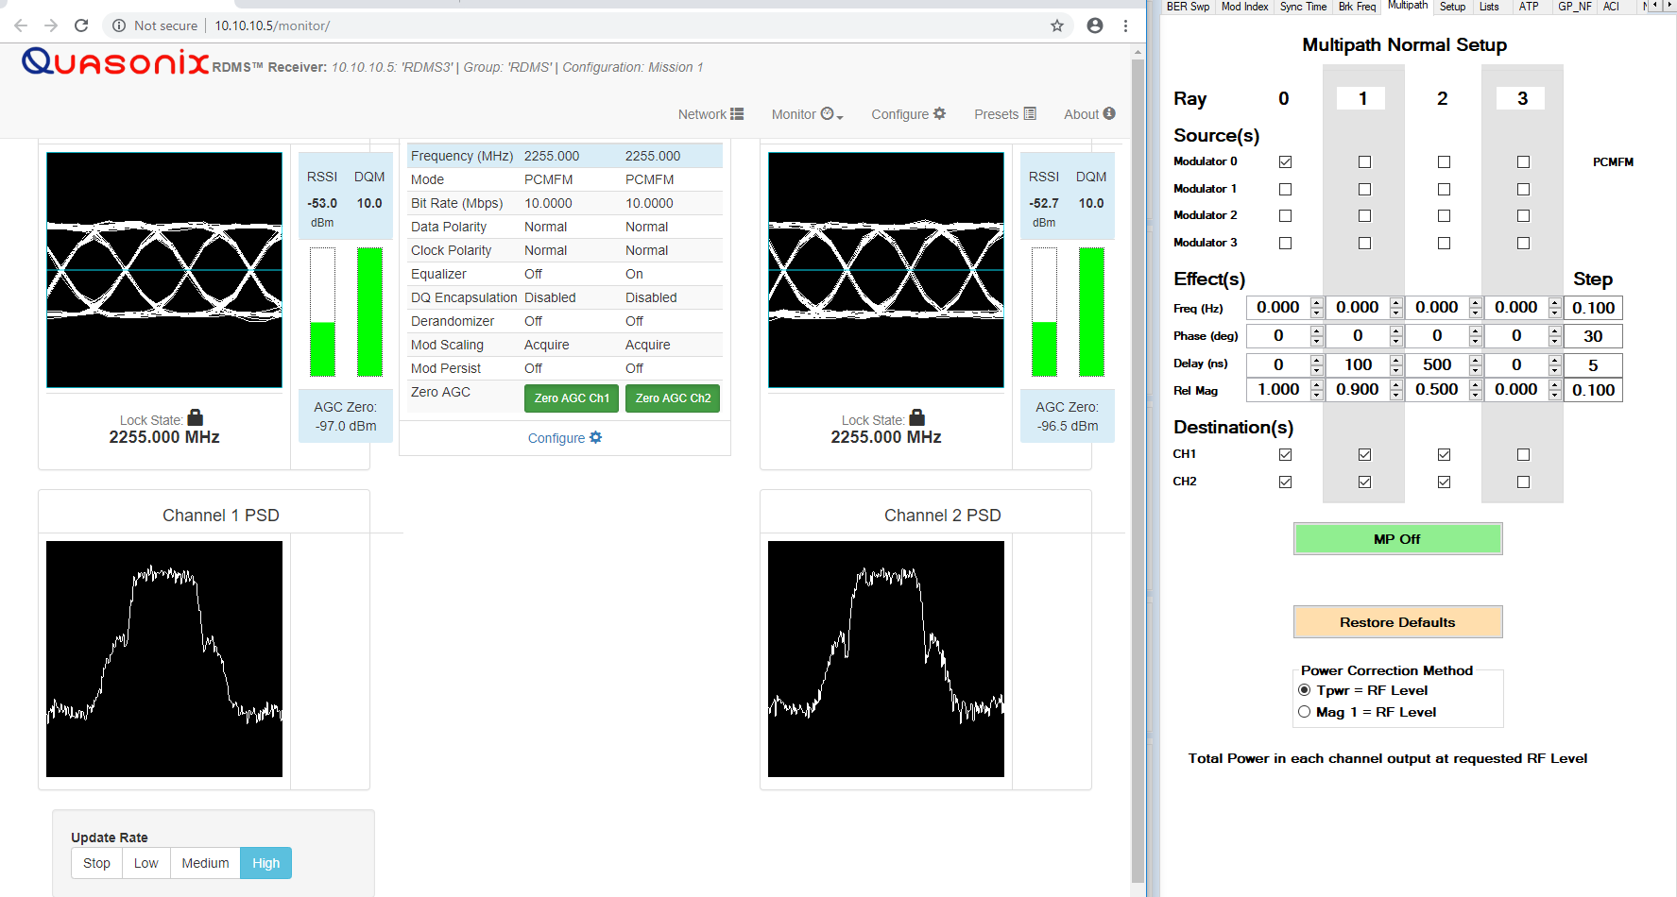
No Multipath, No Problem

Slide 71
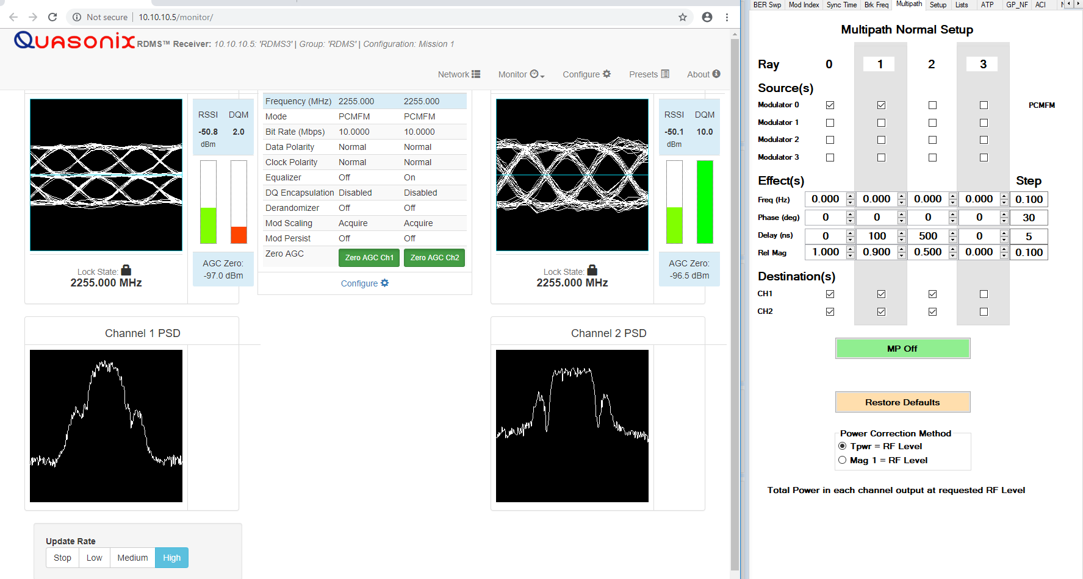
0-100-0.9

Slide 72
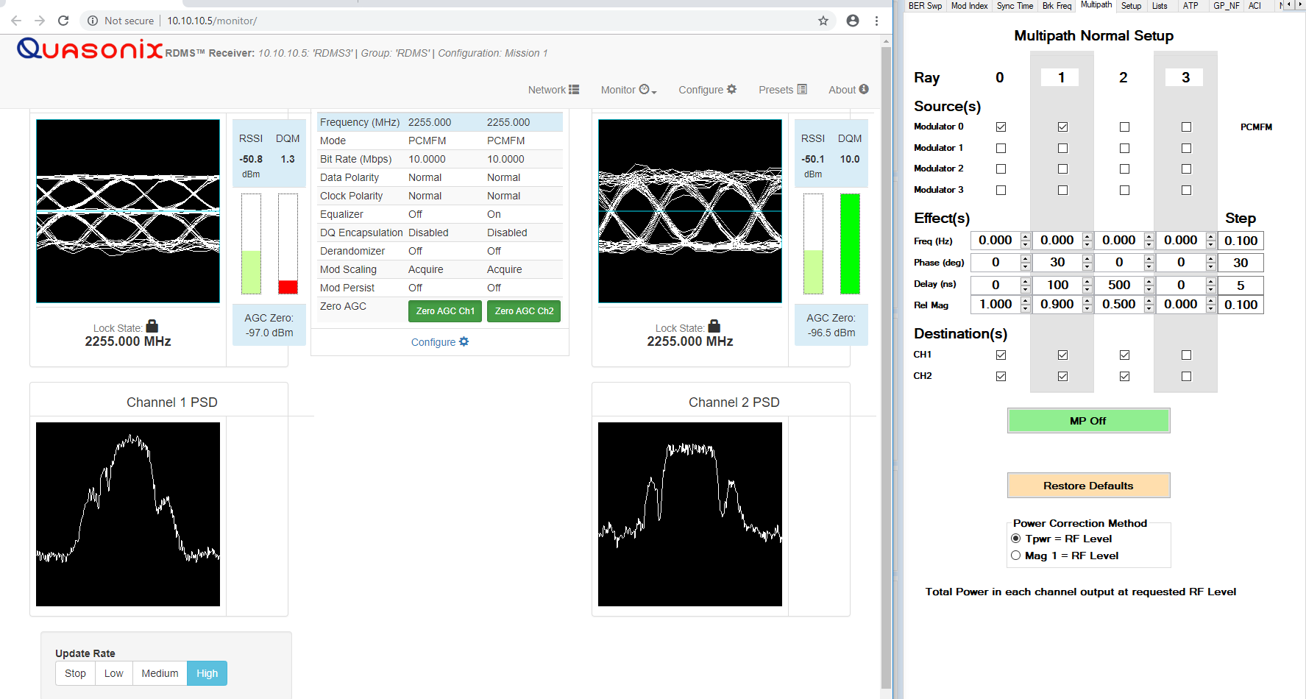
30-100-0.9

Slide 73
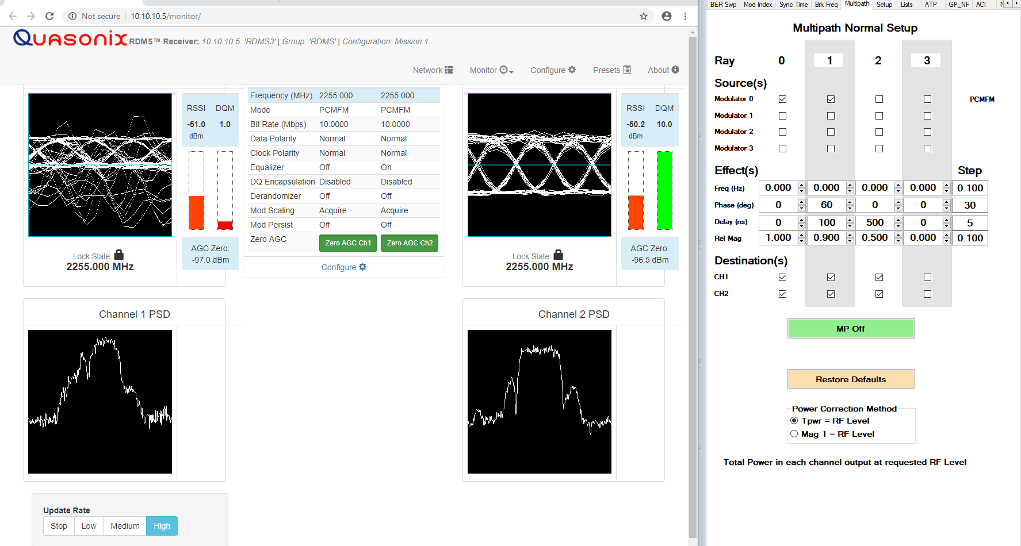
60-100-0.9

Slide 74
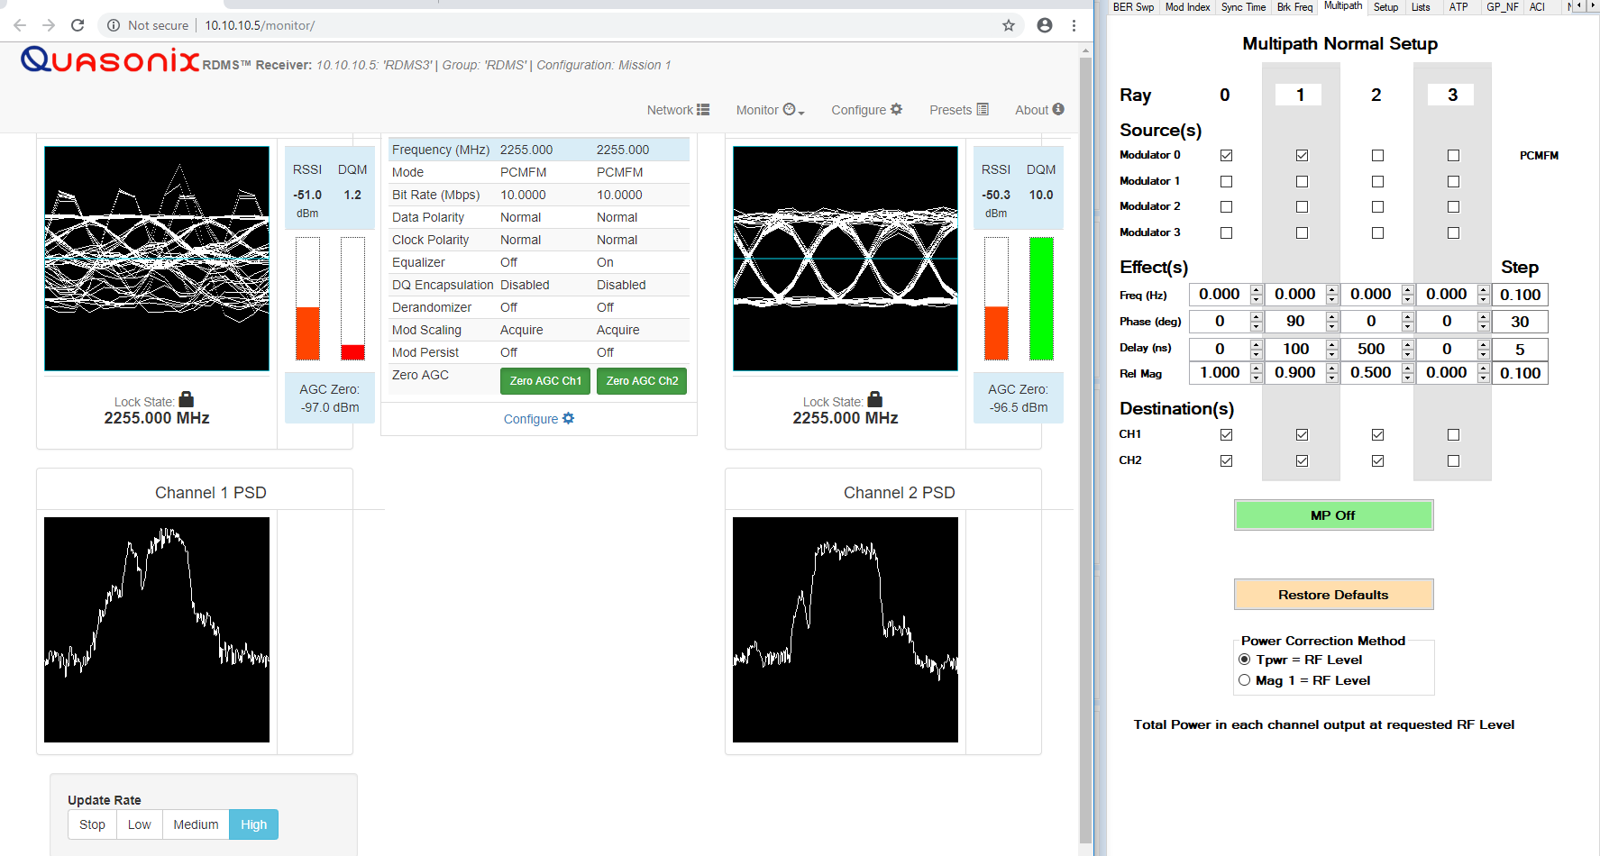
90-100-0.9

Slide 75
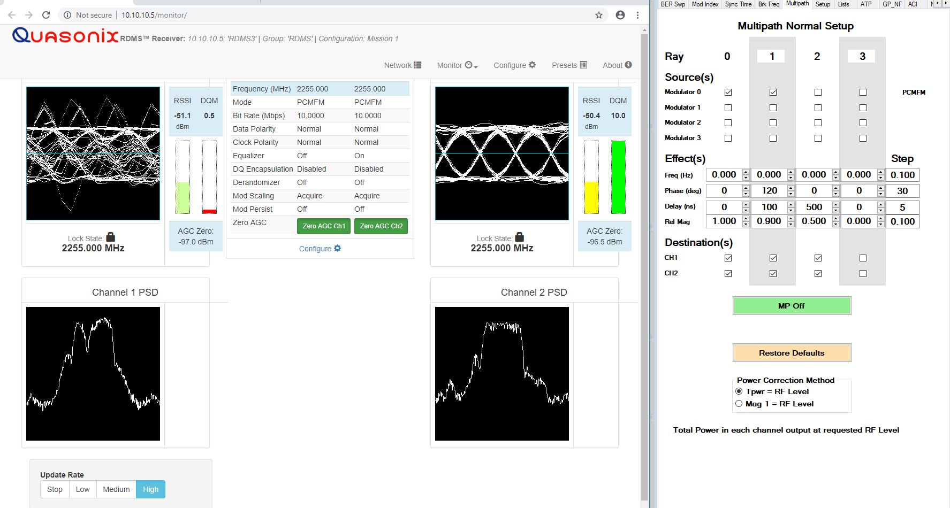
120-100-0.9

Slide 76
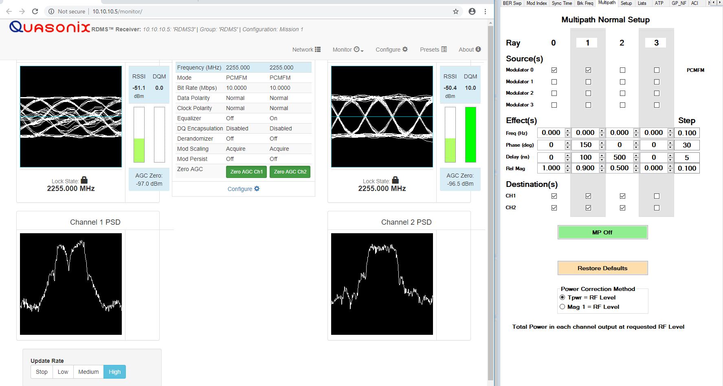
150-100-0.9

Slide 77
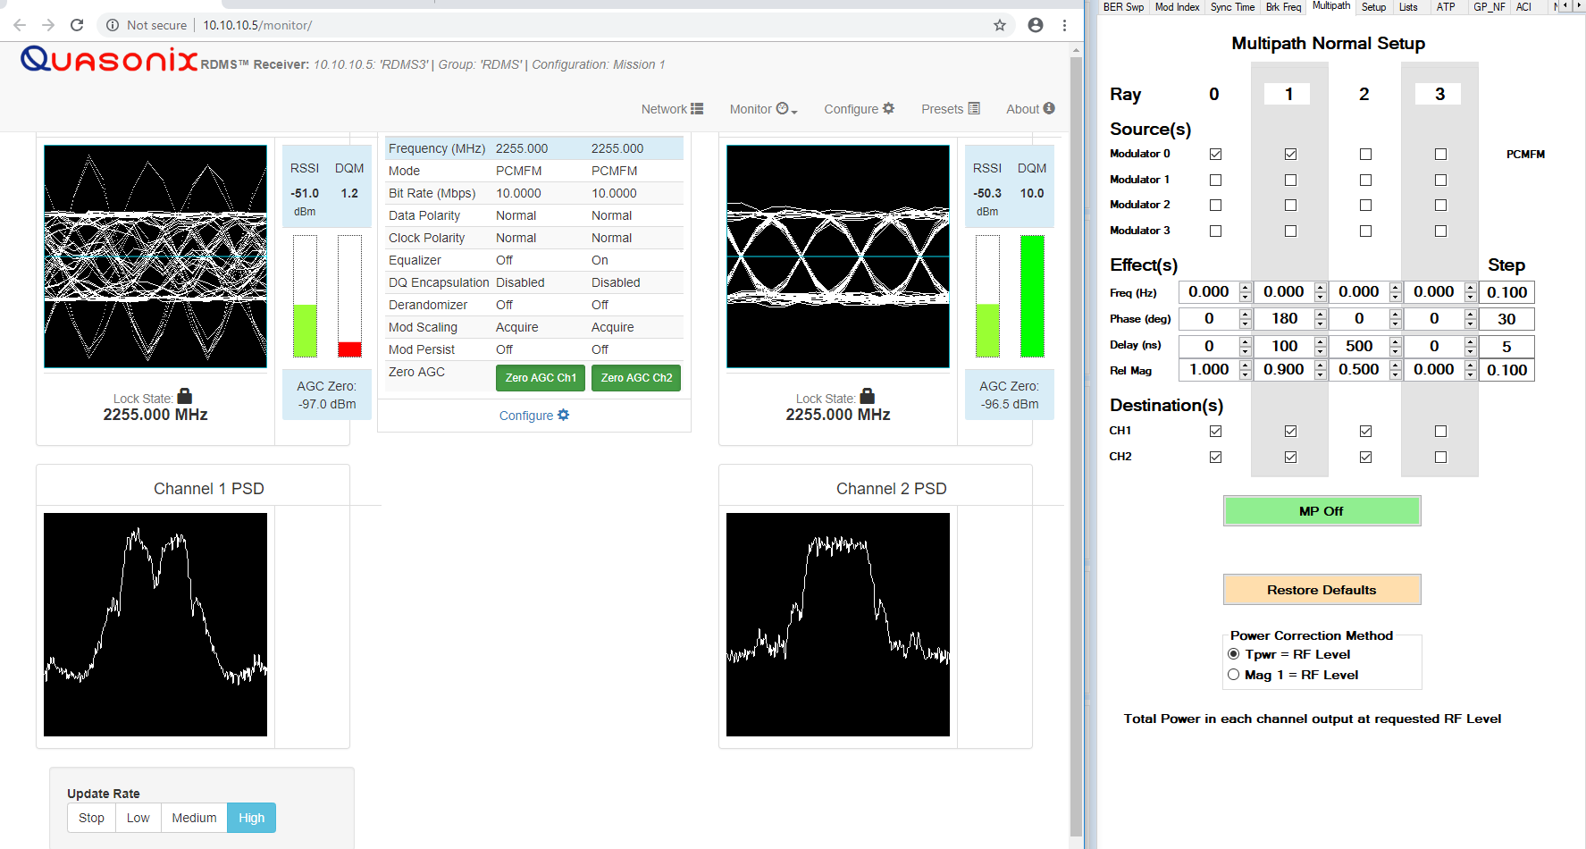
180-100-0.9

Slide 78

210-100-0.9

Slide 79

240-100-0.9

Slide 80

270-100-0.9

Slide 81

300-100-0.9

Slide 82
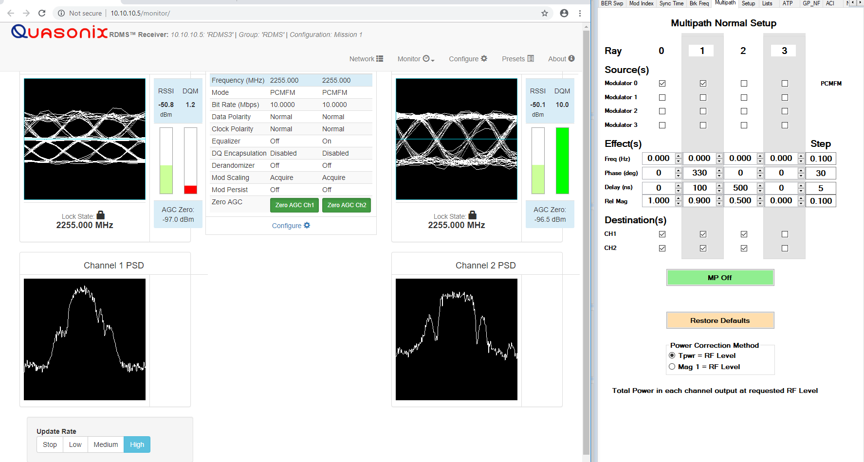
330-100-0.9

Slide 83
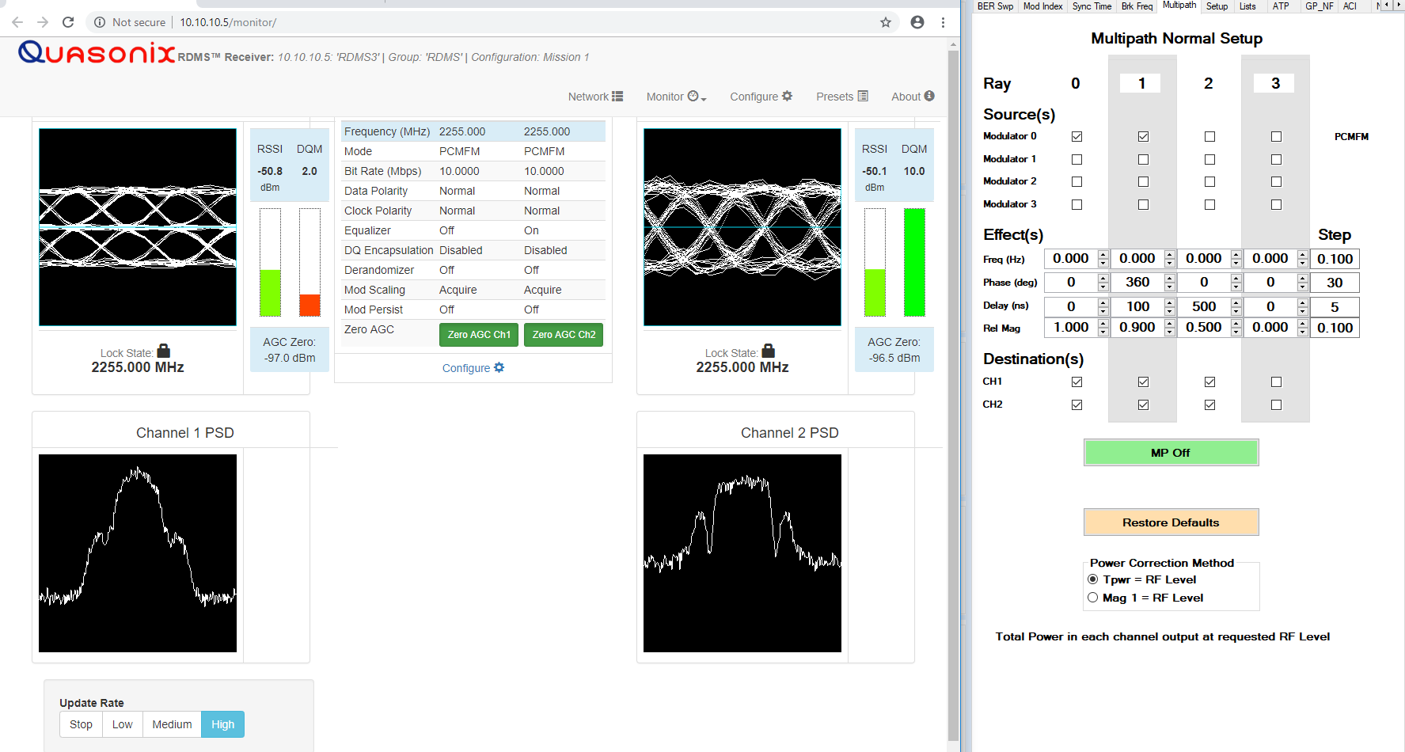
360-100-0.9

Slide 84
Test Results Examples

Slide 85
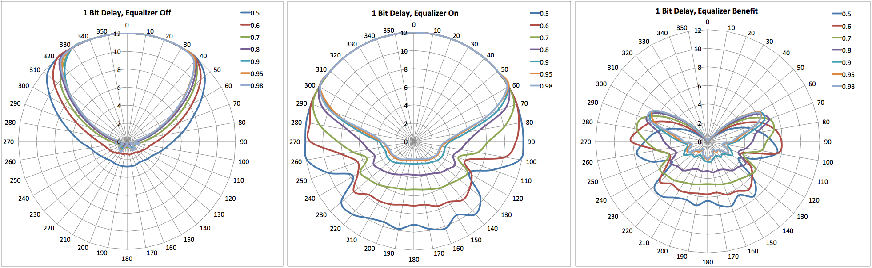
10 Mbps SOQPSK, 1 bit Delay

Slide 86
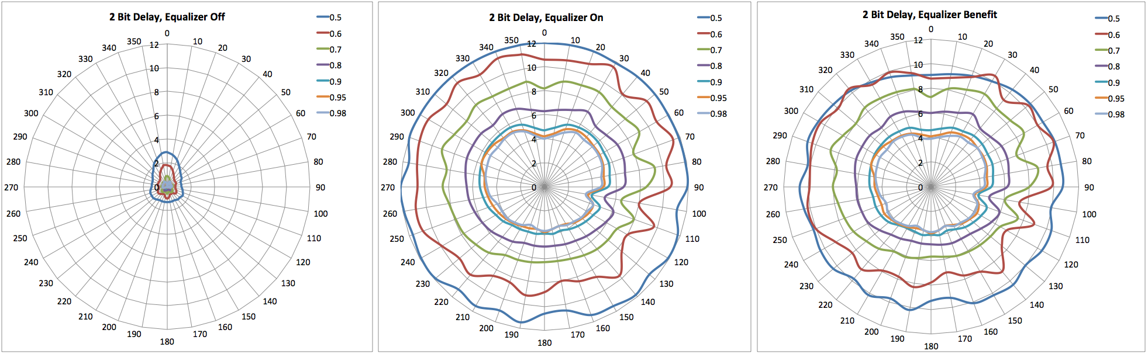
10 Mbps SOQPSK, 2 Bits Delay

Slide 87
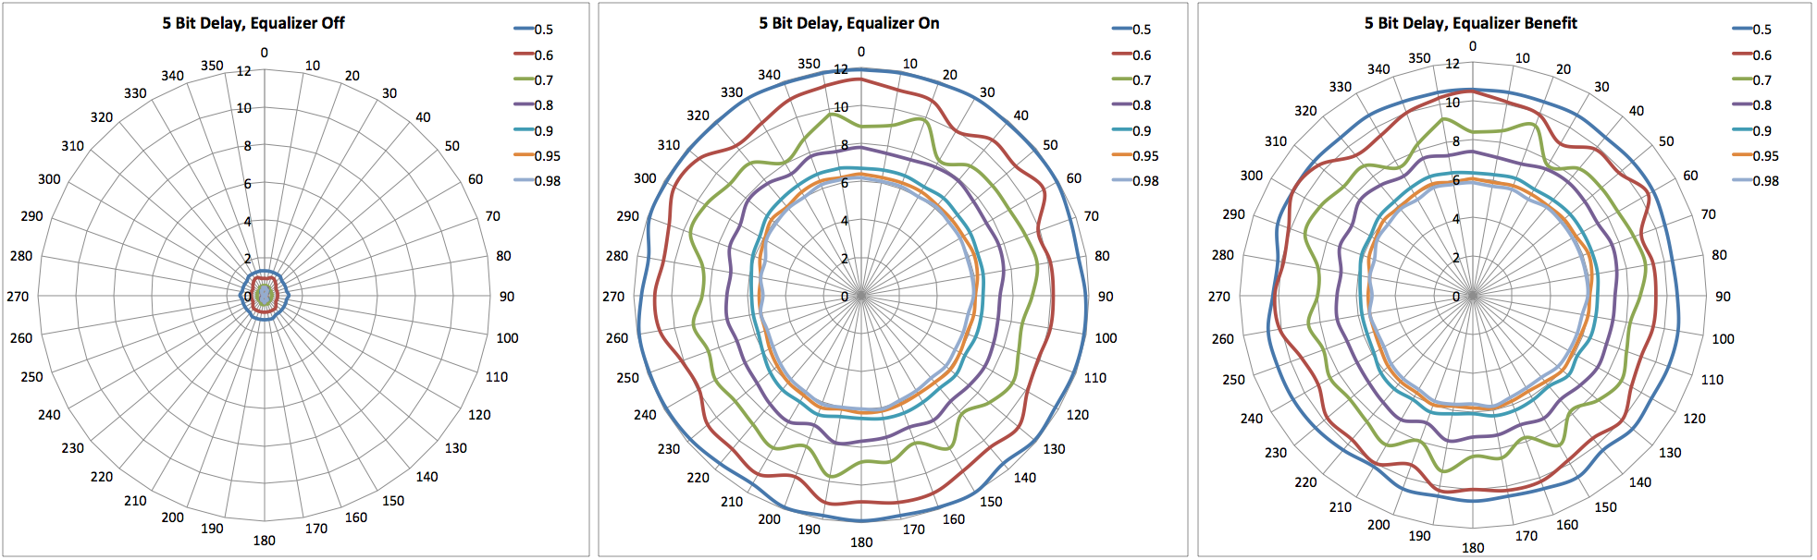
10 Mbps SOQPSK, 5 Bits Delay

Slide 88
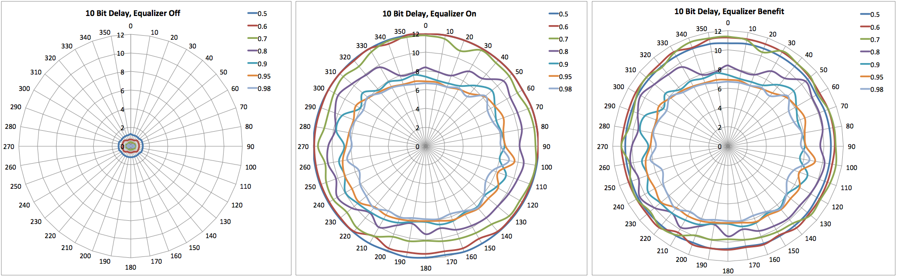
10 Mbps SOQPSK, 10 Bits Delay

Slide 89

10 Mbps SOQPSK, 20 Bits Delay

Slide 90
What About Dynamics?
Most pronounced effect of target motion is variation in phase of the reflected path
  Manifests as spectral nulls sweeping through spectrum
Proposal:
  Stress the equalizer by sweeping the null faster and faster, until the EQ benefit starts to drop.
  Similar to the Break Frequency test for combiners
Figure of merit becomes the “Break Frequency” of the equalizer

Slide 91
What Can we Measure?
Measure the BER, averaged over all phases
  Correlates with moving test article
  Convert to DQM
  Or measure DQM, but average it correctly (see next slide)
For consistency with the static plots, plot DQM versus “spin rate”
Plot multiple delay path amplitudes on one chart
Separate charts for each delay value

Slide 92

Equalizer Break Frequency

Slide 93
Course Outline – Day 3
Impairment Mitigation Techniques
  Adaptive Equalization
  Best Source Selection
  Best Channel Selection
  Space-Time Coding (STC)
  Low Density Parity Check (LDPC) Coding
Using All the Tools Together
Performance Comparison & Summary
Link Budgets

