Slide 1
Telemetry Smorgasbord
A Little Taste of Everything
Terry Hill, Quasonix
Spring 2020

Slide 2
Course Outline – Day 1
Performance Metrics
Continuous Phase Modulation (CPM)
  Tier 0
  Tier I
  Tier II
Demodulation
  Trellis vs. Single-Symbol
  Data Quality Metric
  Synchronization

Slide 3
Course Outline – Day 2
Demodulation
  Trellis vs. Single-Symbol
  Data Quality Metric
  Synchronization
Channel Impairments
  Adjacent Channel Interference
  Multipath Propagation
Impairment Mitigation Techniques
  Adaptive Equalization
  Diversity Combining
  Best Source Selection

Slide 4
Course Outline – Day 3
Impairment Mitigation Techniques
  Adaptive Equalization
  Diversity Combining
  Best Source Selection
  Best Channel Selection
  Space-Time Coding
  Forward Error Correction (FEC)
Using All the Tools Together
Performance Comparison & Summary
Link Budgets

Slide 5
Performance Metrics
Bandwidth Efficiency
  How much (or how little) spectrum do I need?
Information Fidelity
  How many of the bits are correct?
Bandwidth-Power plane

Slide 6
Power Spectral Density (PSD)

Slide 7
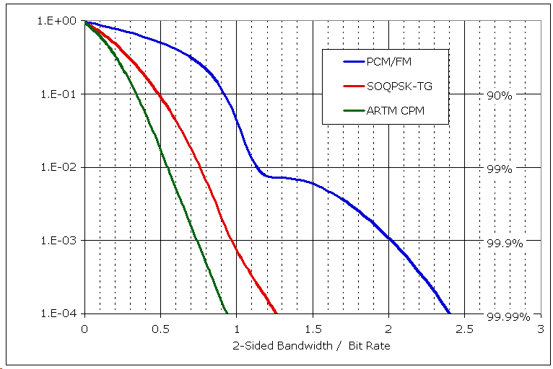
Fractional Out-of-band Power
5 Mbps

Slide 8
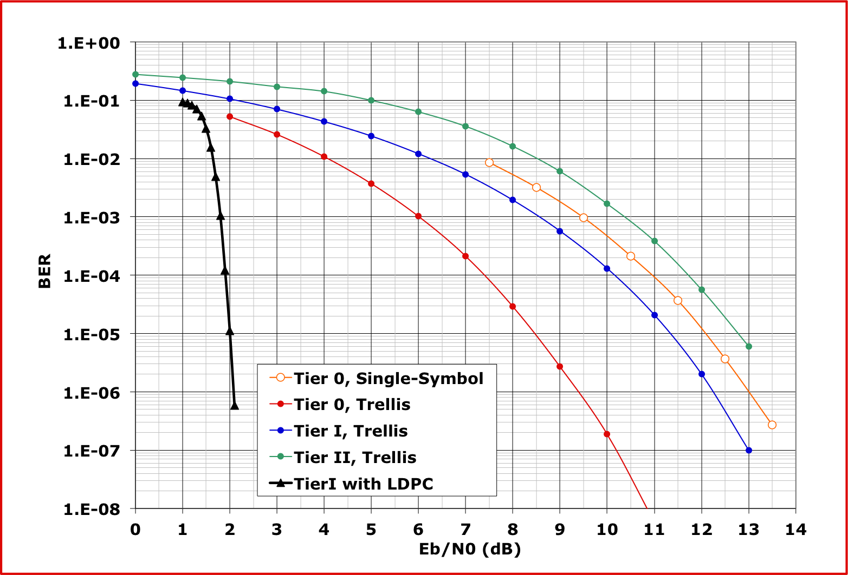
BER Performance Comparison

Slide 9
Bandwidth-Power Plane
Simultaneous representation of
  Bandwidth Efficiency (Bandwidth normalized to Bit Rate)
  Power Efficiency (Eb/No required to achieve 10⁻⁵ BEP)

Slide 10
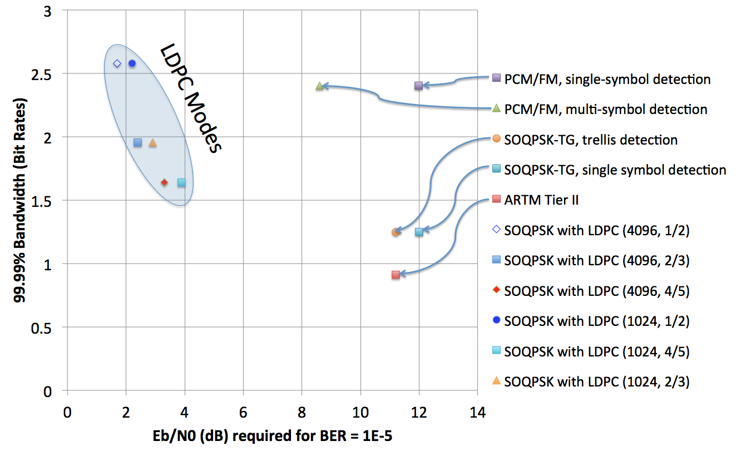
Today’s Modulation Tour

Slide 11
Continuous Phase Modulation

Slide 12
The Modulation Universe
Analog, Digital
Amplitude modulation
Quadrature amplitude modulation
Angle modulations
  Frequency modulation
  Phase modulation

Slide 13
Angle Modulations
Includes both frequency modulation and phase modulation
Some have an amplitude modulation component
  BPSK
  QPSK
  Offset QPSK
Some are constant envelope
  Binary FM
    FSK, MSK, premod filtered MSK, GMSK
  M-ary FSK
  SOQPSK
  Multi-h continuous phase modulation
  No amplitude variation
Saturated power amplifiers are ideal for constant envelope waveforms

Slide 14
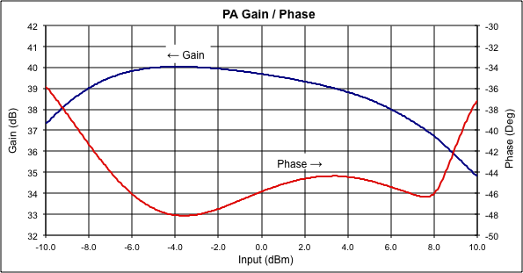
Saturated Power Amplifiers
DC-to-RF conversion efficiency is important
  Minimizes cooling requirements
  Maximizes battery life
Maximizing efficiency demands nonlinear operation
Non-linear operation creates AM-AM and AM-PM conversion:

Slide 15
Constant Envelope Modulations
Before ARTM (Tier 0)
  PCM/FM
  “Legacy” waveform for telemetry
Advanced Range Telemetry (ARTM) Program
  ARTM Tier 1
    Proprietary Feher-patented FQPSK
      FQPSK-B, Revision A1
      FQPSK-JR
    SOQPSK-TG
      Equivalent in performance to FQPSK
      Non-proprietary
  ARTM Tier 2
    Multi-h CPM (M=4, L=3RC, h1 = 4/16, h2 = 5/16)
PCM/FM, SOQPSK and Multi-h CPM are all continuous phase modulations (CPM)

Slide 16
CPM Notation and Parameters
-∞< t <+∞
Where α_{i} represents an M-ary symbol sequence
  α_{i} derived from input bits d_{i}
h is the modulation index
g(t) is the frequency pulse shape in the interval 0 < t < LT
  L = 1 is “full response” signaling
  L > 1 yields “partial response”
CPM is a modulation with memory due to the constraint of continuous phase. Further memory is introduced with L > 1.

Slide 17
ARTM Tier 0
(PCM/FM)
(CPFSK)
The way things were

Slide 18
Tier 0 in CPM Notation
-∞< t <+∞
M = 2 (binary)
α_{i} = 2d_{i} - 1
  d_{i} = {0, 1}, α_{i} = {-1, +1}
h = 0.7
g(t) is the normalized impulse response of a high order Bessel filter with 3 dB bandwidth = 0.7 * bit rate
  Normalized such that the integral over all time = 1/2

Slide 19
PCM/FM as a Phase Modulation

Slide 20
Power Spectral Density (PSD)

Slide 21
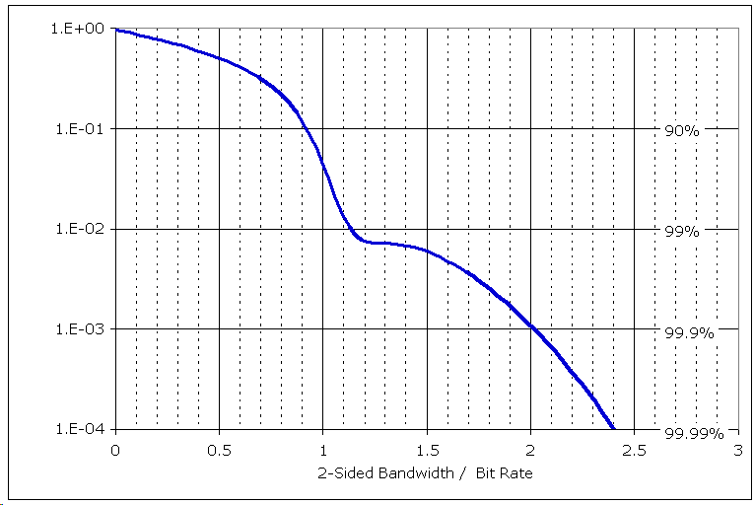
Fractional Out-of-band Power
5 Mbps

Slide 22
PCM/FM Summary
Legacy waveform
  Equipment is ubiquitous
Constant envelope
Several practical implementations
99.9% bandwidth: 2.03 times bit rate
M | α_{i} | h | g(t)
2 | {-1, +1} | 0.7 | Normalized impulse response of a high order Bessel filter with 3 dB bandwidth = 0.7 * bit rate

Slide 23
ARTM Tier I
(SOQPSK-TG)
The way things are

Slide 24
SOQPSK in CPM Notation
-∞< t <+∞
M = 3 (ternary)
α_{i} = {-1, 0, +1}
  a_{i} = 2d_{i} - 1
  a_{i} = {-1, +1}, d_{i} = {0, 1}
h = 0.5
g(t) = windowed impulse response of spectral raised cosine
  Normalized such that the integral over all time = 1/2

Slide 25
SOQPSK-TG Phase Tree

Slide 26
Measured PSD (Tier 0 & 1)

Slide 27
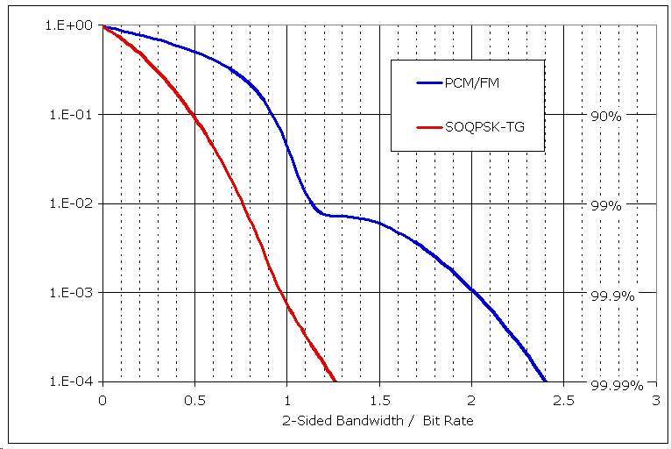
Fractional Out-of-band Power
Often-cited factor of two
5 Mbps

Slide 28
Shaped Offset QPSK Summary
Constant envelope, CPM waveform
Adjustable shaping factor for BW and detection efficiency trade-off
Improved spectral containment over OQPSK
Compatible with standard OQPSK receivers and demodulators
Adopted as an ARTM Tier I waveform
99.9% bandwidth: 0.98 times bit rate
Interoperable with FQPSK
M | α_{i} | h | g(t)
3 | {-1, 0, +1} | 0.50 | Normalized windowed impulse response of a spectral raised cosine

Slide 29
ARTM Tier II
(ARTM CPM)
(Multi-h CPM)
The way things can be

Slide 30
ARTM Tier II in CPM Notation
-∞< t <+∞
M = 4 (quaternary)
α_{i} = 2 [2d_{1i} + d_{0i}] - 3
  α_{i} = {-3, -1, +1, +3}
  d_{i} = {0, 1}
h = {4/16, 5/16}, alternating
g(t) = raised cosine, 3 symbols (6 bits) in duration
  Normalized such that the integral over all time = 1/2

Slide 31
Frequency Pulse & Phase Tree

Slide 32
PSD (Tier 0, I, & II)

Slide 33
Fractional Out-of-band Power
5 Mbps

Slide 34
Tier II Multi-h CPM Summary
Similar detection efficiency to PCM/FM.
Constant envelope waveform is ideal for efficient non-linear PA’s.
Enhanced performance gained by increasing demodulator complexity.
99.9% bandwidth: 0.75 times bit rate
M | α_{i} | h | g(t)
4 | {-3, -1, +1, +3} | {4/16, 5/16} | Normalized raised cosine, 3 symbols (6 bits) long

Slide 35
Side by Side Summary
Tier | M | α_{i} | h | g(t) | 99.9% BW
0 | 2 | {-1, +1} | 0.7 | Normalized impulse response of a high order Bessel filter with 3 dB bandwidth = 0.7 * bit rate | 2.03
I | 3 | {-1, 0, +1} | 0.5 | Normalized windowed impulse response of a spectral raised cosine, 8 bits long | 0.98
II | 4 | {-3, -1, +1, +3} | {4/16, 5/16} | Normalized raised cosine, 3 symbols (6 bits) long | 0.75

Slide 36
Demodulation

Slide 37
Demodulation
As the shop manual says, “Installation is reverse of removal.”
Demodulation is intrinsically more difficult
  Unknown carrier frequency
  Unknown carrier phase
  Unknown clock frequency and phase
  Signal corruption
    Noise
    Interference
    Multipath
    Doppler shift
Multiple techniques can be applied

Slide 38
Single-Symbol Demodulation
Tier 0
  Legacy (nearly exclusive in 20th century)
  Simple to build
  Robust to signal defects and channel impairments
  ~3.5 to 5 dB short of theoretical limit
Tier I
  Requires optimization for SOQPSK
  Weakly synchronized
  Requires high SNR for acquisition
  ~1.0 to 1.5 dB short of theoretical limit
Tier II
  No practical single-symbol detectors

Slide 39
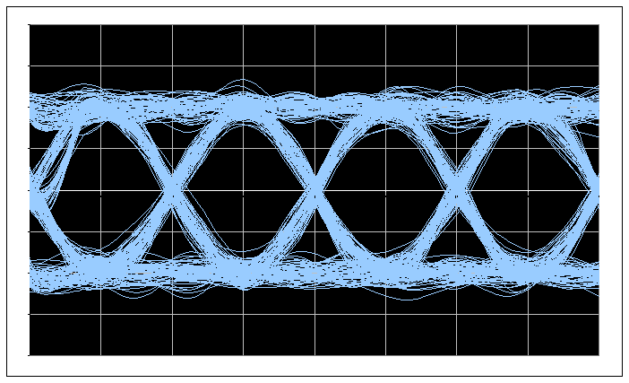
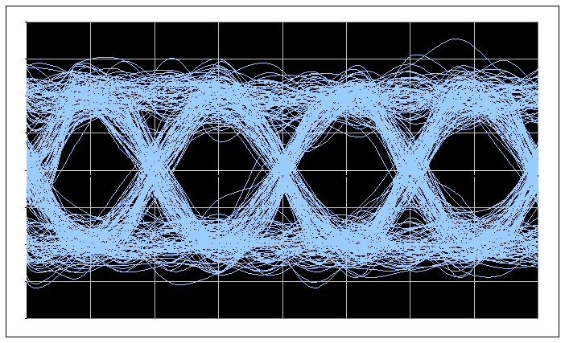
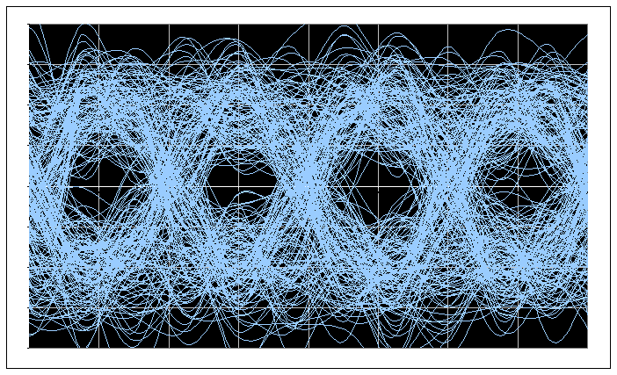
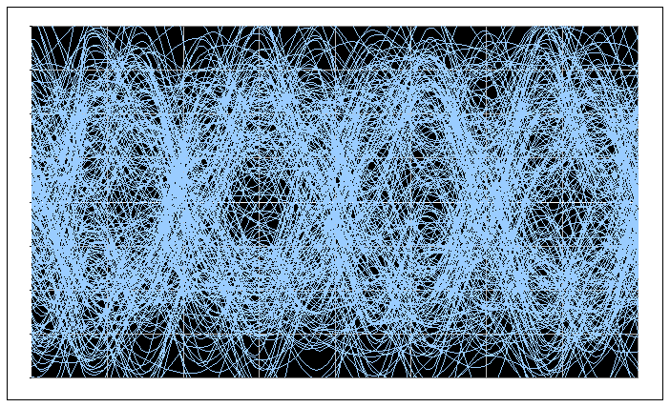
Tier 0 Frequency Detection

Slide 40
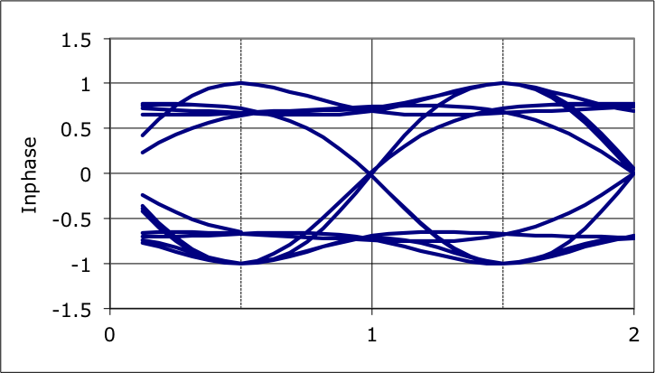
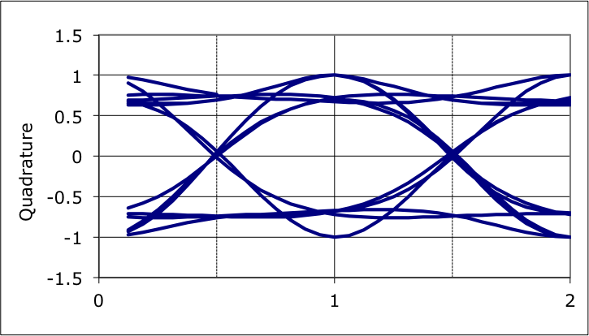
SOQPSK-TG Eye Patterns
Single-symbol detection ignores memory inherent in waveform
Can be detected by conventional (non-shaped) offset QPSK demod
I&D detector endures additional loss due to waveform mismatch

Slide 41
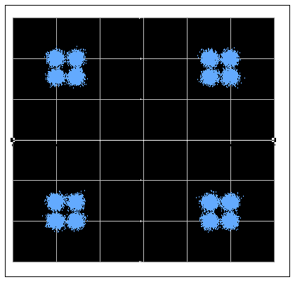
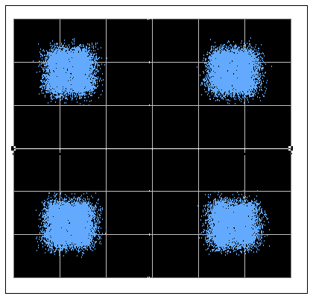
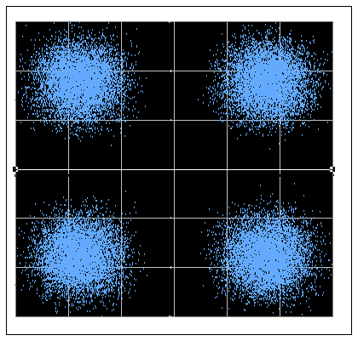
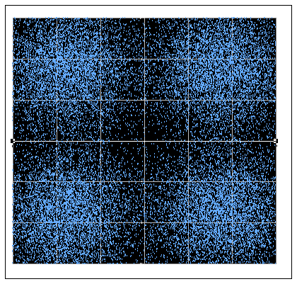
SOQPSK Constellations

Slide 42
Waveform Comparison
PCM/FM (1x) SOQPSK (2x) Multi-h CPM (2.5x)

Slide 43
Trellis Demodulation Overview
Tier 0
  Invented in 1974, introduced in 2001
    Osborne & Luntz, “Coherent and Noncoherent Detection of CPFSK”, IEEE T-COM, August 1974
  Requires significant signal processing power
  Signal defects and channel impairments require attention
    DSP techniques can be applied to solve these issues
  Operates within 0.2 dB of theoretical limit
Tier I
  Strong, rapid synchronization
  Operates within 0.2 dB of theoretical limit
Tier II
  Mandatory for practical implementation

Slide 44
Tier 0 Phase Tree
h = 0.7
A multi-symbol detector finds the data sequence that best fits the observed phase trajectory

Slide 45
Why Does It Matter?
Multi-symbol detector decides “one” – correcting the error
If this bit is different, the phase trajectory is forever shifted…
Therefore, later bits can help make decisions about earlier bits.
Noise-corrupted trajectory
Single-symbol detector decides “zero”

Slide 46
Multi-Symbol Detector Example
Brute force approach – yields performance gain, but leads to extreme hardware complexity

Slide 47
Tier 0 BER Performance

Slide 48
Legacy PCM/FM Transmitters
h = 0.8
h = 0.7
h = 0.6

Slide 49
Effect of TX Deviation Error

Slide 50
What About Phase Noise?
No phase noise:
The entire trellis is helpful
Minimal phase noise:
Several bits of the trellis are helpful
Significant phase noise:
A few bits of the trellis are helpful
Severe phase noise:
Not a candidate for trellis demodulation

Slide 51
Phase Noise
Trellis demodulation is based on the assumption that the signal is following a predictable path through the trellis.
If this is not true (due to high phase noise), then a trellis demodulator may not provide the expected performance gain
Most often an issue at low bit rates
Some trellis demods handle this case by modifying the trellis calculations.

Slide 52
SOQPSK Detection
Can be detected by conventional (non-shaped) offset QPSK demod
Non-matched filtering loss of about 2 dB
Butterworth lowpass filter is reasonable approximation to matched filter
Trellis detection is optimum, but more complex

Slide 53
SOQPSK-TG Phase Tree

Slide 54
Multi-h CPM Detection
Modulator intentionally creates severe inter-symbol interference
  3-symbol RC premod filter
Symbol-by-symbol detection is essentially useless
Trellis detection is required

Slide 55
BER Performance Comparison

Slide 56
Course Outline – Day 2
Demodulation
  Trellis vs. Single-Symbol
  Data Quality Metric
  Synchronization
Channel Impairments
  Adjacent Channel Interference
  Multipath Propagation
Impairment Mitigation Techniques
  Adaptive Equalization
  Diversity Combining
  Best Source Selection

