Slide 1
Meaningful G/T Measurements – Made at Night
International Telemetering Conference
October 2023

Slide 2
Why Do We Care About G/T?
Short-term checkup
Is it the same as last week, last month…
This does not require an accurate absolute value
Relative to previous measurements is all we need
Long-term planning
G/T is an additive term in the link budget
If it’s short of the predicted value, your link margin will be short
This requires a “real” value
How do we get it?

Slide 3
Solar-Noise G/T Method
Point antenna at the sun, get P_{h} in dBm
Point at cold sky, get P_{c} in dBm
Y_{dB} = P_{h} - P_{c}
Calculate Y factor: Y = 10^(Y_{dB}/10)
Estimate Fudge Factors
C = Beam correction factor
A = Atmospheric attenuation factor
$\left(\frac{G}{T}\right) =$ $\left(\frac{8πk(Y−1)}{S0λ2CA}\right)$

Slide 4
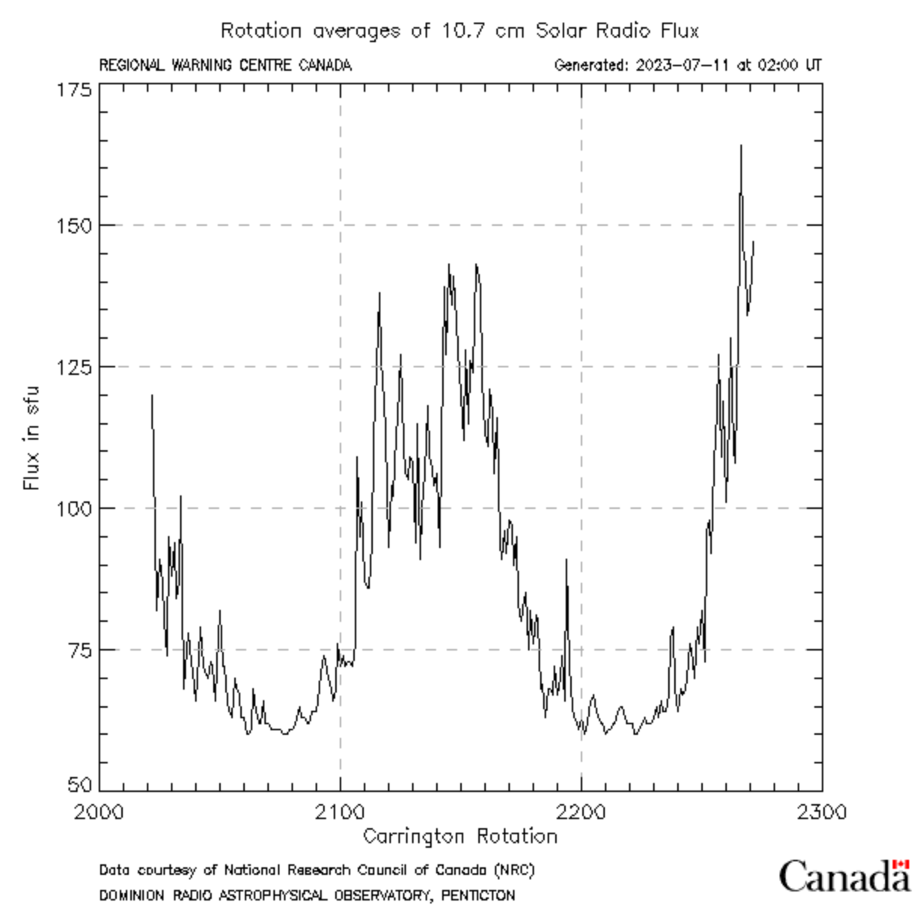
Solar Flux Uncertainties
Solar flux (S₀) varies with
Location (only measured in a few places)
Frequency (only measured at a few frequencies)
No station measures flux at telemetry frequencies
Date and time (multiple cyclic variations)
Carrington rotation every ~27 days
Interpolation algorithms needed
No “certain” value

Slide 5
Y Factor Uncertainties
Y factor varies
Inherently noisy measurement
Cold sky temperature varies
Sidelobes pick up interference
Low elevations see more Earth, raising temperature
Environmental noise raises noise floor
Antenna tower height affects background noise
Almost unmeasurable for small antennas
Standard procedure uses “coldest sky”
Deliberately creates an optimistic value
Not the value you should expect during operations

Slide 6
Solar G/T Shortfalls
Result is not repeatable
±1 dB common from day to day
Larger variations from place to place
Result is deliberately biased to “look good”
Actual effective G/T may be 3 to 4 dB worse
Can’t be used to characterize multi-beam antennas
Move to a planet with multiple suns?
Surely, we can do better…

Slide 7
Replacing the Sun
Sun is a noise source
Use a signal source instead, with…
Calibrated EIRP (variable power)
High fidelity modulation (variable bit rate)
Polarization control (linear or circular)
Located at a calibrated distance
Power adjusted to achieve a known E_{b}/N₀
Example: 11.4 dB in SOQPSK mode, where BER = 10⁻⁵
Start with a basic link budget equation:
$\frac{E_{b}}{N_{0}}= \frac{PtLtGt}{kR_{b}} (L_{θ})\left(\frac{G}{T}\right){\left(\frac{λ}{4πD}\right)}^{2}$

Slide 8
A Little Math Exercise…
$\frac{Eb}{N0}= \frac{PtLtGt}{kRb} (L_{θ})\left(\frac{G}{T}\right){\left(\frac{λ}{4πD}\right)}^{2}$
10 log ($PtLtGt$) = EIRP, dBm
10 log ${\left(\frac{λ}{4πD}\right)}^{2}$ = L_{p}, Path loss, dB
10 log $(L_{θ})$ = ($L_{θ})dB,$ Polarization loss, dB
10 log ($k$) = -198.6, dBm/(K-Hz)
10 log $\left(\frac{G}{T}\right)$= G/T, dB/K
10 log ($Rb$) = Bit rate, dB-Hz
$${\left(\frac{Eb}{N0}\right)}_{dB}= \left(EIRP\right)dBm+{\left(Lp\right)}_{dB}+\text{(}L_{θ})dB+ {\left(\frac{G}{T}\right)}_{\frac{dB}{K}} −\left(−198.6\right) −10 log (R_{b})$$

Slide 9
Leading to…
$${\left(\frac{G}{T}\right)}_{\frac{dB}{K}}{=\left(\frac{Eb}{N0}\right)}_{dB}−\left(EIRP\right)dBm−{\left(Lp\right)}_{dB} −\text{(}L_{θ})dB −198.6+10 log (R_{b})$$
We know everything on the right
E_{b}/N₀ can be determined from the known BER performance of the receiver
Or DQM if it’s accurate
Calibrated signal source gives us known EIRP
Polarization control sets the polarization loss
Measuring tape (or Google maps) gives us path loss
Might need some math to account for height
We know the data rate
We can get G/T with no reference to the sun

Slide 10
What Do We Need?
Calibrated EIRP source
Known polarization
Better yet, programmable polarization
Calibrated receiver
Known BER vs. E_{b}/N₀ performance
Calibrated distance
Into the far field, at least
Line of sight path
Accurate pointing
Cameras can help
$$\left(\frac{2D2}{λ}\right)$$

Slide 11
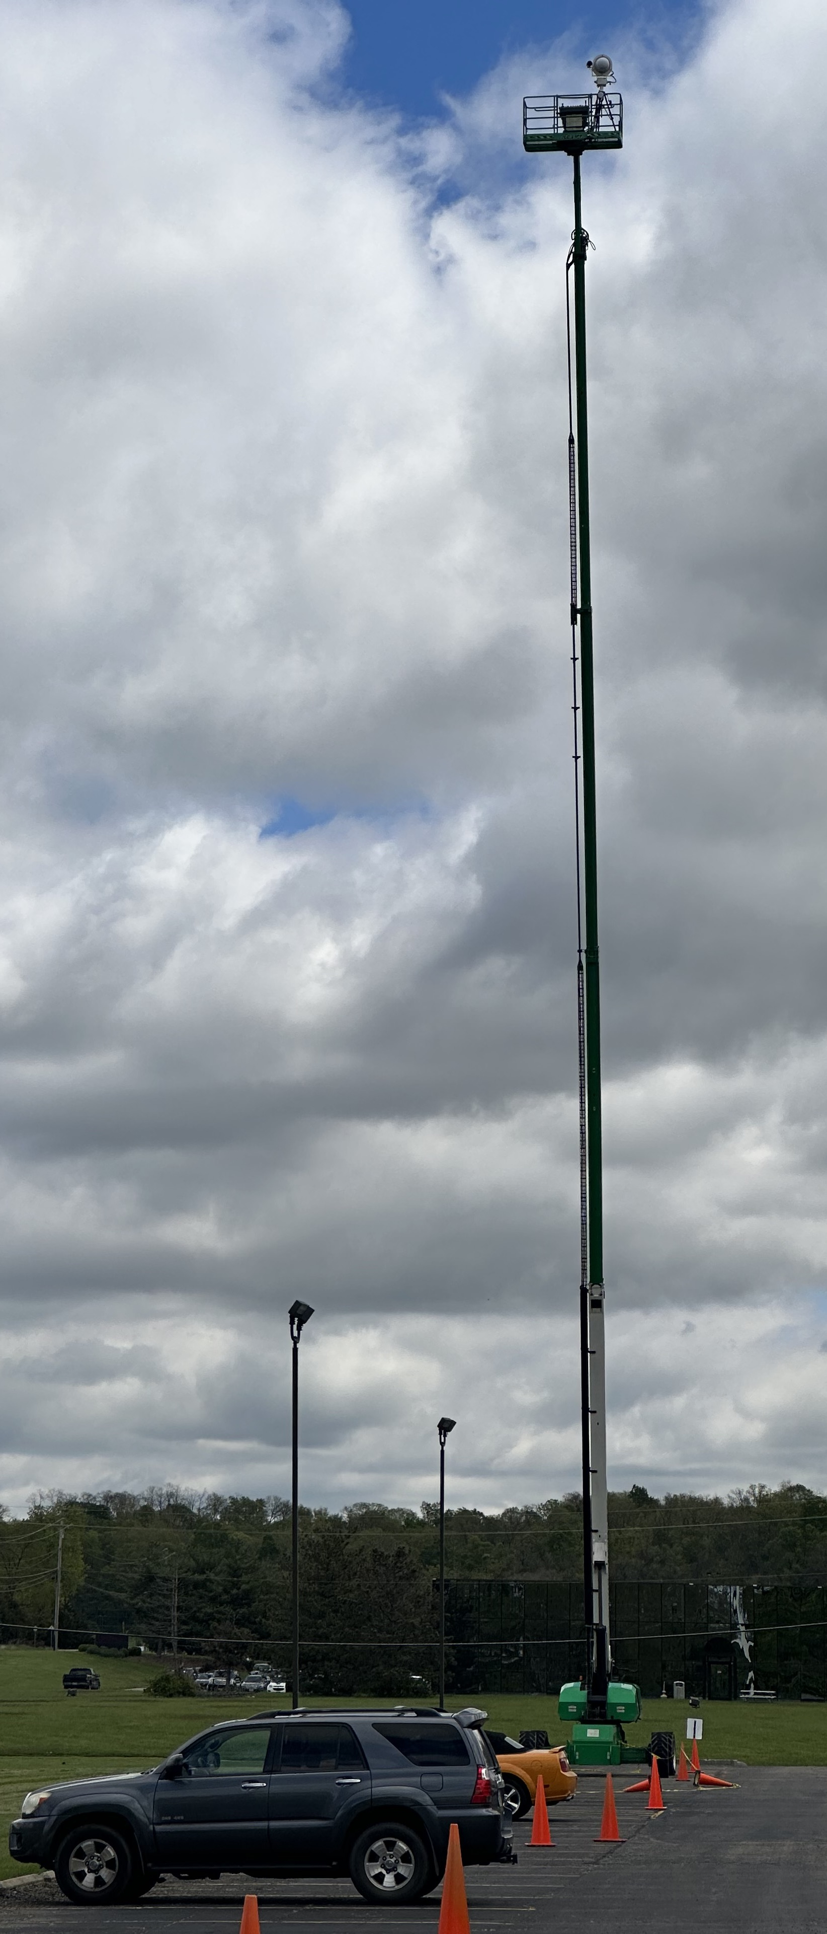
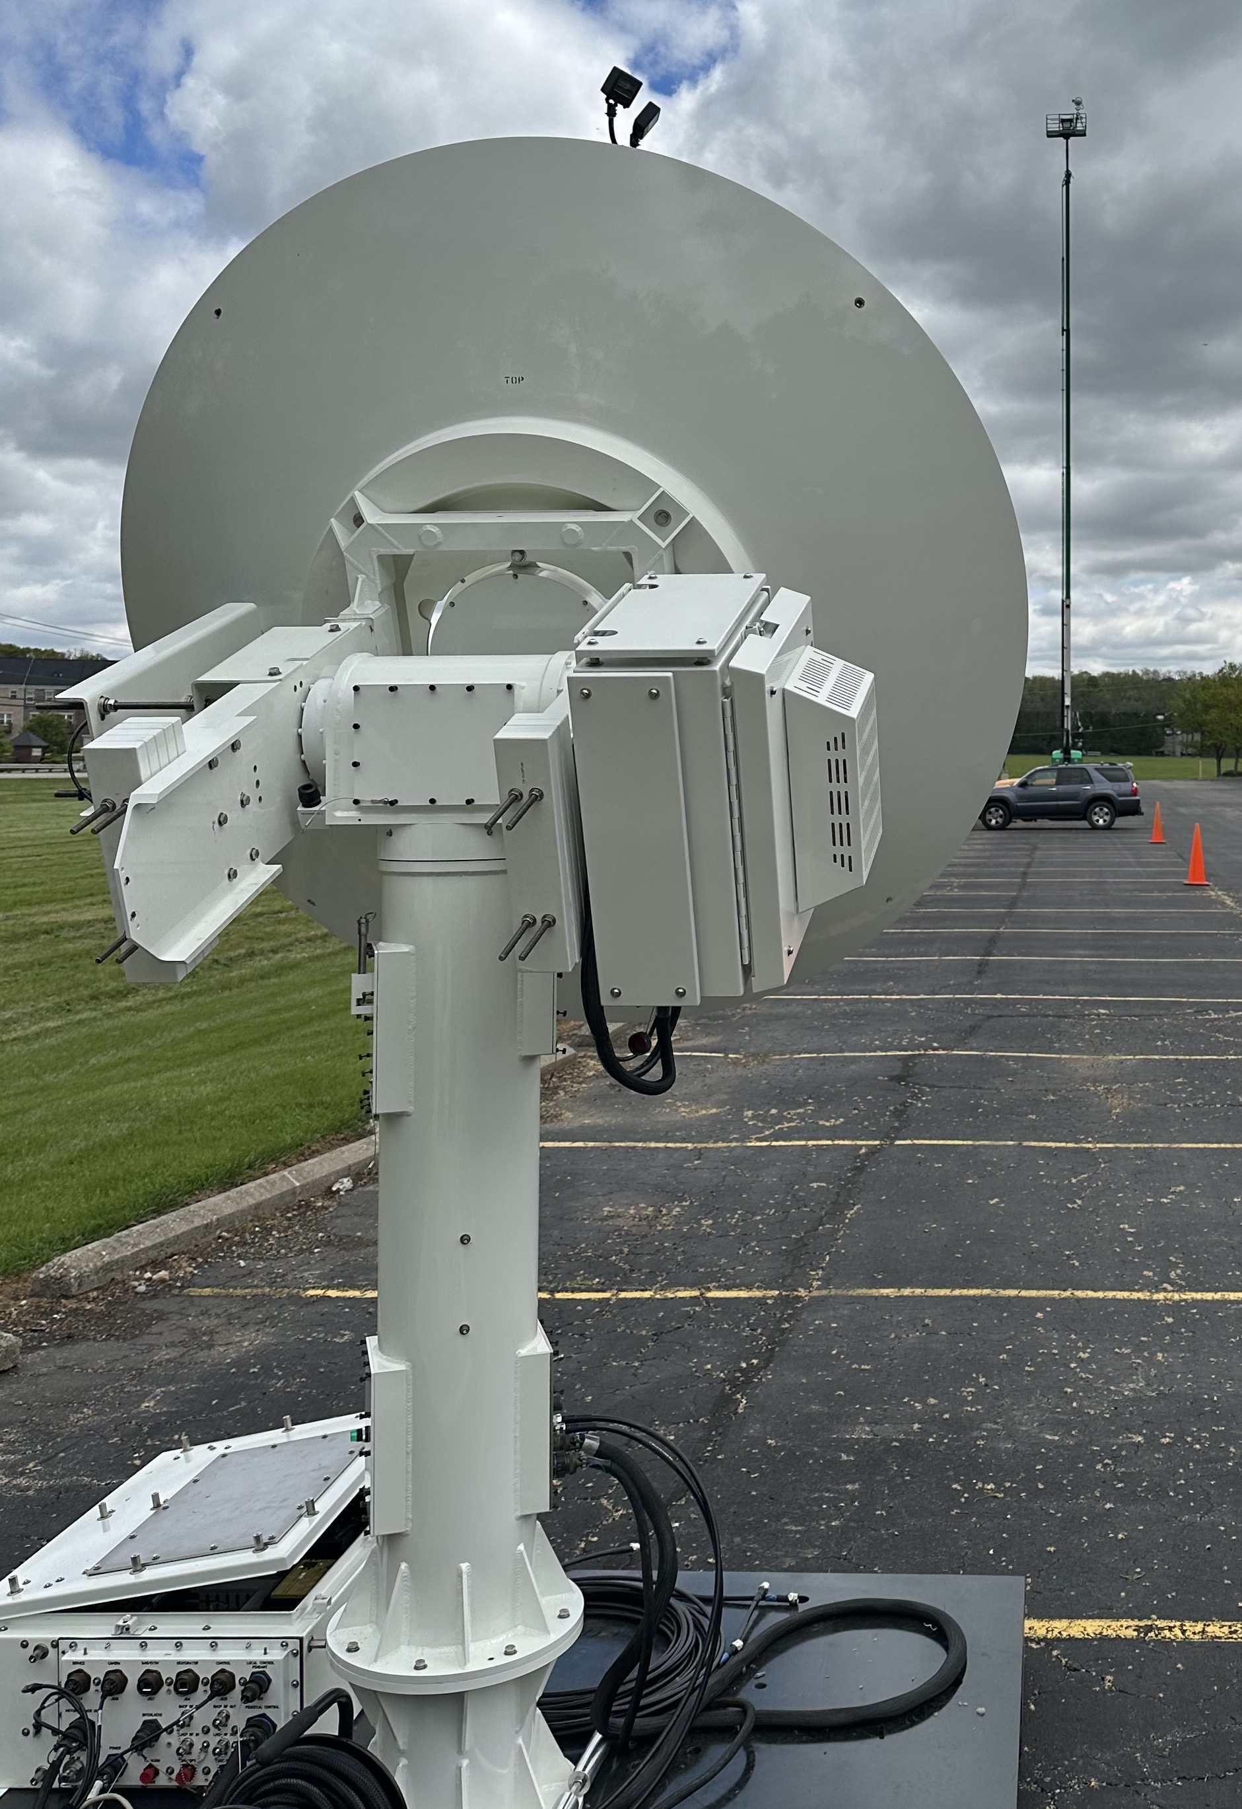
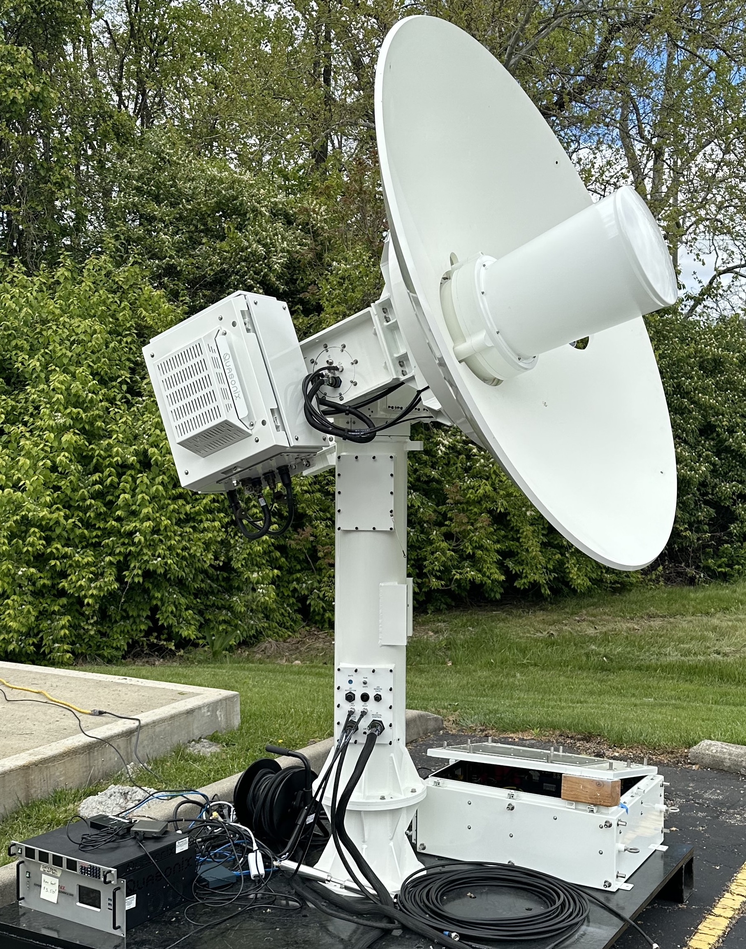
Field Test Setup
QSight™ on a 125-foot mast
PD450 with 6-foot dish

Slide 12
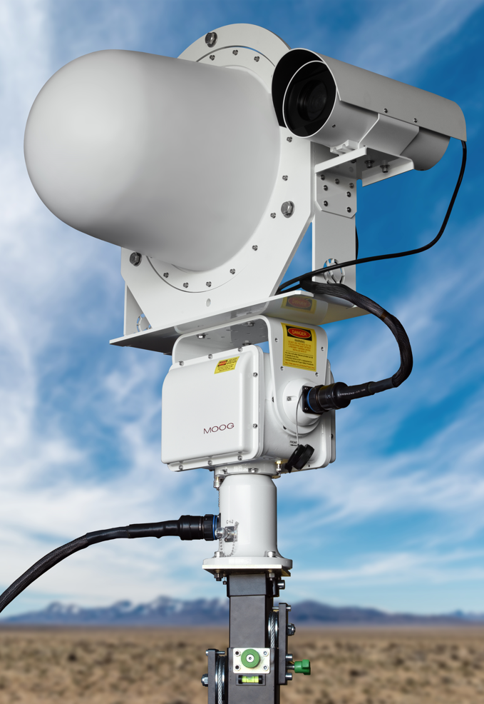
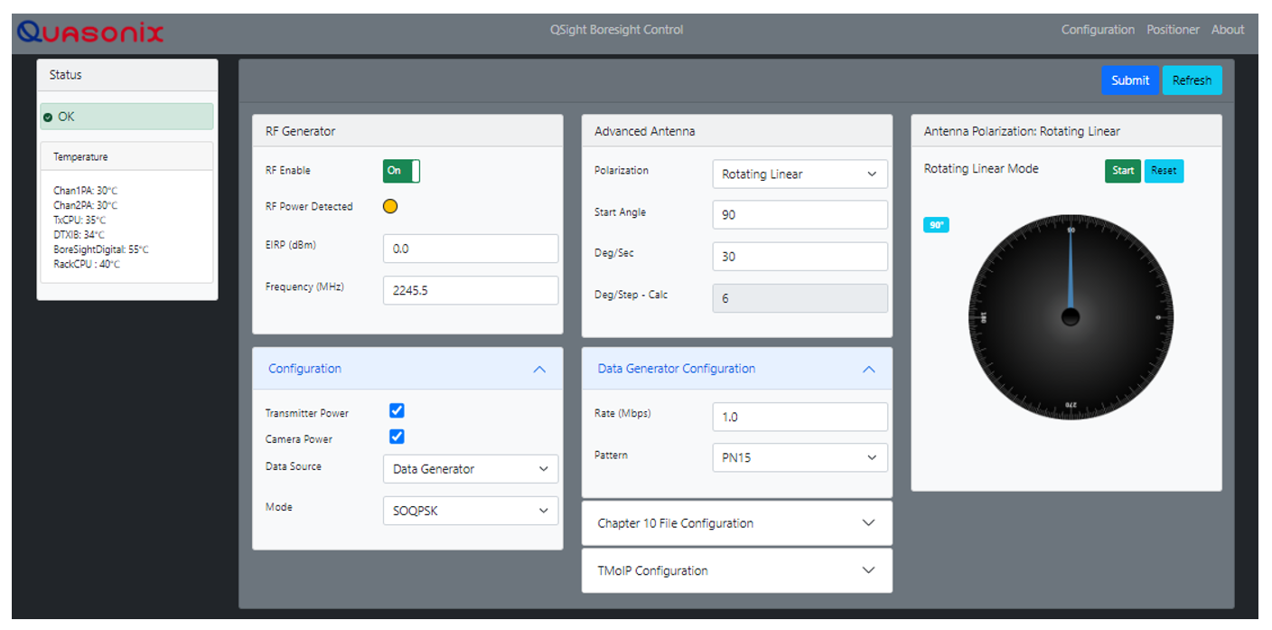
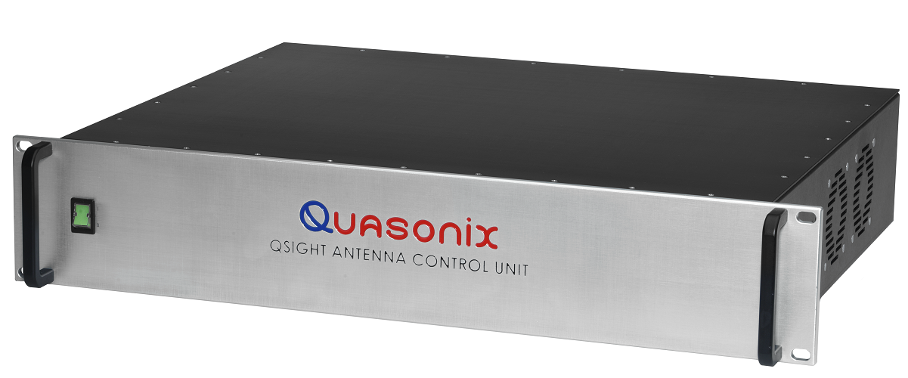
QSightTM L/S/C-BAND BORESIGHT SYSTEM

Slide 13
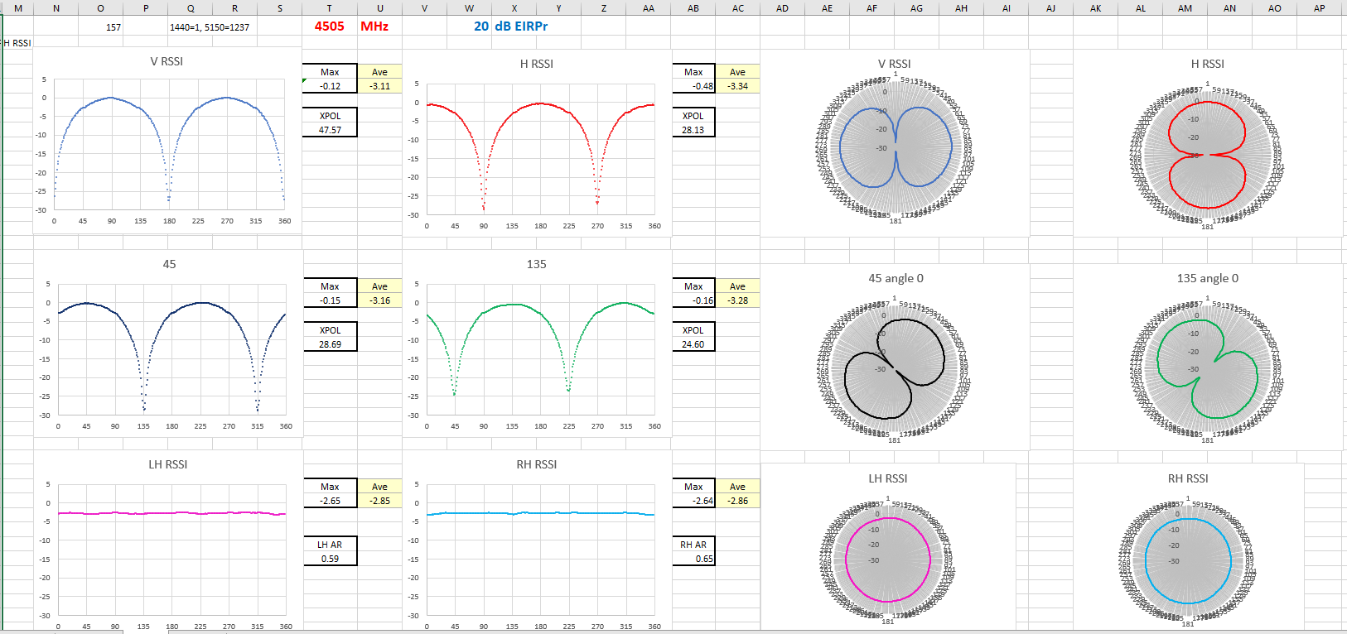
Typical result from verification testing
Frequency, Power Level, Polarization

Slide 14
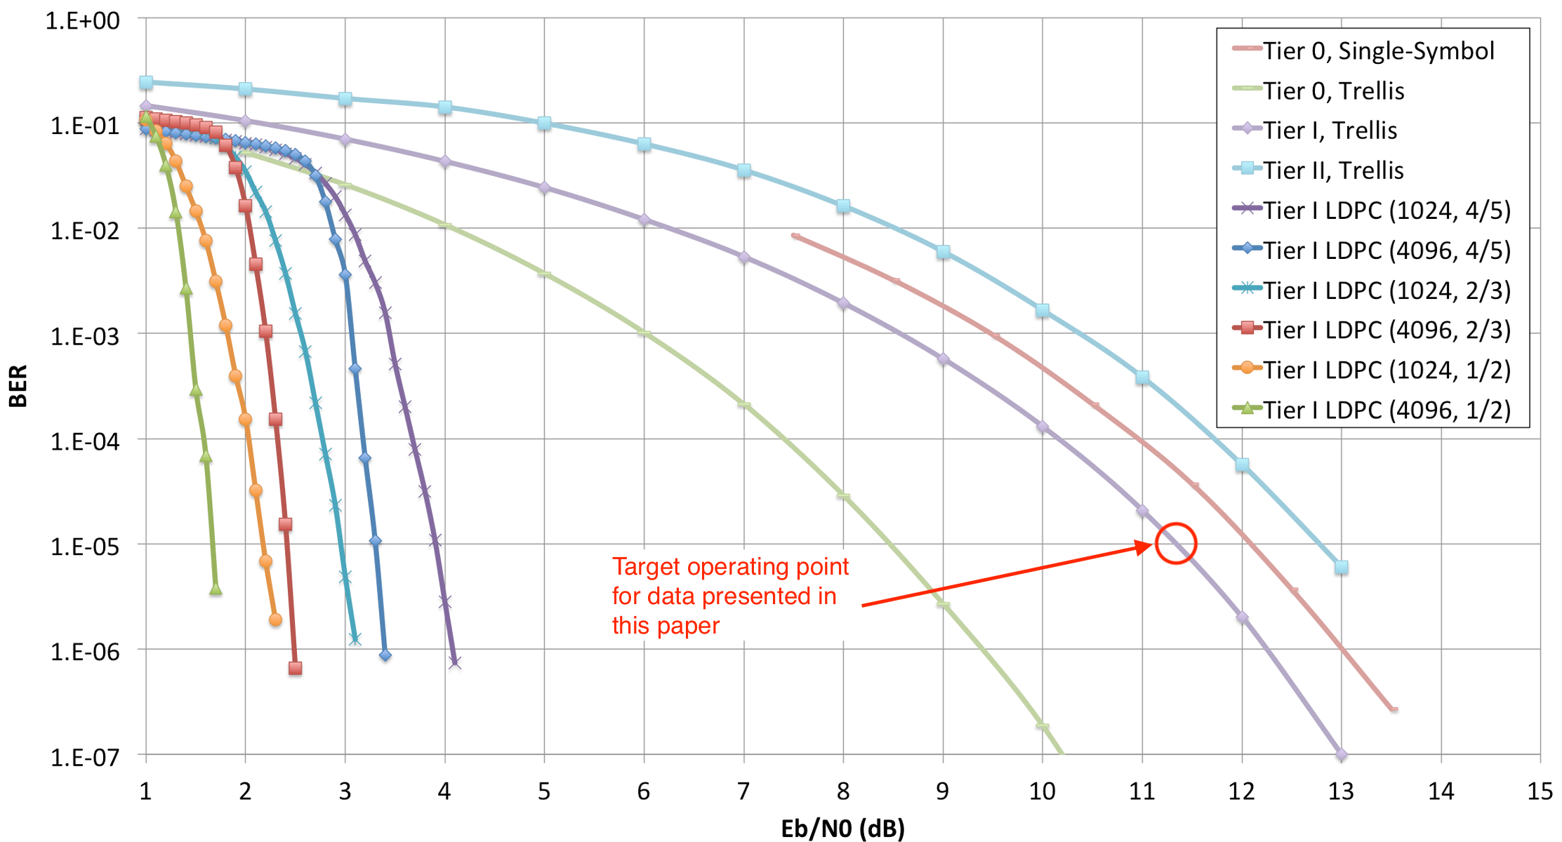
BER vs E_{b}/N₀ – TM Modulations

Slide 15
Technique
Adjust source EIRP, modulation, polarization, and bit rate to achieve a known E_{b}/N₀
Example:
E_{b}/N₀ of 11.4 dB yields BER = 10⁻⁵ (DQM = 5) in SOQPSK
Solve for G/T
This is the G/T while the antenna is looking at the QSight™
NOT the same as G/T using “coldest sky”
$${\left(\frac{G}{T}\right)}_{\frac{dB}{K}}{=\left(\frac{Eb}{N0}\right)}_{dB}−\left(EIRP\right)dBm−{\left(Lp\right)}_{dB} −\text{(}L_{θ})dB −198.6+10 log (R_{b})$$

Slide 16
Does it Match Solar Method?
No. And it shouldn’t!
Solar method built to get the “best” G/T
Find the “coldest” sky → Get the best G/T
Derived G/T will vary with sky temperature
Assumes solar flux is accurately interpolated
Signal source method yields the G/T while looking at the source
Result may still vary with sky temperature
This effect is “real”, belongs in the link budget

Slide 17
Numerical Results

Slide 18
Solves Several Problems
Eliminates solar flux estimation errors
Eliminates “cold sky optimism”
Works for small antennas
No need to guess at tiny Y factors
Works for multi-beam antennas
One source for each beam, spatially separated
Get simultaneous G/T on all beams

Slide 19
Proper Execution Requires…
Calibration of EIRP
Currently accurate from -40 dBm to +40 dBm
Extending the low end would be helpful
Need to get down to target BER (or DQM)
Calibration of BER vs. E_{b}/N₀
Accurate DQM is helpful
Need sufficient distance
Fraunhofer distance is a minimum
$$\left(\frac{2D2}{λ}\right)$$

Slide 20
Conclusions
G/T of a complete ground station can be found without using the sun
Yields meaningful G/T values
Value belongs in your link budget
Works for any antenna
Regardless of size
Works for multi-beam antennas
Yields simultaneous G/T on all beams

Slide 21
Backup Slides
In case of questions

Slide 22
Start with a Link Budget
$\frac{Eb}{N0}= \frac{PtLtGt}{kRb} \left(\frac{Gr}{T}\right){\left(\frac{λ}{4πD}\right)}^{2}$
P_{t} = Transmitter power
L_{t} = Transmit cable losses
G_{t} = Transmit antenna gain
G_{r} = Receive antenna gain
$λ$ = Carrier wavelength
D = Path length
k = Boltzmann’s constant
T = Receiving system temperature
R_{b} = Information bit rate
$\frac{Eb}{N0}$ determines BER performance…

Slide 23
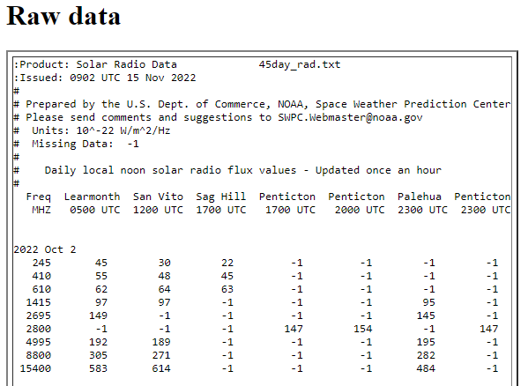
Typical Solar Flux Data

Slide 24
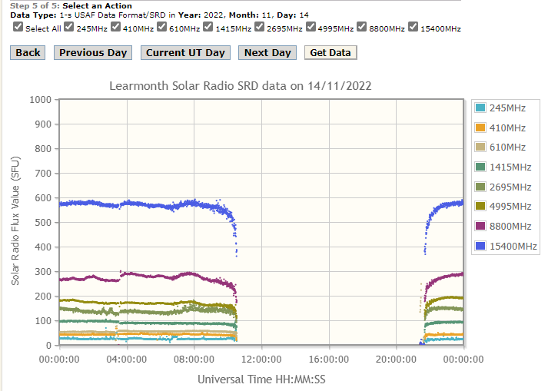
time of day

Slide 25
time of year - Monthly averages of solar 10.7 cm flux

Slide 26
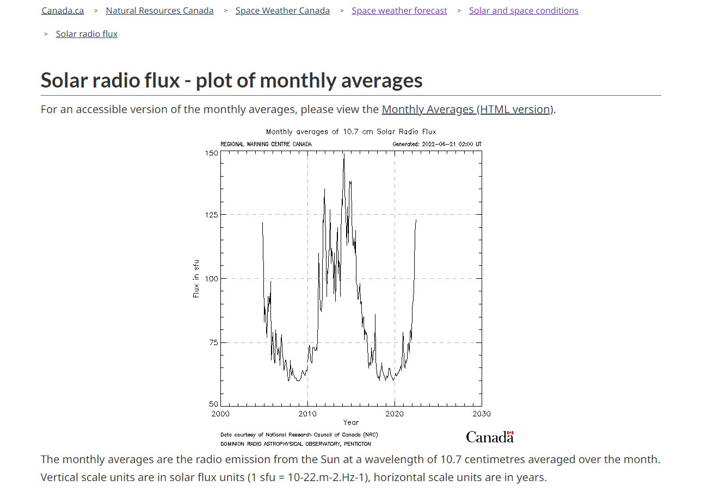
years

Slide 27
interpolation algorithms

Slide 28
interpolation algorithms

Slide 29
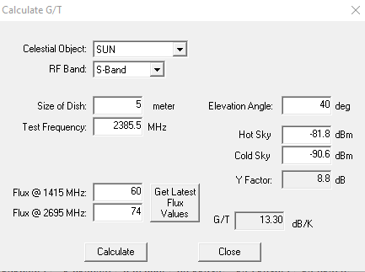
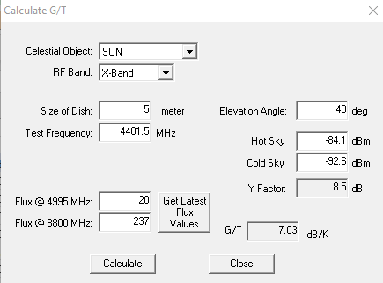
Error compared with linear fit CelesCoord.exe Program G/T calculator
Celest X-band SF linear fit
Celest S-band SF linear fit
Results in +0.2 dB error in G/T at 4401.5 MHz

